Slide 1

The Swicy Revolution
Exploring the Sweet-Heat Trend Captivating Late-Night Snacks & Appetizers
Chef Joe Pina
Senior Executive Chef
UMass Dartmouth Chartwells HE

Slide 2
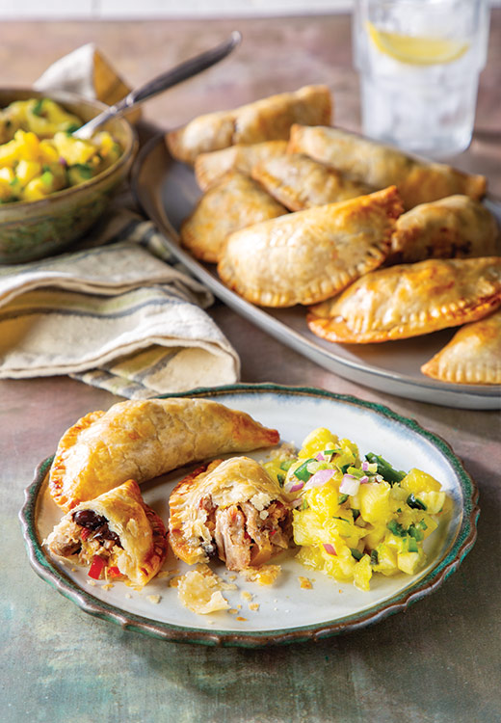



Mojo Pork Empanada with Swicy Pineapple Salsa
The Caribbean is often cited as a foundational blueprint for the swicy trend
The rise of swicy foods in mainstream dining, like spicy fruit salsas, draws from Caribbean-inspired techniques
Swicy pairings are up 38% on menus, largely driven by the adaptation of traditional Caribbean flavors

Slide 3
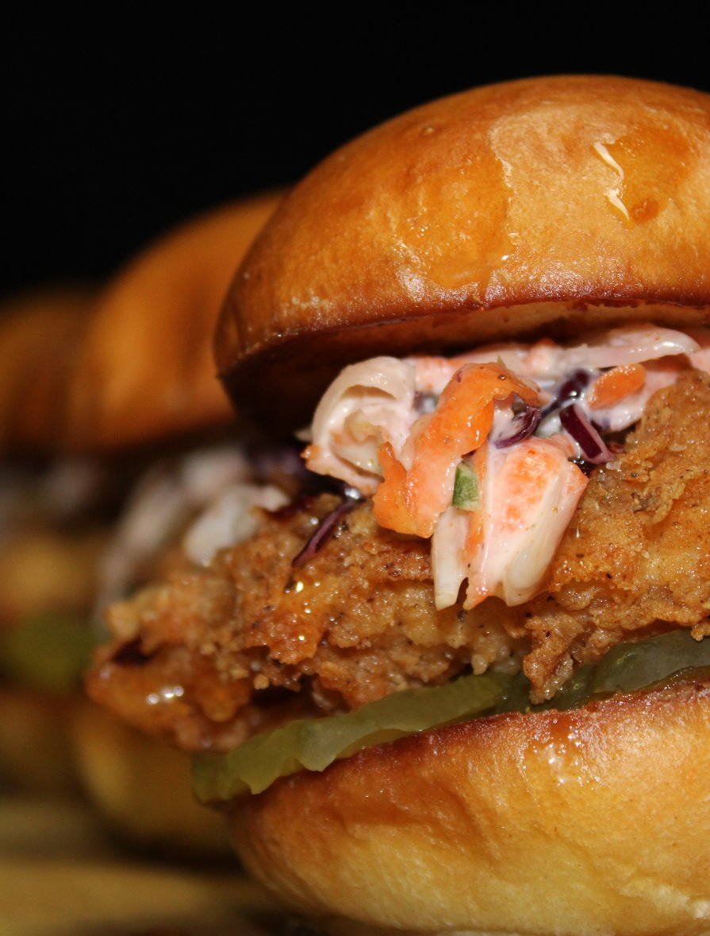
Korean BBQ Fried Chicken Slider
Korean Cuisine
Gochujang
Approachable
Korean cuisine is the primary driver behind the swicy food trend
Gochujang is the foundational ingredient in most swicy dishes
Swicy foods are more approachable for those with tolerances, providing a multi-layered experience for spice lovers

Slide 4
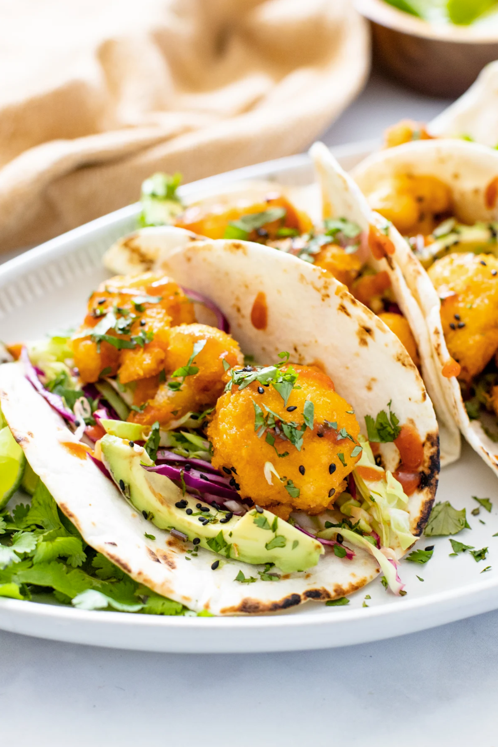


Bang-Bang Cauliflower Tacos
Tacos are a key example of swicy trend combining creamy and sweet chili
Taking the concept of these tacos bridges the gap between Asian and Mexican-style street food
Tacos are a key example of swicy trend combining creamy and sweet chili
Taking the concept of these tacos bridges the gap between Asian and Mexican-style street foods

Slide 5
Thank you!
Chef Joe Pina
Senior Executive Chef
UMass Dartmouth Chartwells HE
Joe.Pina@compass-usa.com

