Slide 1
Profit-Boosting Strategies:
Creating SOPs to Elevate Your Wedding Business
Irene Tyndale
Irene Tyndale Weddings & Events
irenetyndale.com/education

Slide 2
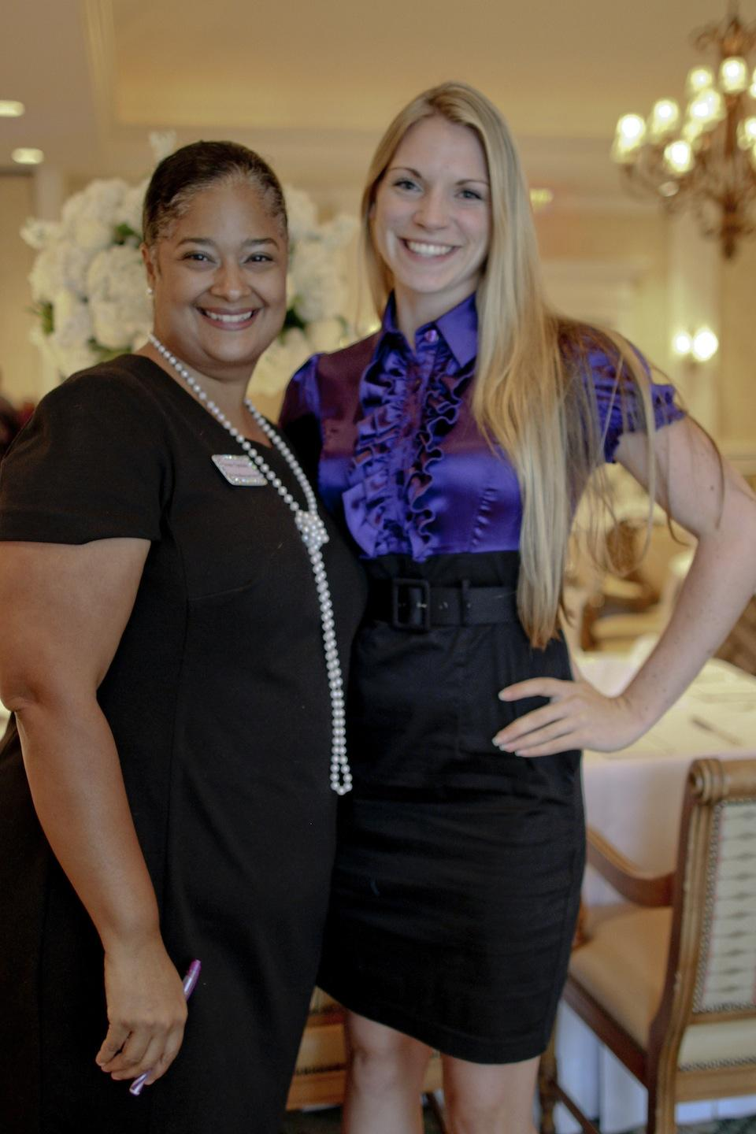
My SOP STORY

Slide 3
My name is Irene
Wife, Mom, CEO
Over 28 Years in the Wedding & Events industry
Planner, Author, Educator, Coach & Podcast Host
Own & operate an award-winning business for 13 Years with a team of 6
Executed over 500+ weddings

Slide 4
"What’s one task in your business you wish could be easier or more efficient?"

Slide 5
Four Takeaways
                Operational Excellence
                Consistent Client Experiences
                Profitability Through Process
                Strategies for creating Simple SOPs

Slide 6
What are SOPs?
Standard Operating Procedures (SOPs) are detailed, written instructions that outline the steps necessary to perform specific tasks or processes within your business.
They are the backbone of your operations, providing clear guidelines for staff to follow, ensuring consistency and efficiency.

Slide 7
Purpose of SOPs:
SOPs help in maintaining quality and consistency across all aspects of your business operations.
Increase productivity and profitability.
They also serve as a training tool for new employees, ensuring they understand how to perform their duties correctly from the start.

Slide 8
Enhances Operational Efficiency
A. Reduces Errors - SOPs create consistency and minimize mistakes that could negatively impact a client's experience
Wedding Planners SOP: A structured client onboarding process ensures that all contracts, payments, and essential details are collected before moving forward.
Error Avoided: Prevents miscommunication, missed deadlines, or incorrect vendor bookings.
Impact: No last-minute surprises; every vendor and client expectation is aligned.
DJs SOP: A pre-event questionnaire to confirm song preferences, special requests, and timeline confirmation.
Error Avoided: Avoids playing the wrong version of songs or missing key moments like the first dance.
Impact: Keeps the couple happy with a well-curated playlist and smooth event flow.

Slide 9
Enhances Operational Efficiency
B. Increasing Productivity -SOPs help streamline workflows, allowing teams to complete tasks efficiently
Venue Owners SOP: A standardized venue setup and teardown guide for staff to follow.
Productivity Boost: Reduces the time spent setting up and ensures all necessary items (tables, chairs, décor) are placed correctly.
Impact: Faster turnaround between events, allowing the venue to host more bookings in a shorter time frame.
Photographers SOP: A pre-wedding checklist to confirm shot lists, lighting conditions, and backup equipment.
Productivity Boost: Ensures all necessary gear is prepared in advance, reducing the need to troubleshoot during the event.
Impact: Saves time on setup and post-event editing due to properly captured images.

Slide 10
Enhances Operational Efficiency
C. Saving Money - By minimizing waste, avoiding costly mistakes, and improving efficiency, SOPs help businesses retain more profit.
Florists SOP: Inventory management for tracking flower orders and preventing over-purchasing.
Money Saved: Reduces waste by ensuring flowers are only ordered as needed.
Impact: More accurate budgeting and increased profitability.
Caterers SOP: Food storage and handling guidelines to prevent spoilage.
Money Saved: Avoids having to discard ingredients due to improper storage.
Impact: Reduces costs associated with wasted ingredients and improves health code compliance.

Slide 11
Outline 3-5 steps in the task/process you shared or wrote down earlier.

Slide 12
Ensures Customer Satisfaction
Delivering consistent service
Contributes to high-quality service
Impacts customer satisfaction, retention, and referrals.

Slide 13
What’s one service you offer that MUST be consistent every time?
How do you ensure this happens?

Slide 14
Increases Profitability
Standardized processes lead to higher profits
Opportunities for Upselling and Cross-Selling
Build and/or expand your team
Outsource task
Creates partnerships and collaborations

Slide 15
What is one way you can turn a repeated process into an SOP that increases efficiency and profitability?

Slide 16
Practical Strategies for CREATING & Implementing SOPs
Start with a Process Review:
  Map out all the steps involved in your business operations and client services.
    Note everything you want your team to know and execute consistently.

Slide 17
Practical Strategies for CREATING & Implementing SOPs
2. Document and Organize:
Clearly document each process in a logical flow.
Create a comprehensive guide that anyone can follow to perform tasks to your standards.
    Inquiry to Sales
    Onboarding & Offboarding
    Hiring Process
    Ordering products - ie. Florals, Food, Rentals, etc.
    Creating & Posting Blogs
    Brand Guide - Colors, Logo Formats, Fonts, etc.

Slide 18
Practical Strategies for CREATING & Implementing SOPs
3. Tailor to Your Business:
Customize SOPs to reflect your leadership style, team learning style, brand values, client expectations, and specific business needs.
Involve your team in the creation process for practical insights.
  Find the right platform for your business & team
    Google Docs/Sheets
    Asana/Trello/Clickup
    Word Doc/Excel
    Zoom/Loom
    Dropbox, Google Drive

Slide 19
Practical Strategies for CREATING & Implementing SOPs
4. Train and Implement:
Conduct training sessions to introduce SOPs and ensure everyone knows where to find them.
Make SOPs easily accessible for consistent application.
5. Monitor and Optimize:
Regularly review and update SOPs to keep them relevant.
Use feedback to continuously improve and align SOPs with business goals.

Slide 20
"It all started with SOPs and the desire for a better life - to spend more time with my kids, take vacations, grow my company, build the best planning firm in Atlanta, and increase profitability."
@irenetyndale

Slide 21

With SOPs you will…
Streamline
Operate
Plan
Succeed
“Creating Simple SOPs' Worksheet & Video”
Enter Promo Code - CSTSE
@irenetyndale

Slide 22
Let's connect online
INSTAGRAM - @IRENETYNDALE
PODCAST ON SPOTIFY - “INSIDE THE WEDDING PLANNERS MIND”
FB COMMUNITY FOR PLANNERS -
NEW PROGRAM: The Wedding Planner's Blueprint
EMAIL - IRENE@IRENETYNDALE.COM
For upcoming courses and events visit
irenetyndale.com/education
@irenetyndale

Slide 23
Profit-Boosting Strategies:
Creating SOPs to Elevate Your Wedding Business
Irene Tyndale
Irene Tyndale Weddings & Events
irenetyndale.com/education

