Slide 1
Behind the Scenes:
What to Look for at an Event Site Visit

Slide 2




Notes:
Cara

Slide 3
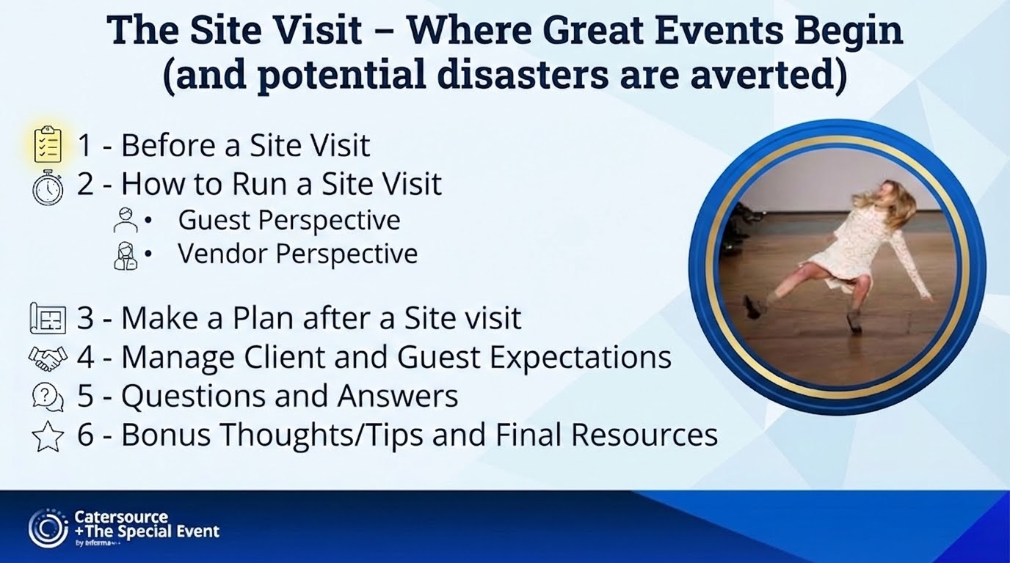
Notes:
Cara

Slide 4
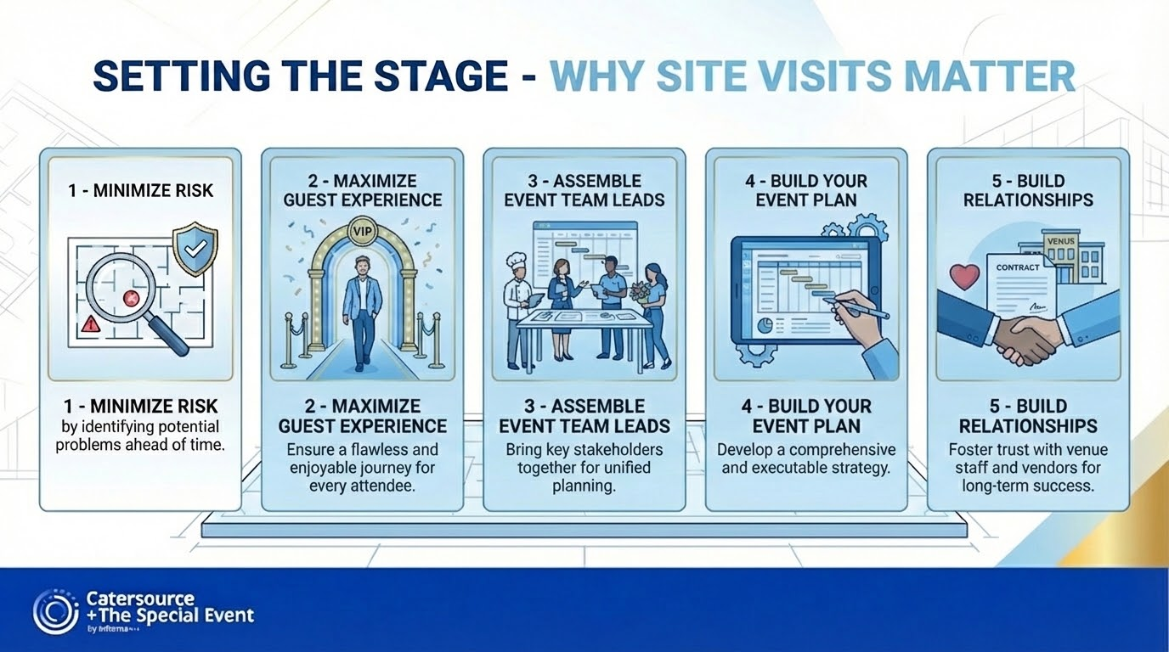
Notes:
Cara

Slide 5
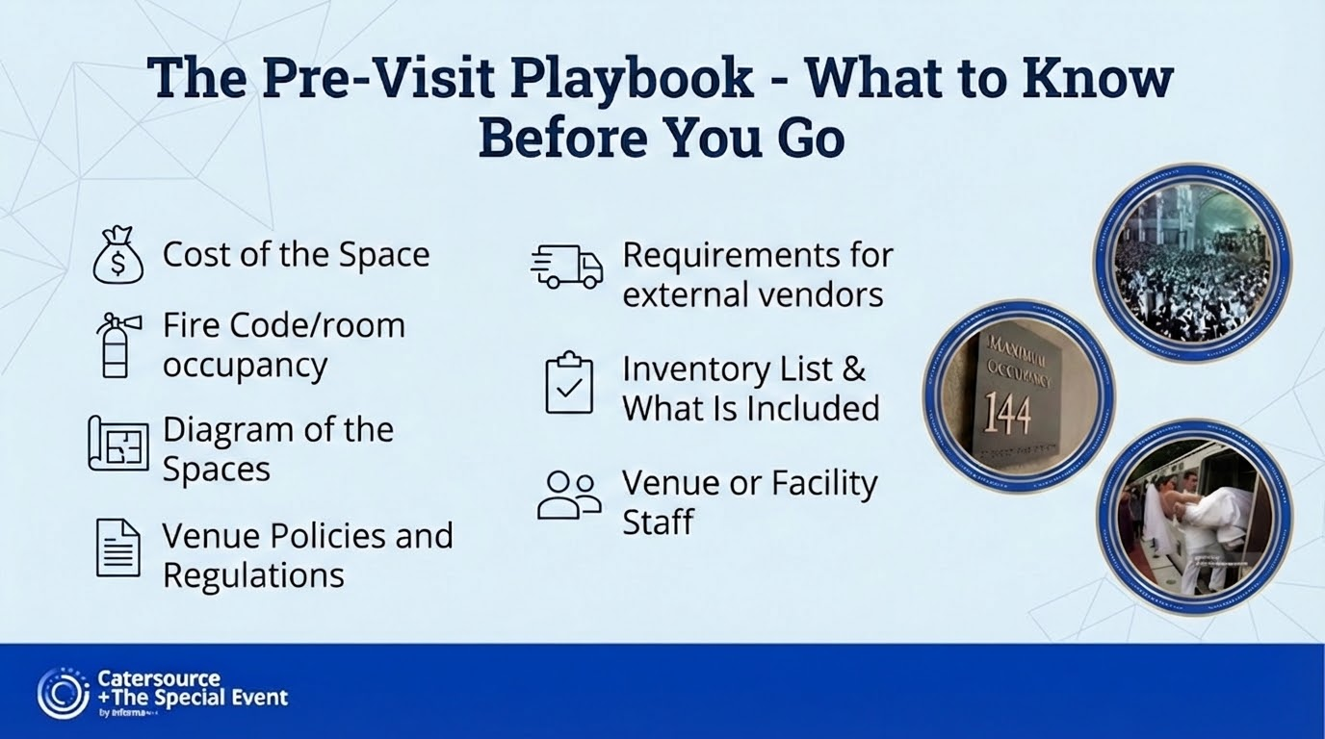
Notes:
Cara

Slide 6
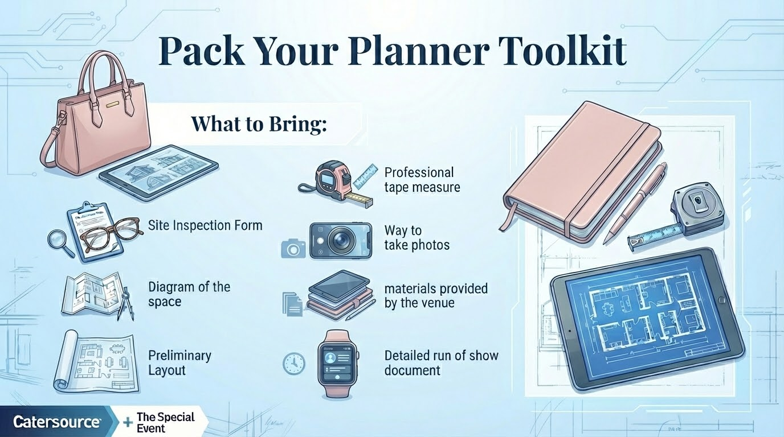
Notes:
Cara

Slide 7
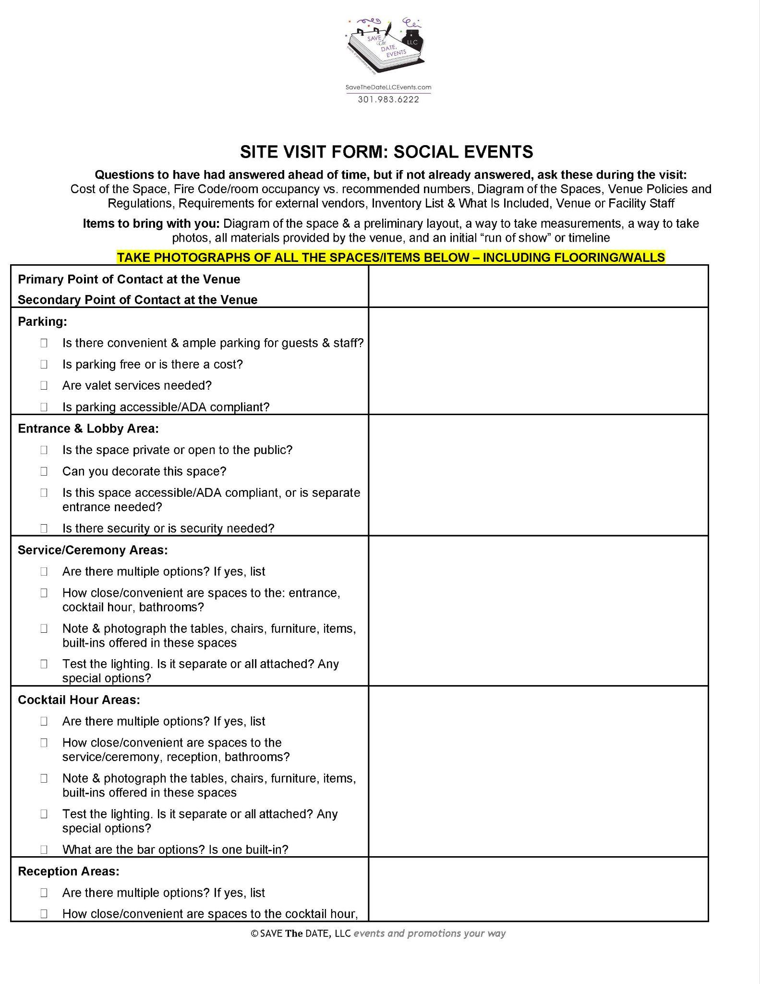
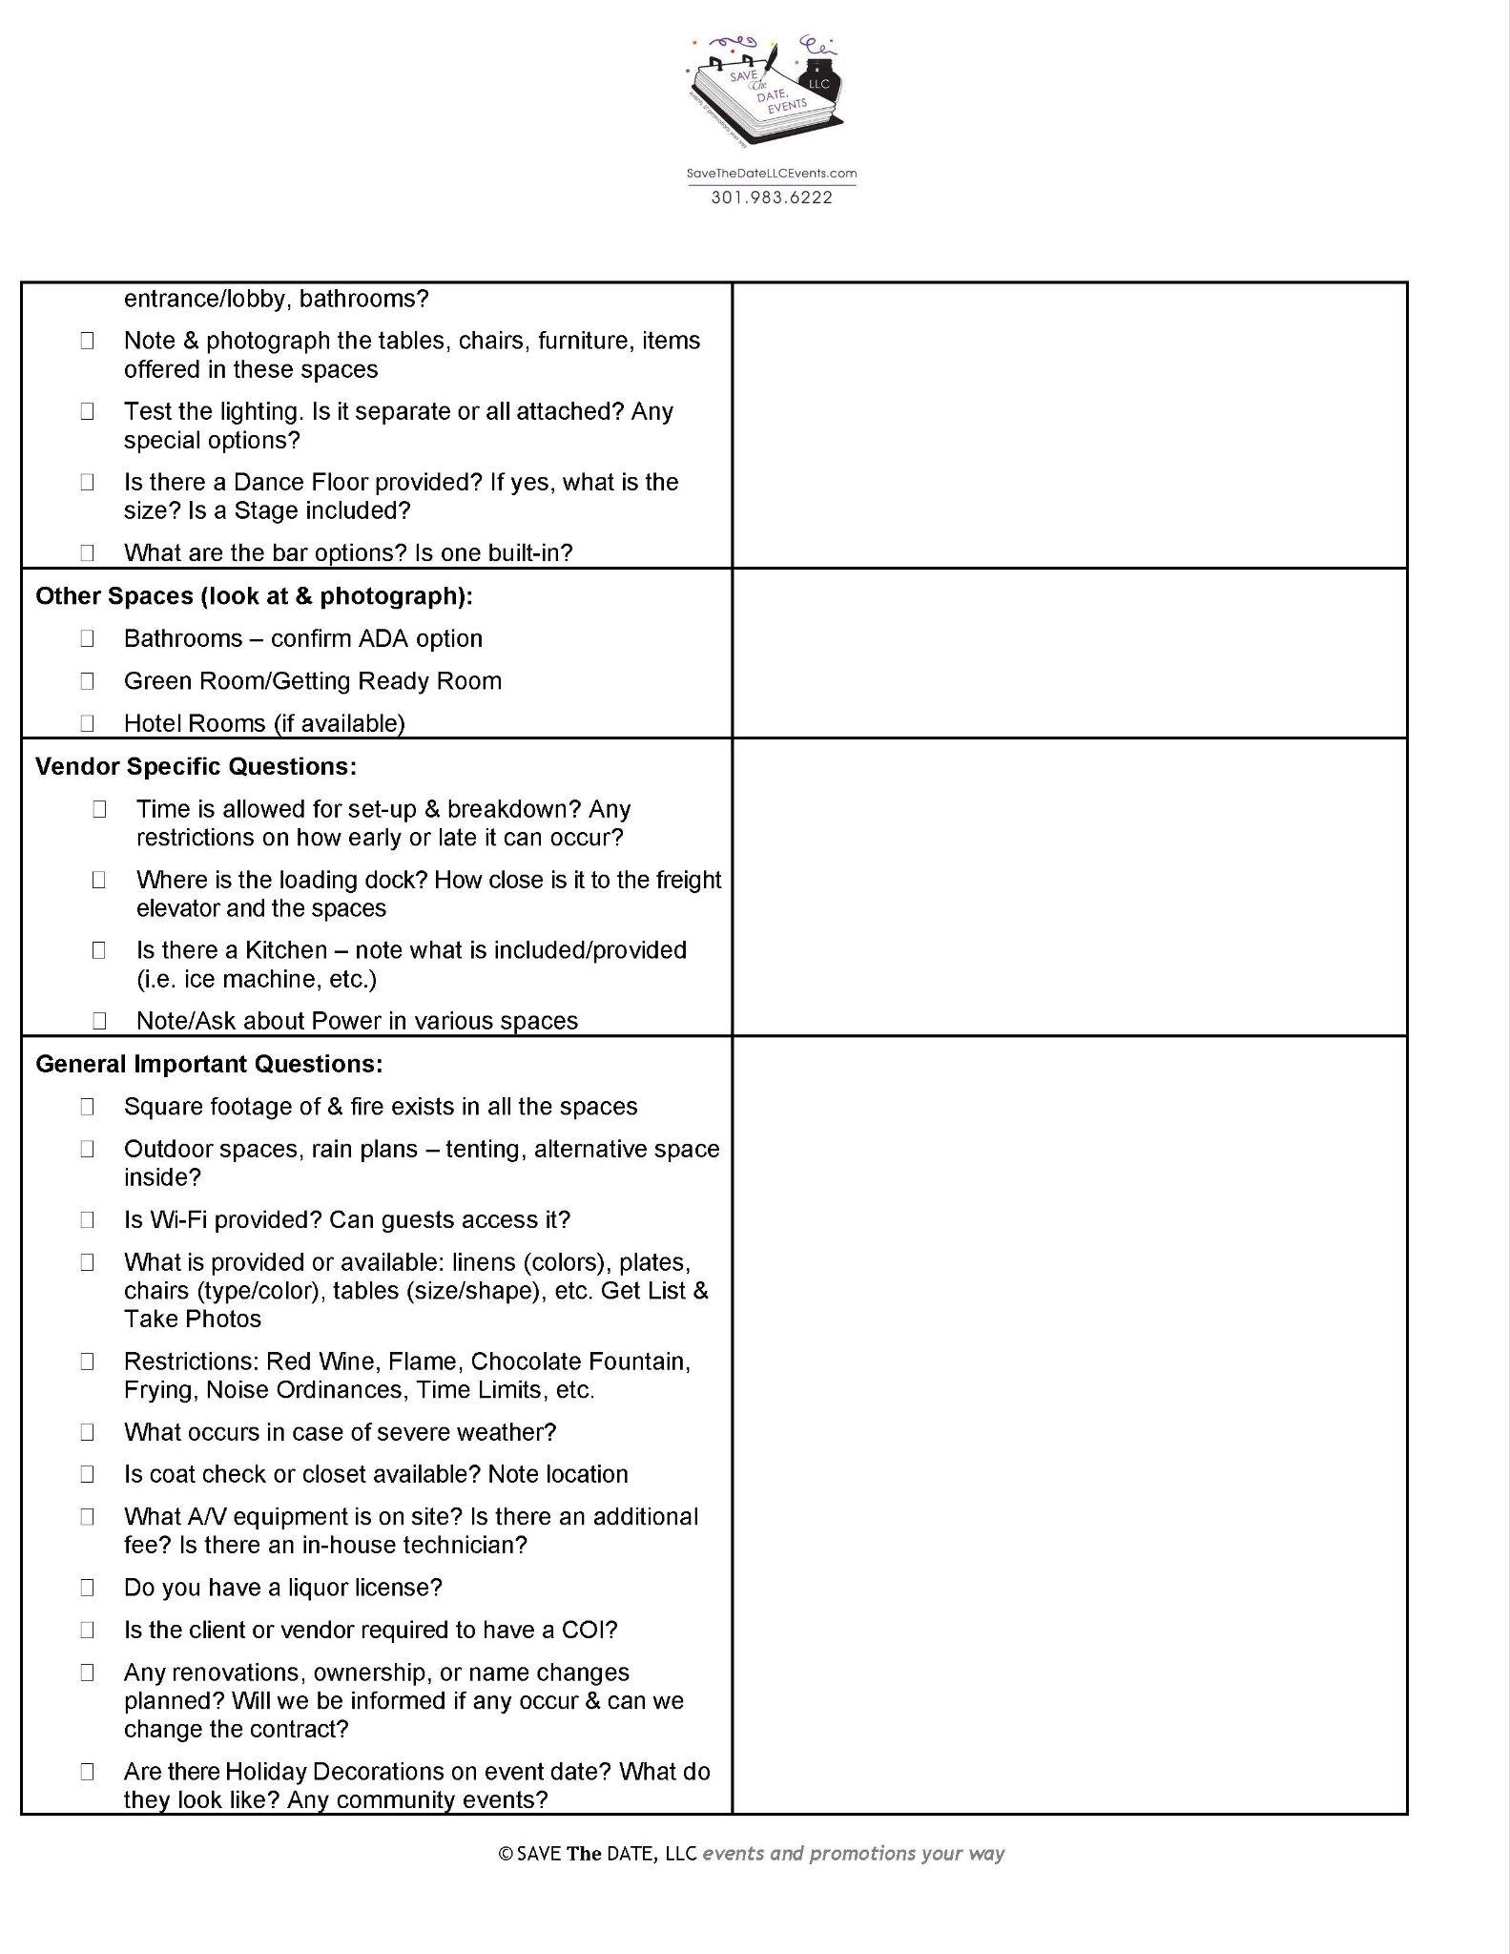

Slide 8
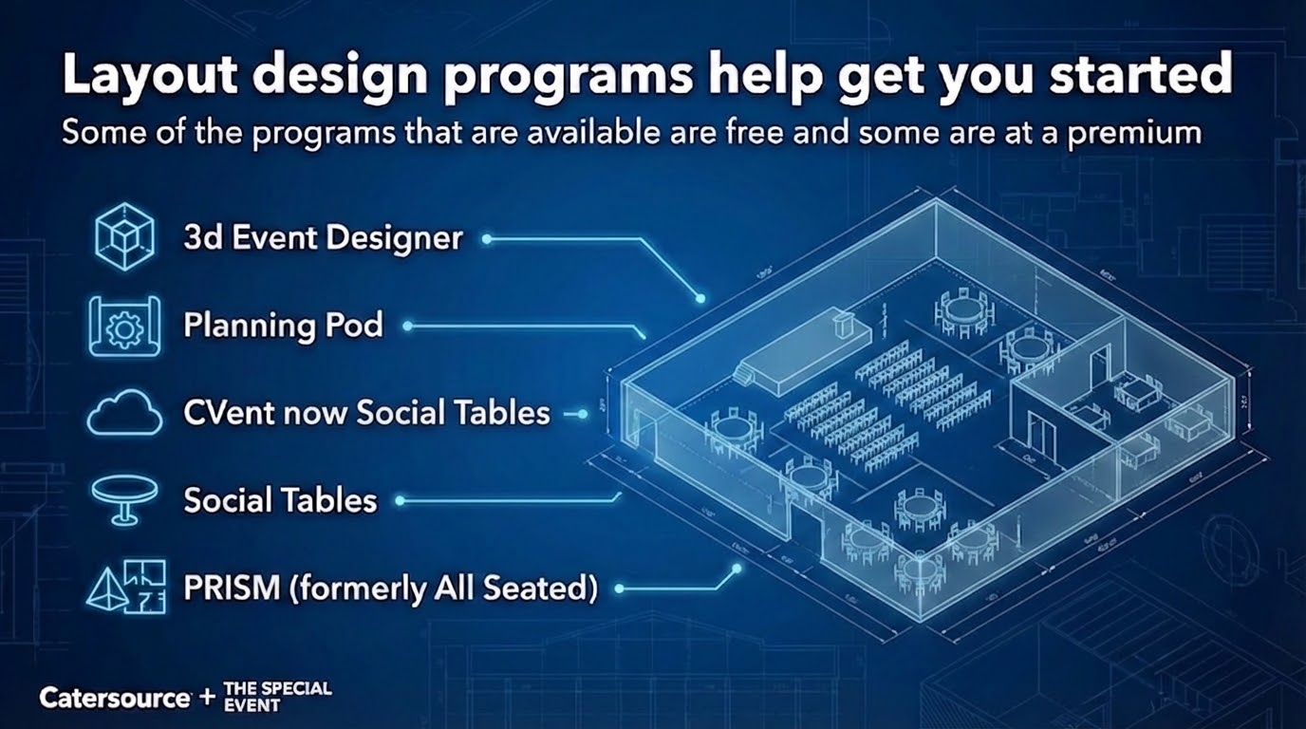
Notes:
Cara

Slide 9
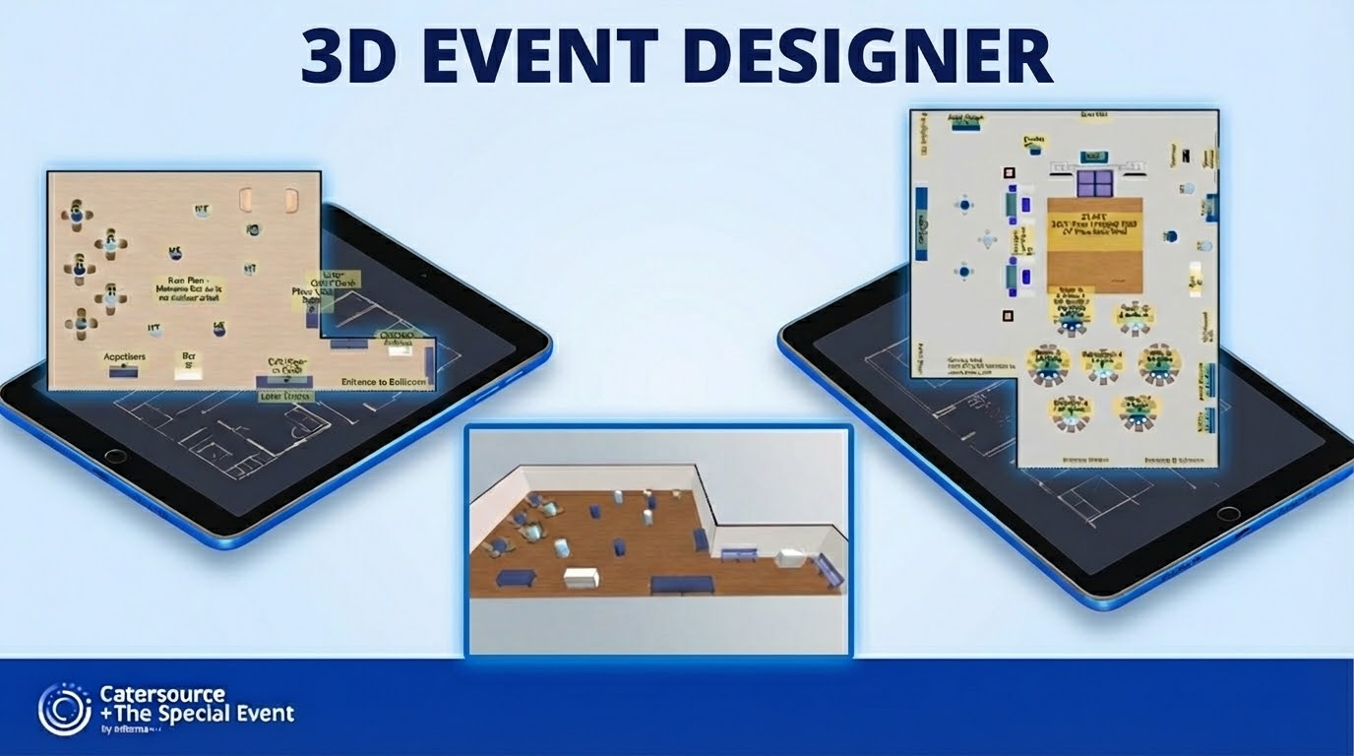
Notes:
Cara

Slide 10
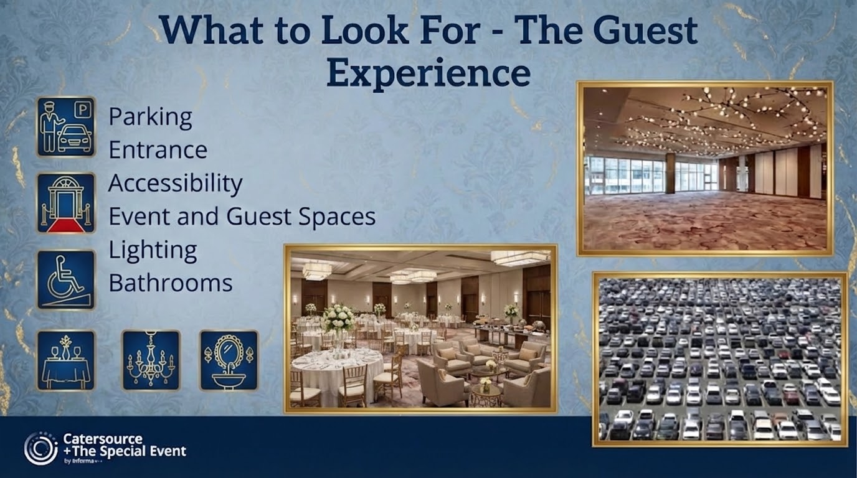
Notes:
Christine

Slide 11
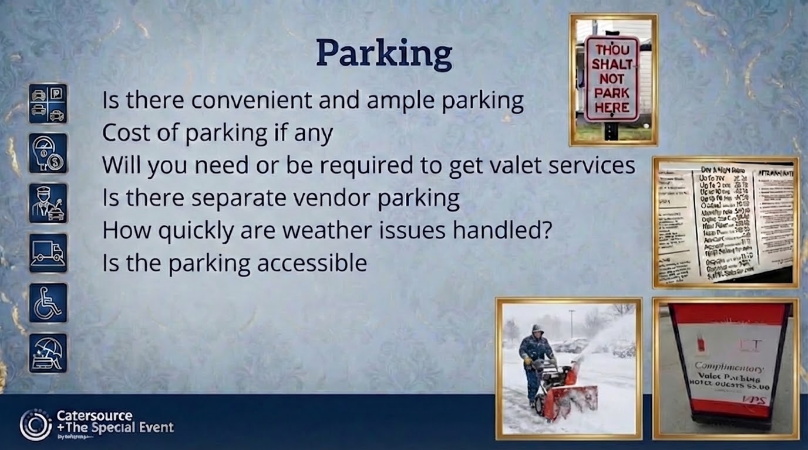
Notes:
Christine

Slide 12
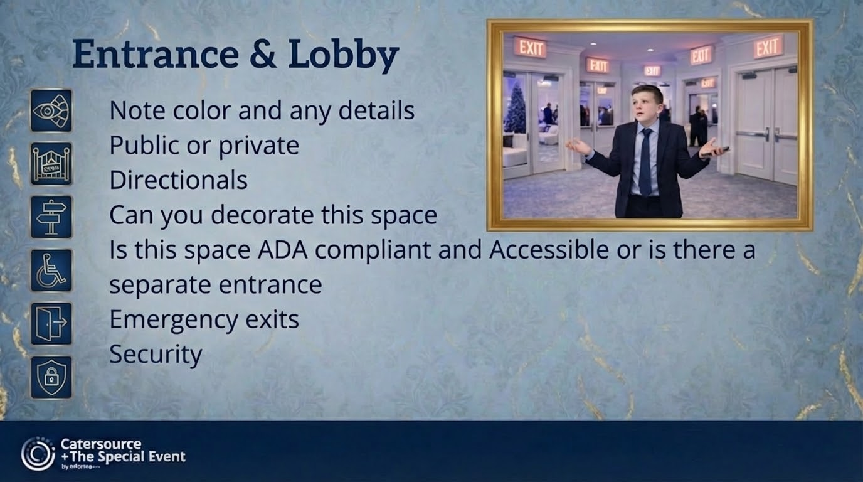
Notes:
Christine

Slide 13
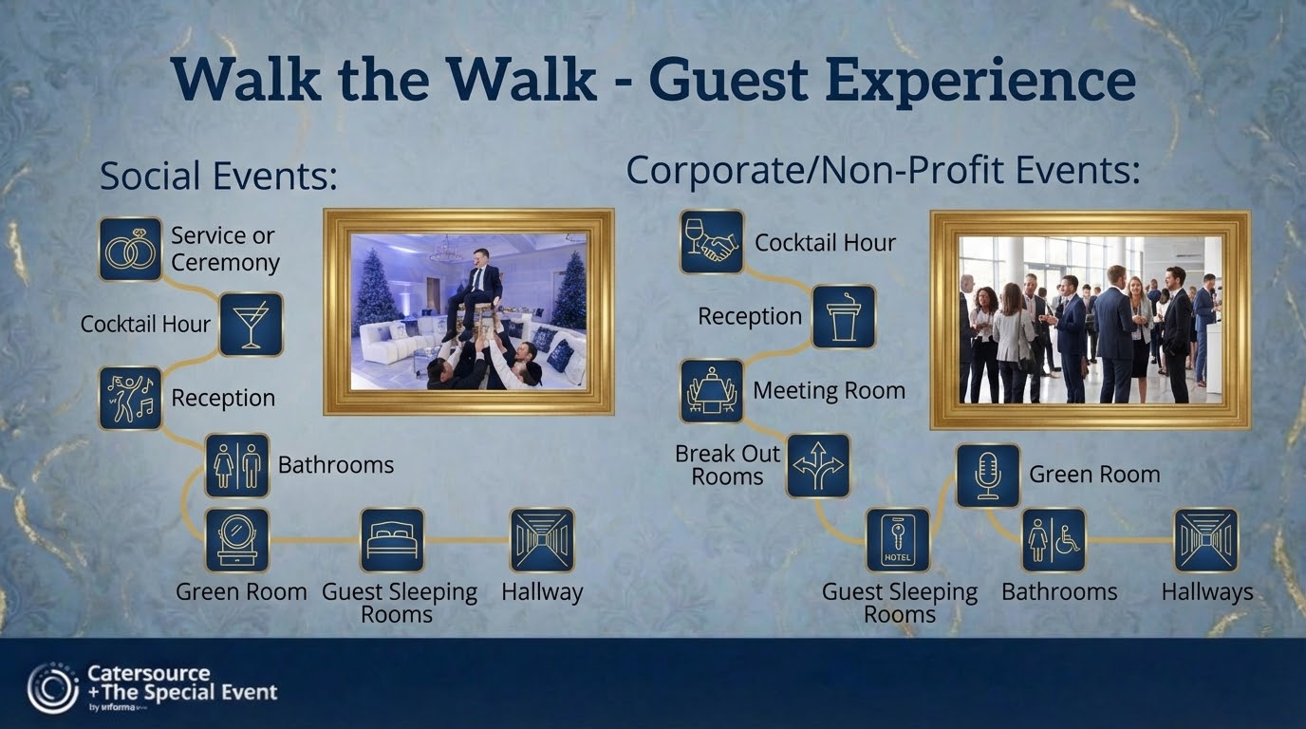
Notes:
Christine

Slide 14
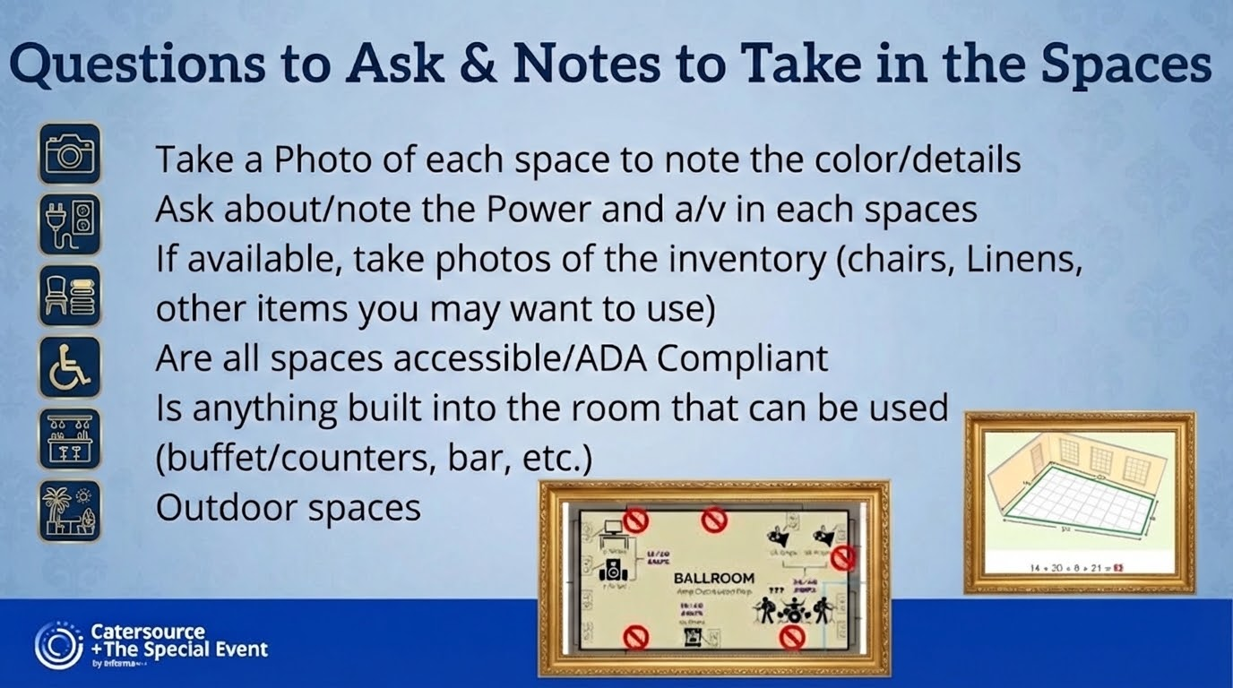
Notes:
Christine

Slide 15
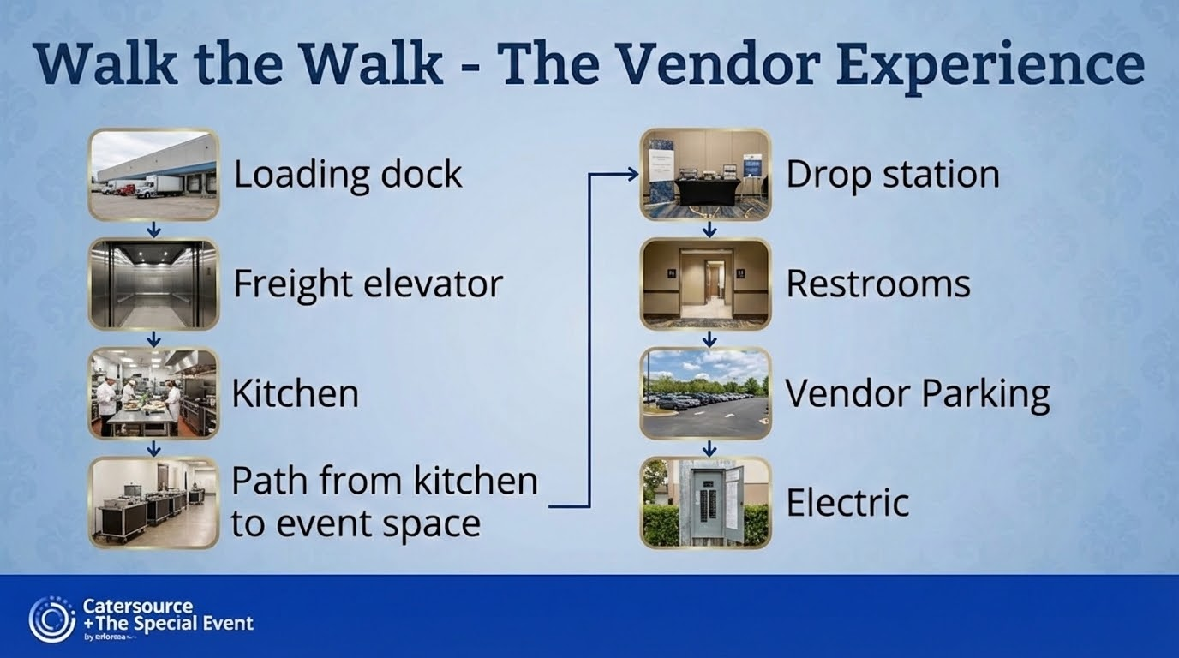
Notes:
Glynis

Slide 16
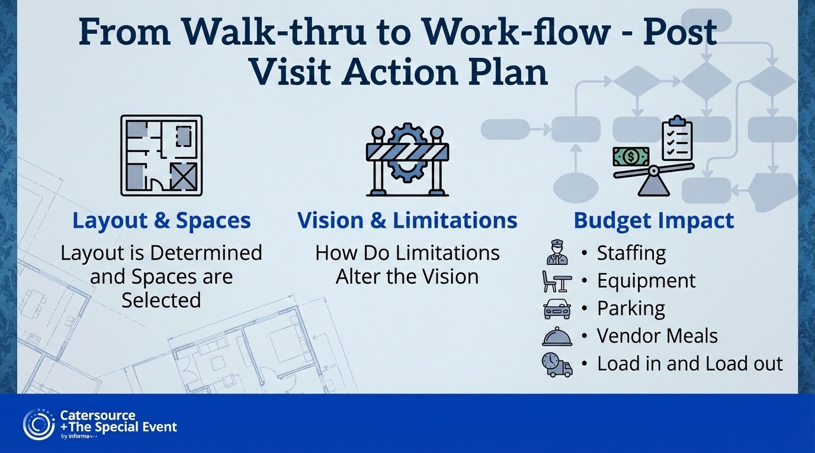
Notes:
Glynis

Slide 17
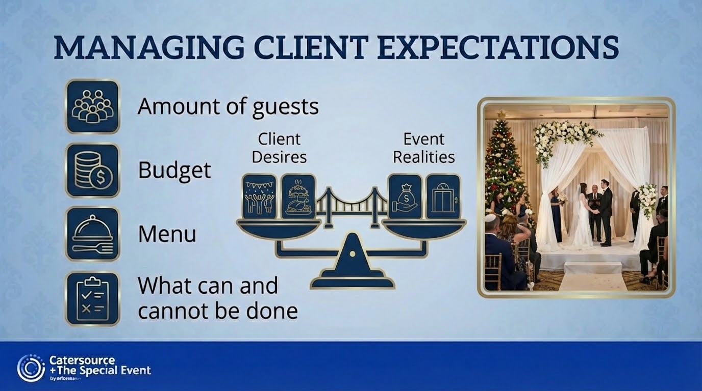
Notes:
Glynis

Slide 18
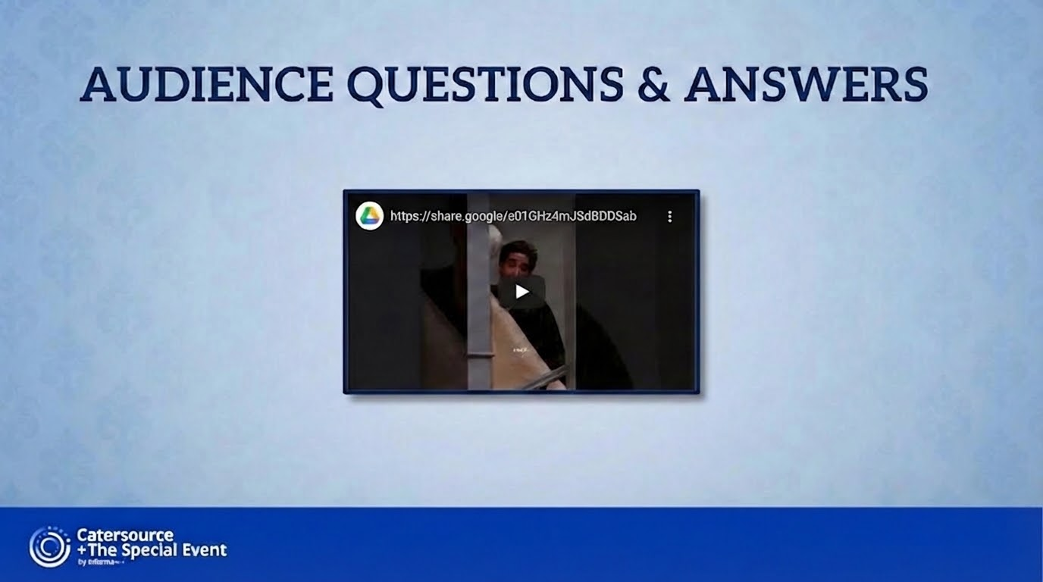
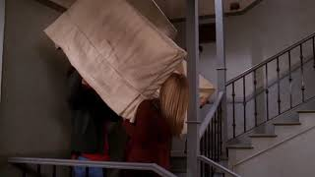
Notes:
Glynis https:/share.google/e01GHz4mJSdBDDSab

Slide 19
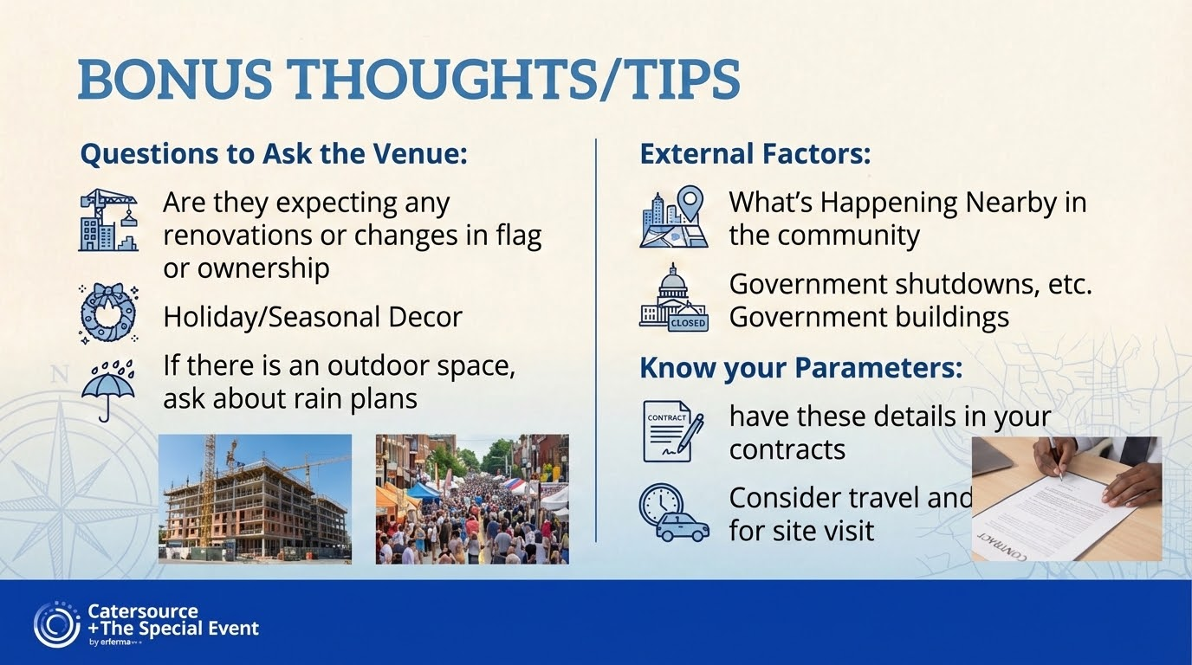
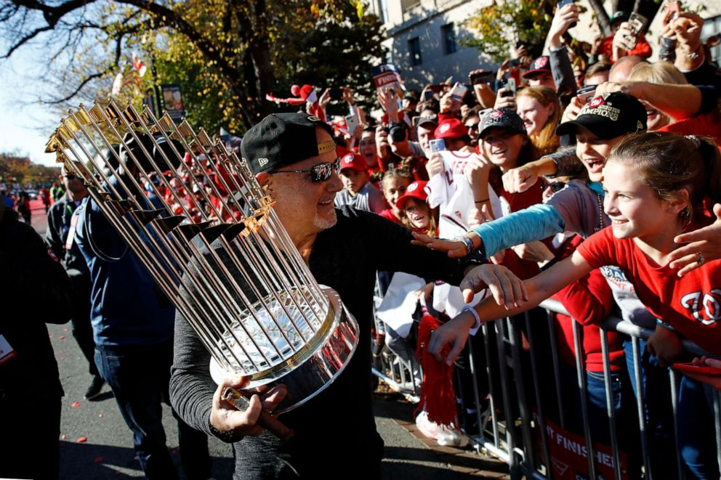
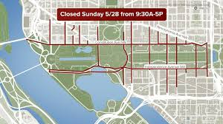
Notes:
all

Slide 20

Notes:
Glynis

