Slide 1

Bridging the Gap with Mental Health:
The Boss vs The Leader

Slide 2
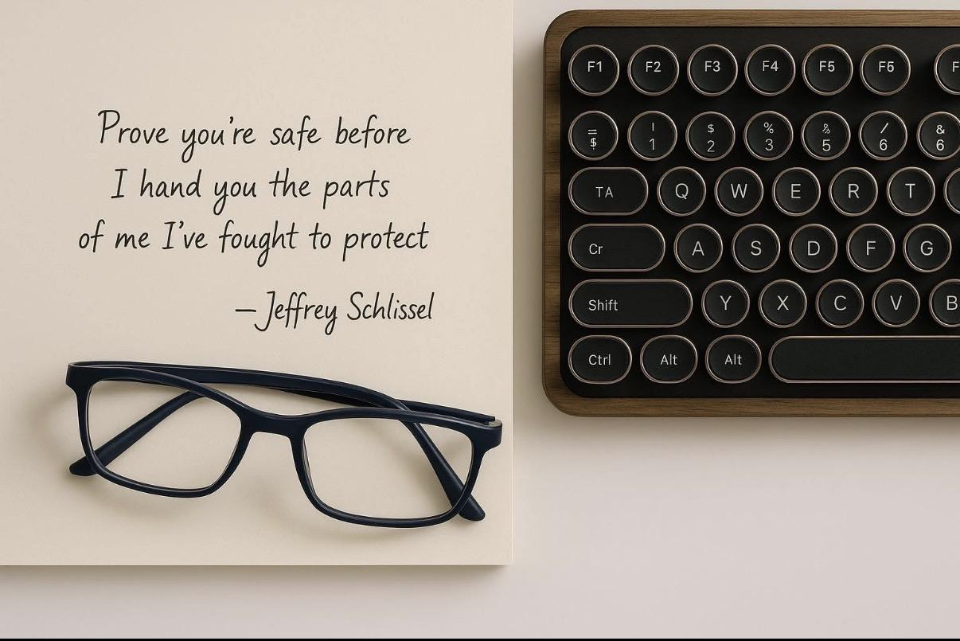

Slide 3
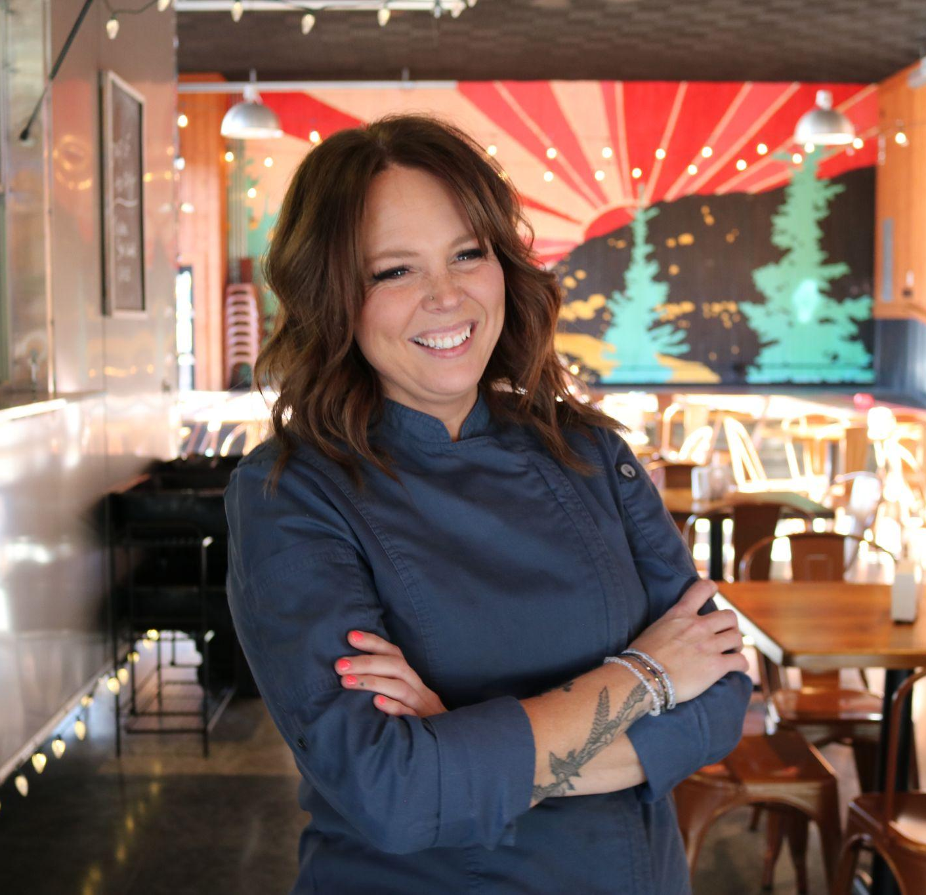
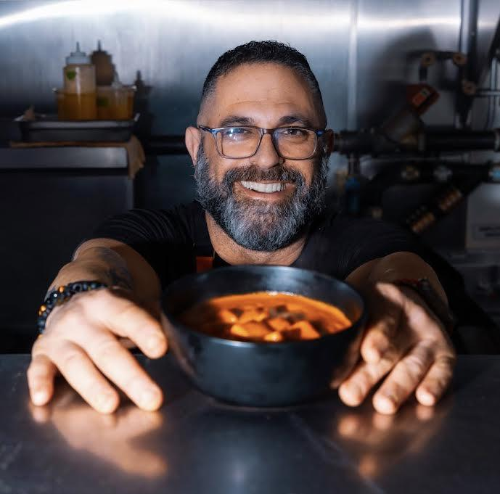
Chef Mary Davidson
Sous Chef | General Manager
Northwest Montana | Mom of 6+
Teen Mental Health Advocate
Chef Jeffrey Schlissel
Chef | Award Winning Author
Florida | Mental Health Advocate

Slide 4

Notes:
How we are going to go through the presentation / deck. What we expect from the audience.
We need to ask for one person per generation to “man” the post it notes.

Slide 5
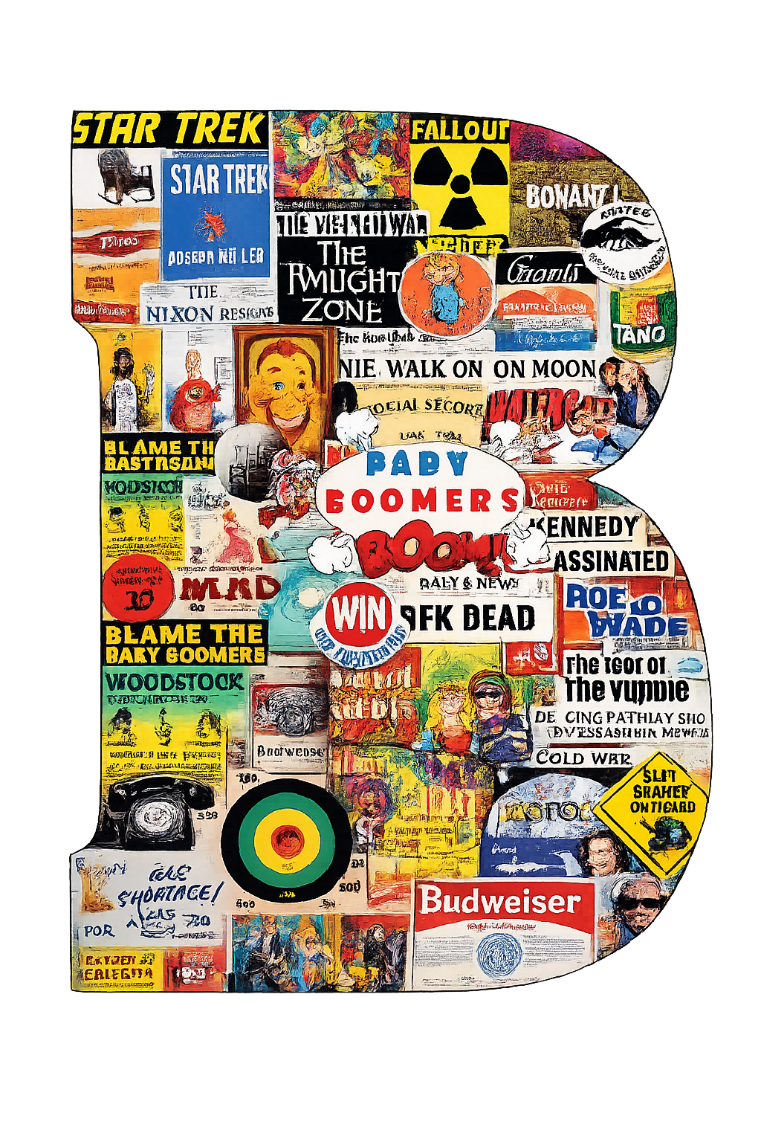
Boomers 1946-1964
Notes:
Only 15% seek therapy - suffer in silence

Slide 6

Gen X 1965-1980
Notes:
“tough -it-out” mentality 3x less likely to seek help. 16-17% experience chronic mental health conditions. Reluctant to discuss emotions

Slide 7

Millennials (Gen Y) 1981-1996

Slide 8

Gen Z 1997-2012
Notes:
46% had therapy in the last year - moe likely to voice their mental state, seek help,

Slide 9
Notes:
1 Per generation - answer what do you think of when you hear the words mental health? - boss vs leader?
Each rep. Writes down the answers per generation

Slide 10
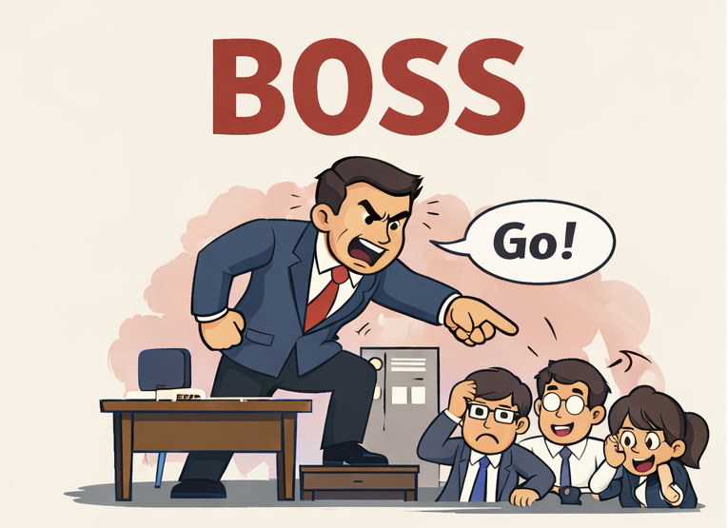
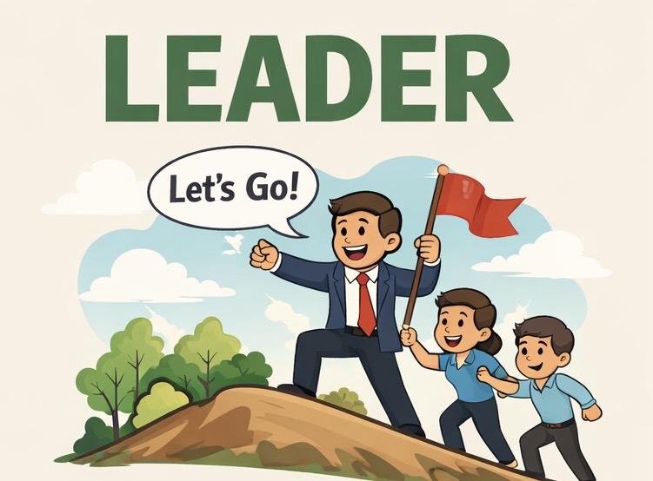
Demands Respect
Issues Ultimatums
Uses People
Takes Credit
“My way is the only way”
Micro Manages
Places Blame
Commands
Earns Respect
Coaches
Models Behavior
Develops People
Motivates
Gives Credit
Accepts Blame
“I've got your back”

Slide 11
How do you handle when someone comes to you and says “I’m not okay.”?

Slide 12
“Calm down.”
“Come here.”
“What were you thinking?”
“We need to talk.”
“You’re acting like …”
“Get over it.”
“What’s your problem.”
“Why would you do that?”

Slide 13
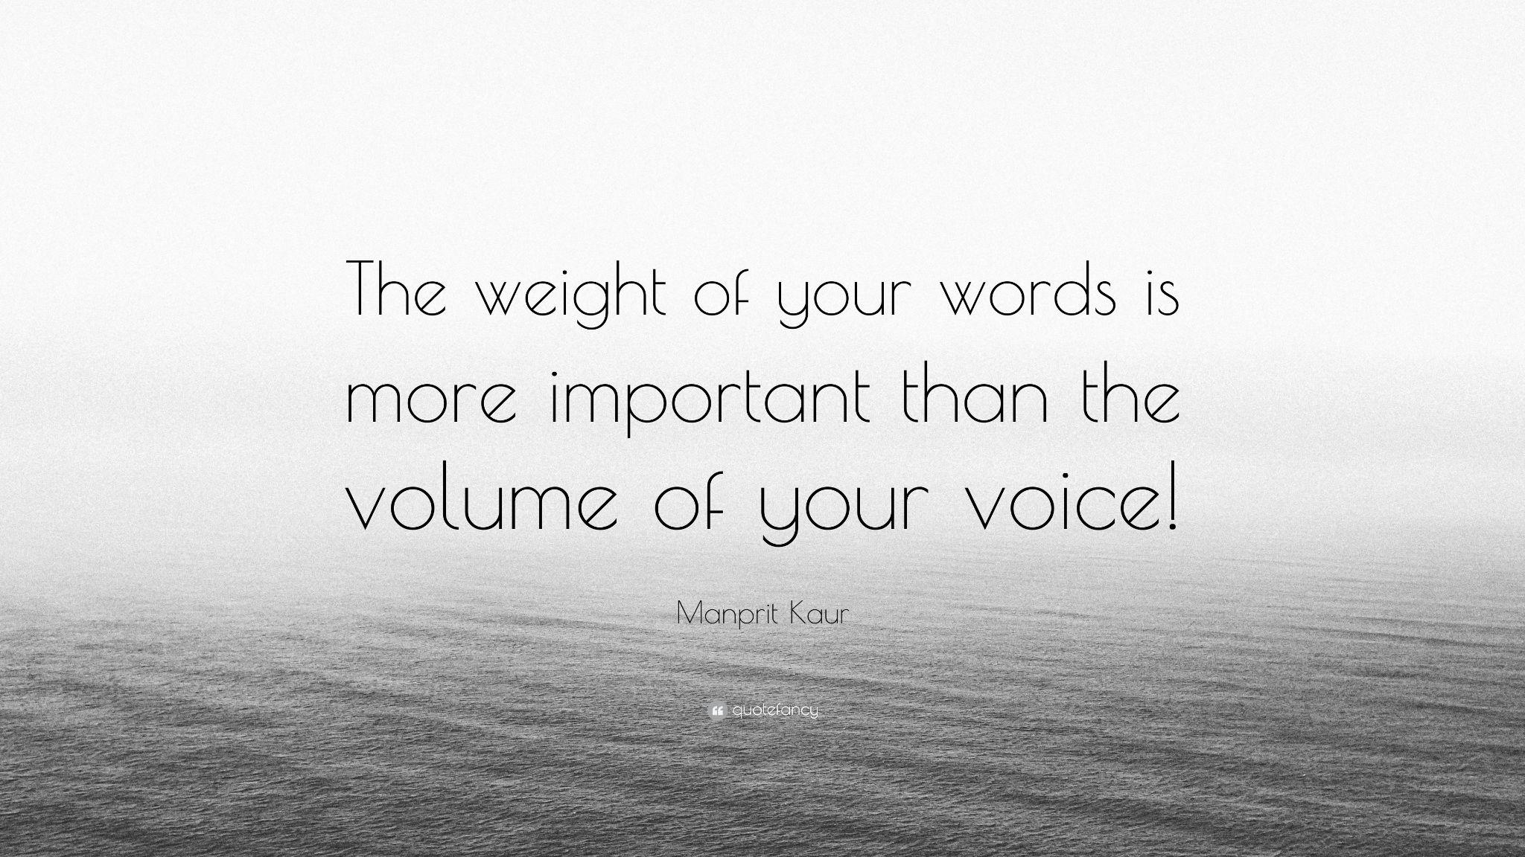
Notes:
Mary looks for a scale of fat and muscle

Slide 14
There are 26 letters in the alphabet. It is in the order in which we combine them, to form words, that can either lift someone, inspire them, or destroy them.
Words are like bullets they can never be taken back.

Slide 15
Are you ok?
Notes:
Asking if anyone has or knows of someone battling mental health. If anyone says no … are you ever sad, mad, glad

Slide 16
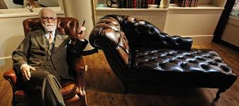
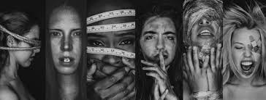
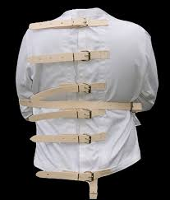

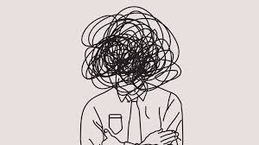
Notes:
What do you think of when you hear the words mental health

Slide 17
Mental Health
Depression
Anxiety
Bi-Polar
Schizophrenia
Panic Disorder
PTSD
Phobias
OCD
Eating Disorders
Postpartum Depression
Prolonged Grief Disorder
Night Terrors
Restless Leg Syndrome
Narcolepsy
Insomnia
Sleepwalking
TBI
Amnesia
Borderline Personality
Autism Spectrum
Anti-Social Disorder
Body Dysmorphic Disorder
Addiction
DMDD
ADHD
ADD

Slide 18
11.8%
80-85%
5.7%
Alcohol
Stress
Suicide Ideation
11.3%
Death by Suicide-Females
34.7%
Death by Suicide-Males
70%
Anxiety
78%
19.1%
Burn Out
Drug use
60%
Depression

Slide 19
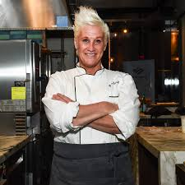
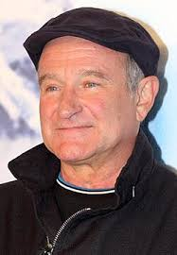
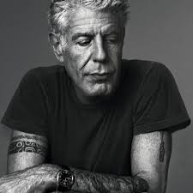
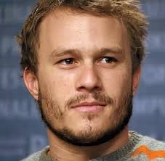
1 in 3
Every 11
Notes:
This is to compare how many men take their lives when one woman does. It also includes how many people complete sucide daily, every 11 minutes

Slide 20
Mental Health isn’t generational, its human. We just need to speak the language each other understands.

Slide 21
la salute mentale
Salus Mentis
精神的健康
santé mentale
mentális egészség
saúde mental
afya ya akili
mental hälsa
Xīnlǐ jiànkāng
mentalno zdravlje
ruh sağlığı
психічне здоров'я
sức khỏe tâm thần
ψυχική υγεία

Slide 22
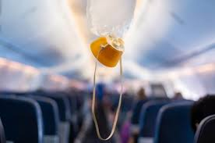
Boundaries aren’t lazy.
They are the oxygen mask that allows you keep showing up at your best.
Notes:
We have to drive the point about how the generations communicate

Slide 23
Hospitality teams are expected to work in harmony while under pressure. Yet we rarely train them to communicate effectively across life experiences.
By fostering mental health, literacy, and authentic leadership, we reduce burnout, improve retention, and cutivate team cohesion.
Notes:
Why this matters

Slide 24
Annual turnover in restaurant industry exceeds 75%.
52% of food service workers cite mental toll and burnout as primary reasons for leaving.
Training New Hires:
FOH: 28hrs | BOH: 36hrs
Management: 219-261hrs
Beyond Initial Onboarding: 15-33hrs per person
Notes:
Ask the question: How do you handle churn? What are things you can change to lower churn? What have you done to combat churn?
Hey asshole dont treat your ppl like dog shit.

Slide 25
If your life was a movie, and people were watching up to this point.
What would they be screaming at the screen, telling you to do?
Notes:
Talk about moments when we made life pivots and walking through opportunities door even when scared

Slide 26
“Barbecues may not be the road to world peace,
but it's a start”
Anthony Bourdain
Notes:
Family meal - sad mad glad - life check ins -

