Slide 1
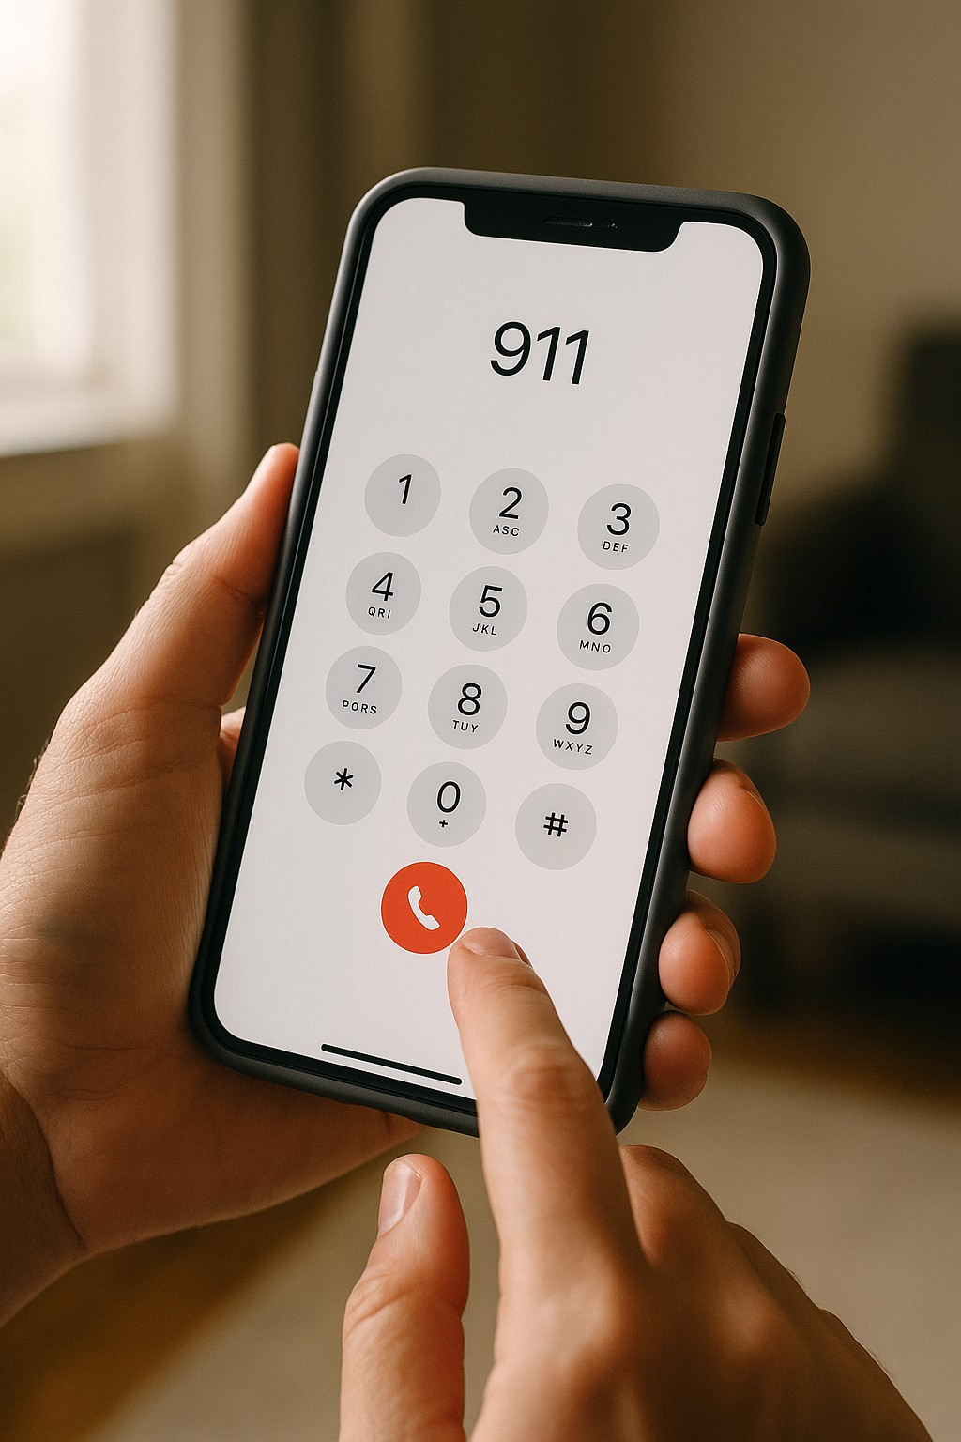
What’s Your 911?
Strategies for Preparation and Response to
Event Emergencies

Slide 2
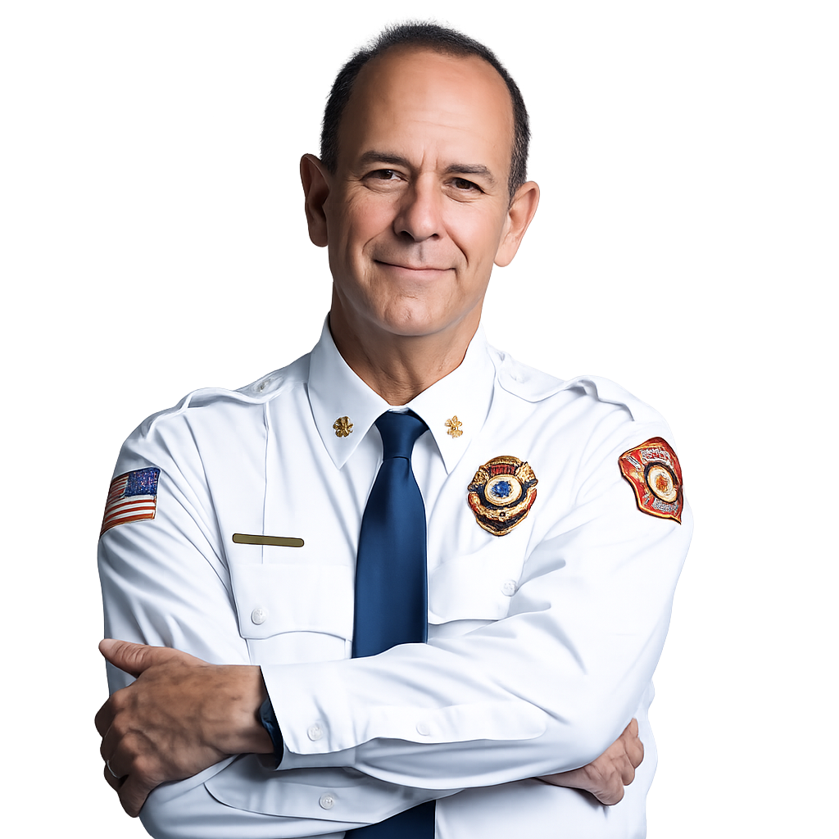
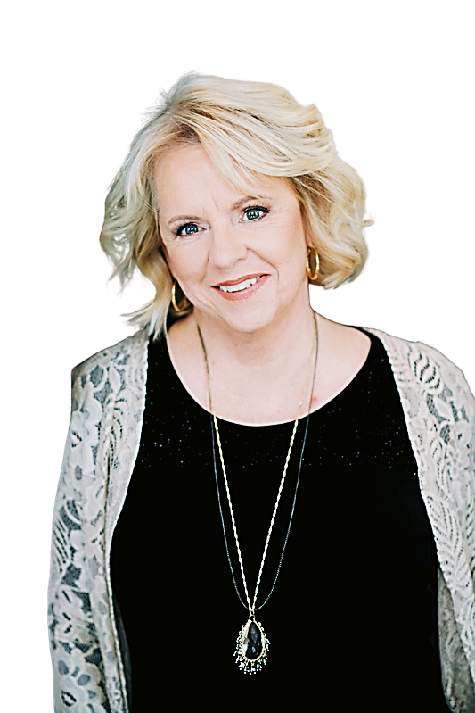
Meet your Event Safety Experts
Charles A. Moore has 45 years of fire service experience, including 30 years as a fire chief and 3 years as an agency Fire Marshal. He managed a 200-member fire service agency in Nevada and guided multiple large-scale fires that required community wide evacuations. He has prepared safety and response plans for many special events.
JoAnn C. Moore has over 30 years of event planning experience. She is a certified Master Wedding Planner and certified Green Wedding Planner. She also has 20 years of experience as a cardio-pulmonary technician and is an author and international instructor on sustainable weddings and events.

Slide 3

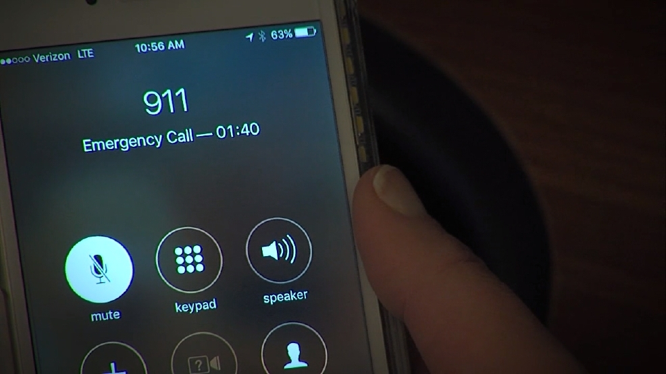
Anticipate and Prevent
Proactive Risk Identification
  Identifying risks early enables timely intervention and reduces negative consequences for you, your clients and the event.
Early Problem Detection
  Spotting problems at an early stage helps you address issues before they become critical.
Culture of Safety
  Cultivate a mindset of safety without sacrificing professionalism or the client experience.
Notes:
Image source: Microsoft 365 content library
Proactively identifying risks allows for timely intervention and reduces negative impacts. Early detection of problems helps organizations address issues before they become critical. Building a culture focused on prevention leads to smarter decision-making, improved safety, and long-term success by avoiding costly mistakes and disruptions.

Slide 4


Real Event Emergencies!
Blizzard
Child with 2nd degree burn
Elderly guest evacuation
Guest heart attack
High altitude pulmonary edema
Drug overdose
Guest’s coat caught fire
Anaphylactic reaction to a bee sting
Broken ribs
Kitchen fire
Anaphylactic reaction to shellfish
Wedding party bus crash
Groom bitten by a bear
Wedding party chased by a bear
Fights
Lightning Strike
Firework misfire launches a mortar into spectators
Dehydration leading to unconsciousness

Slide 5
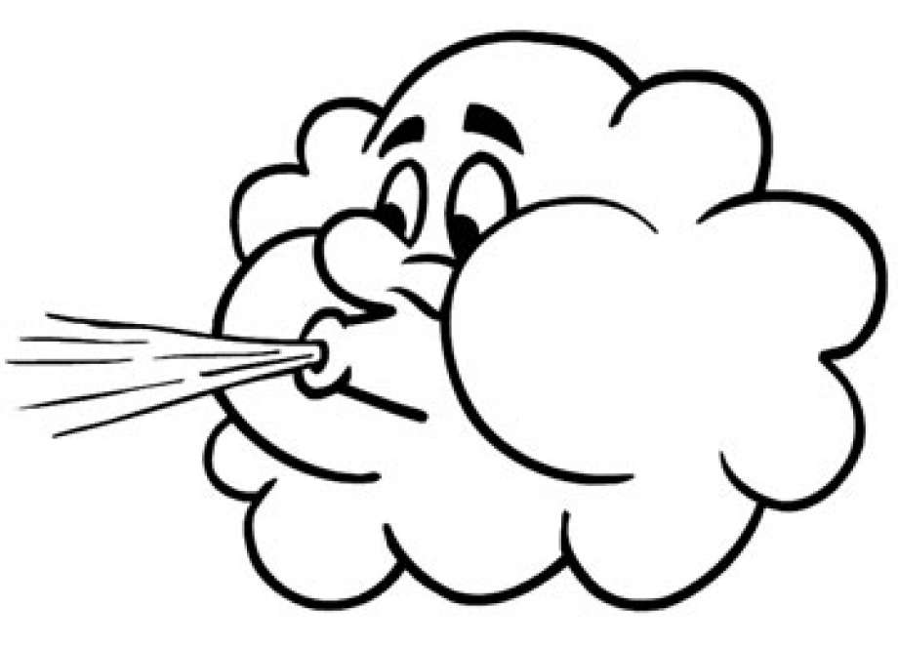
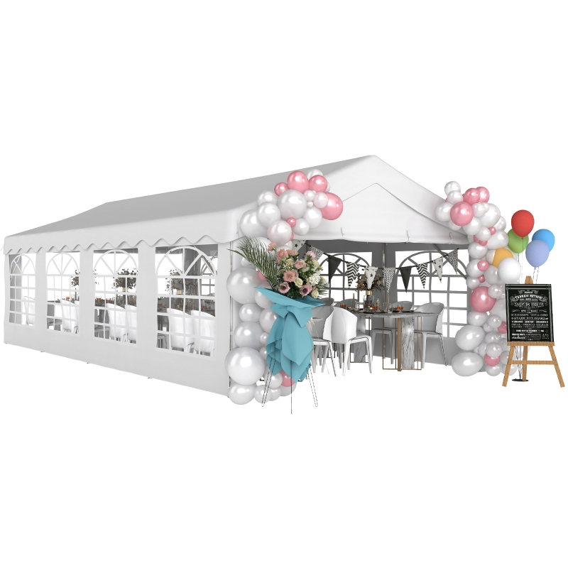
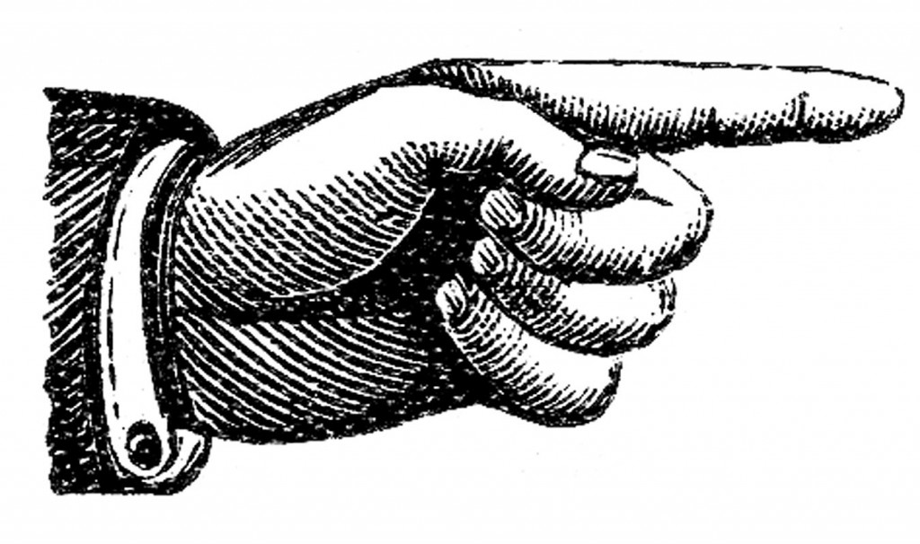
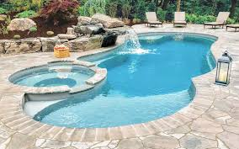
The Big 6 Watch Outs!
Wind and Weather
Special Structures
Bodies of Water

Slide 6



The Big 6 Watch Outs!
Open Flame & Pyrotechnics
911 Readiness
Exits

Slide 7
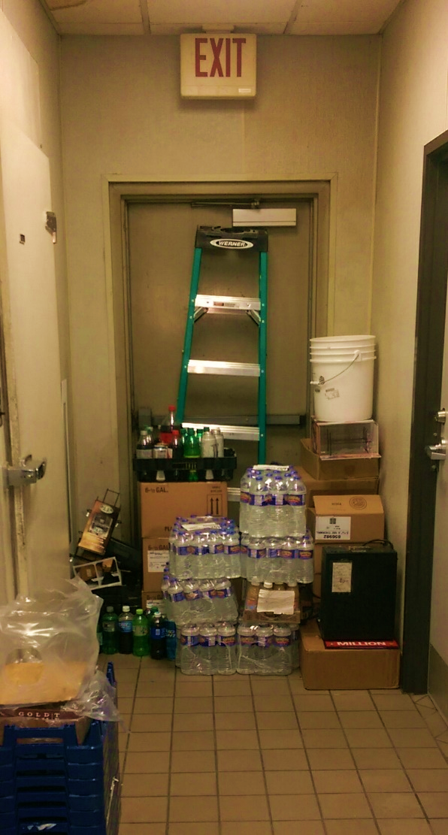
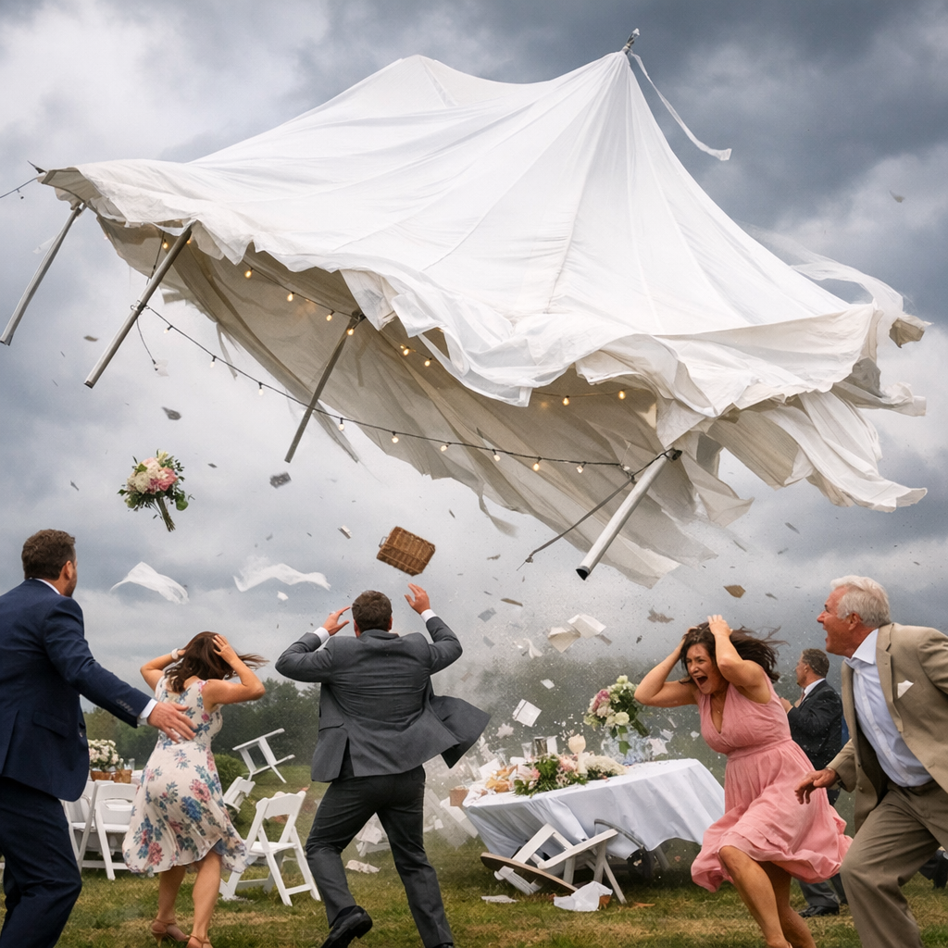
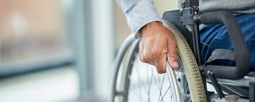
A little more about the Big 6 …..
911
Weather
Guests with special assistance needs
Exits

Slide 8
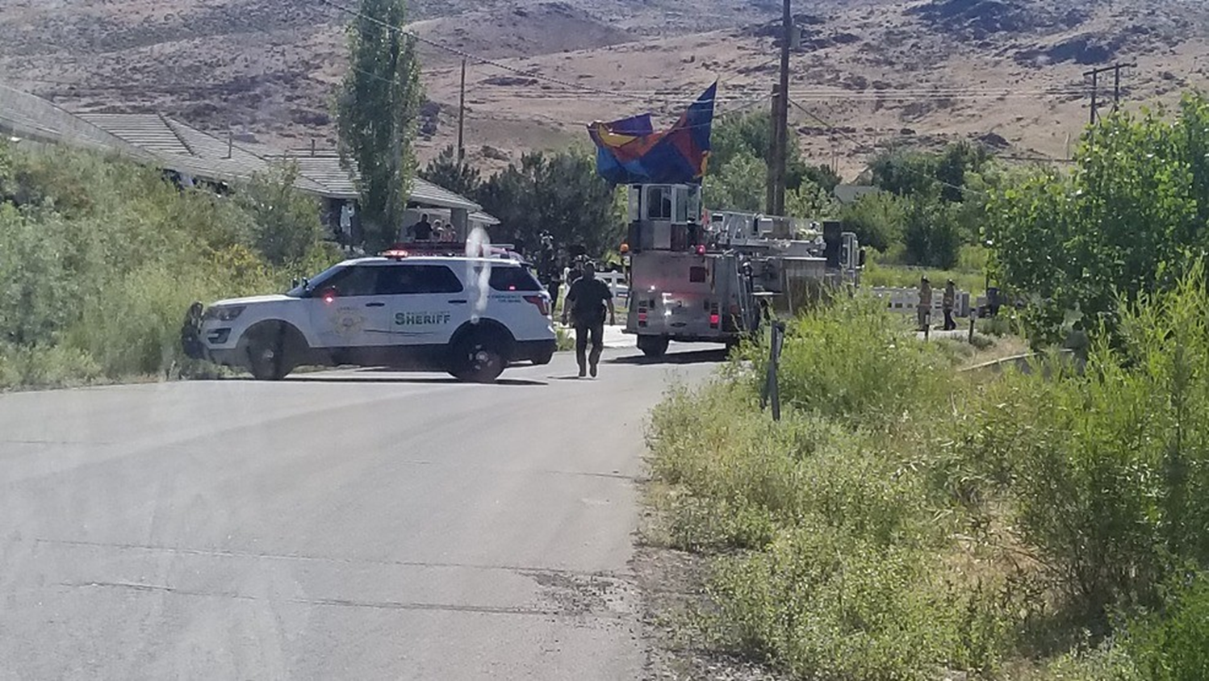


Slide 9

Before the Guests Arrive –
Review the guest list and information:
Who has special dietary or mobility needs?
Who has health issues?
Are any of the guests medically trained, such as paramedics or physicians?
Is your event at altitude? Who is coming from sea level?

Slide 10
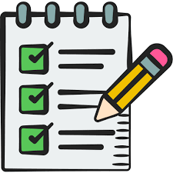
Day of the Event–
Venue walk through with your team:
Venue address written down for every staff member.
Where are the fire extinguishers?
Where is the AED (automatic external defibrillator)?
Is your event at altitude? Who is coming from sea level?

Slide 11

A Life Saved…
A heart attack during a wedding reception.
Gentle persuasion
How to recognize symptoms. (Symptoms are different in men and women).

Slide 12

Where to get training:
Red Cross, American Heart Association, local fire department or ambulance company, hospitals, local community college, private companies.

Slide 13
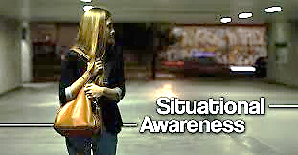
Let’s keep YOU safe.

Slide 14

Questions & Answers!
Charles Moore
cmoorenevada@gmail.com
JoAnn Moore
joann@joannmooreweddings.com
Thank you!

