Slide 1

Chaos, Confetti & Comebacks
The real talk on resilience in the wedding industry
Jaclyn Watson of Jaclyn Watson Events
Helping couples survive the weather, the budget, and their in-laws since 2009

Slide 2

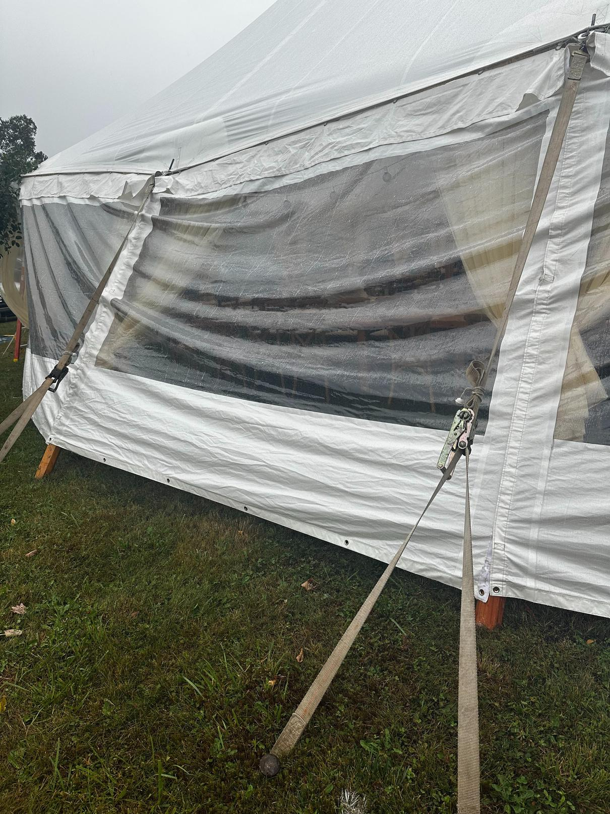
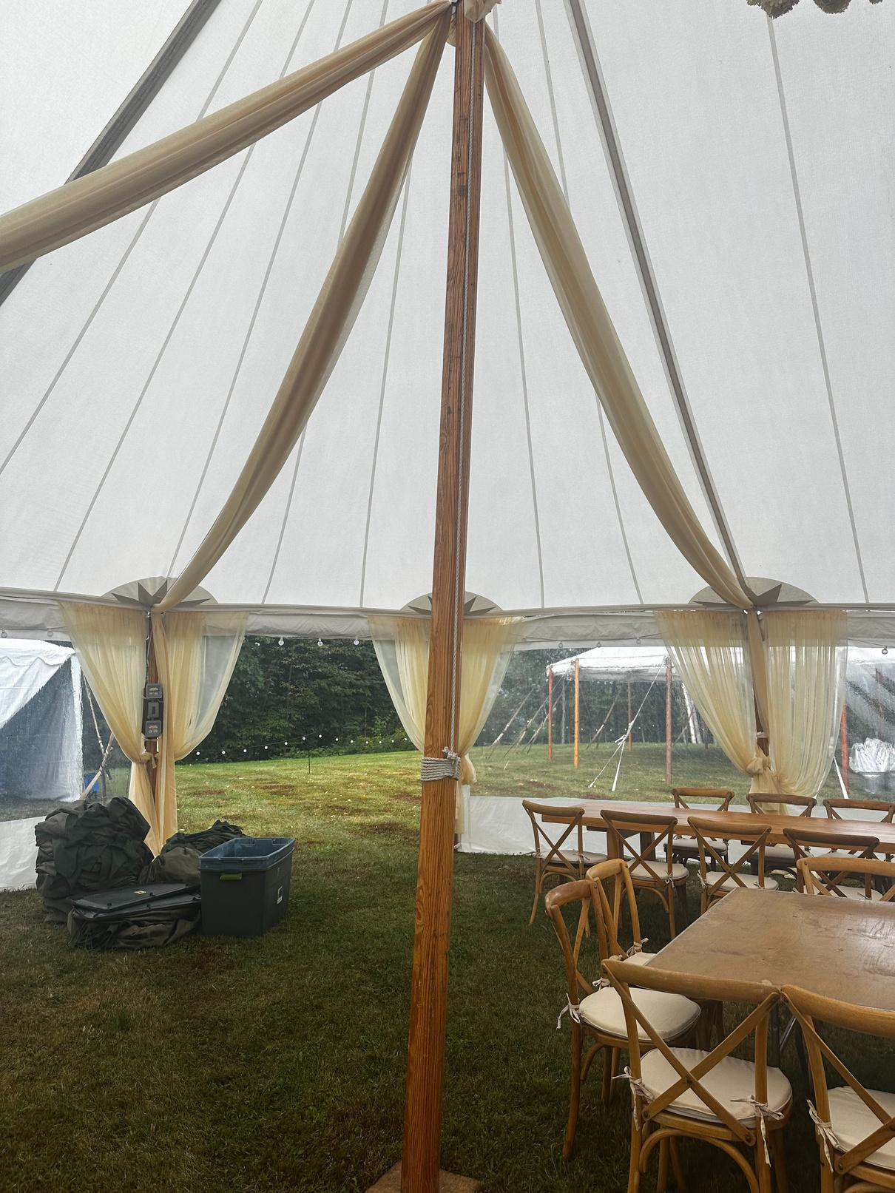
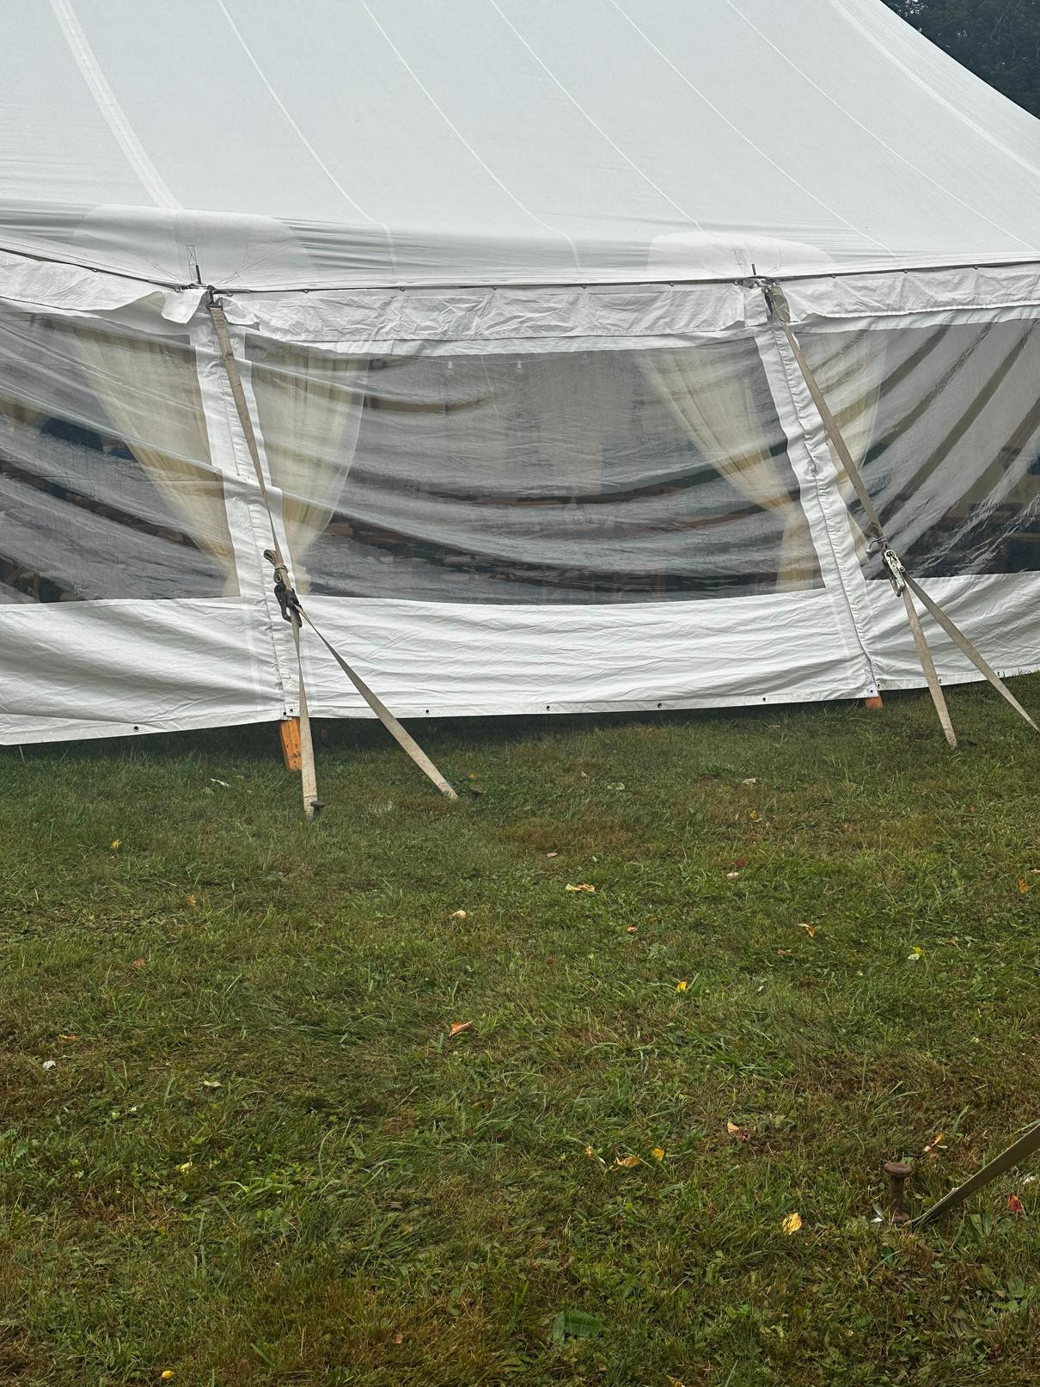
The chaos this year
Notes:
The chaos
Here is what I felt in that moment
Here is how we came back

Slide 3

Chaos, Confetti & Comebacks
  Chaos: The moment everything feels like it is on fire
  Confetti: What the client, guest, & vendor remember
  Comeback: How you respond, recover, and learn
What is the first story that pops into your head when I say, ‘wedding chaos?’

Slide 4

Chaos, Confetti & Comebacks
Who has had at least one oh shit moment at a wedding
  Name the chaos you are in
  How did you come back from it
  What is the one shift you can use at your next event
Are you here more for client chaos, vendor chaos, or your own burnout chaos?

Slide 5
Chaos, Confetti & Comebacks
3 simple steps.
  Pause – regulate yourself so you do not add to the chaos
  Prioritize – decide what matters in the next 10 minutes
  Communicate – clear, calm updates to clients, vendors, and team
Notes:
Ask them: “Which step do you skip most often, if you are honest, pause, prioritize, or communicate?”
Quick show of hands.

Slide 6
Chaos, Confetti & Comebacks
Systems that save you
  Over Order all rentals
  Clear weather plans for all aspects of the day
  Standard “crisis scripts” for clients and vendors
Write down one system you do not have that you know you should.
Here is what is happening.
Here is what we are doing about it, and here is what I need from you.
Notes:
Ask them: “Which step do you skip most often, if you are honest, pause, prioritize, or communicate?”
Quick show of hands.

Slide 7

Chaos, Confetti & Comebacks
Hotseat time

Slide 8
Chaos, Confetti & Comebacks
Your takeaways today
Controlled Chaos is normal in our Industry. It is not a personal failure.
Your systems and scripts decide how fast you recover.
Your comeback is your brand.
Notes:
Ask them: “Which step do you skip most often, if you are honest, pause, prioritize, or communicate?”
Quick show of hands.

Slide 9
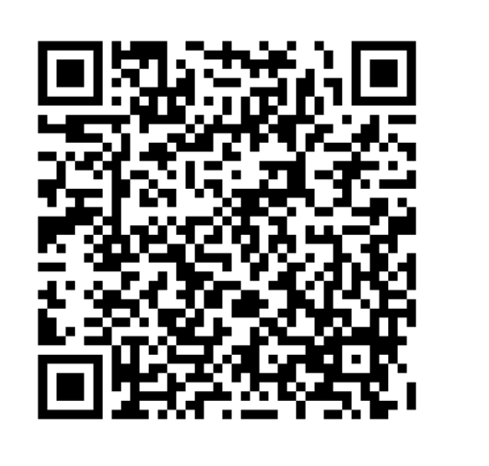
Want to reach out!
Email: Jackie@Jaclynwatsonevents.com or echeloncreativeandco@gmail.com
Phone: 802-324-1433
Websites: www.jaclynwatsonevents.com & https://www.echeloncreativeco.com
Session Evaluation
Notes:
Ask them: “Which step do you skip most often, if you are honest, pause, prioritize, or communicate?”
Quick show of hands.

