Slide 1


Celebrating Differently
Tap into the Growing Market of Alternative & Non Traditional Events

Slide 2

Not every milestone follows tradition,
but every milestone deserves celebration.

Slide 3

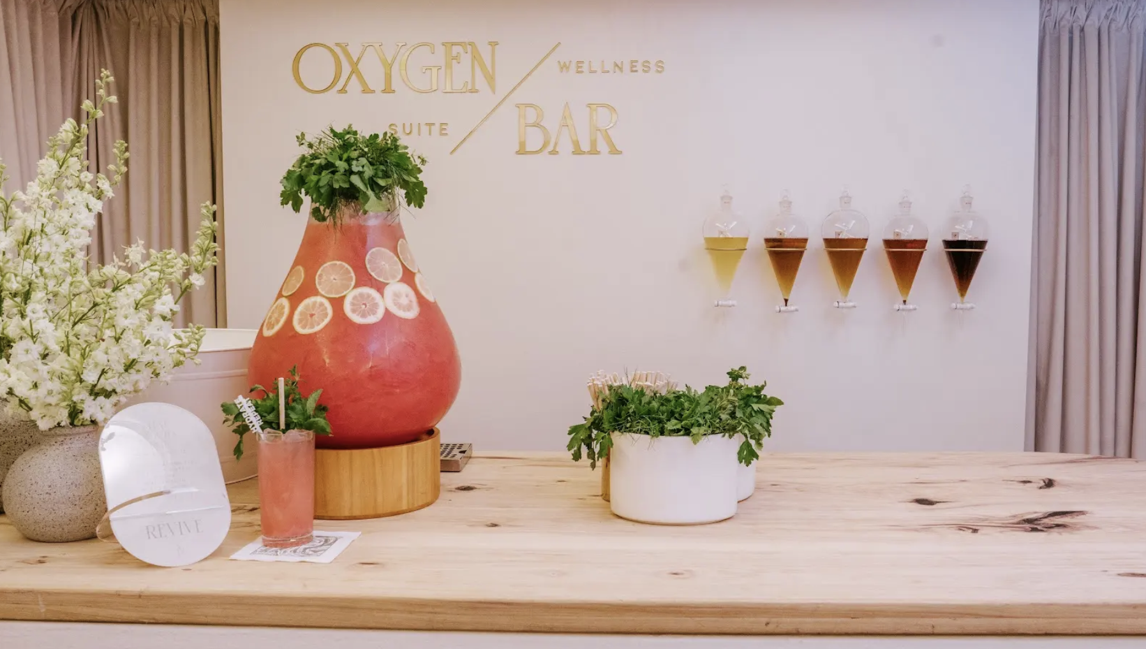
What Are Alternative Celebrations?
Divorce parties • Business showers
Puppy showers • Wellness retreats
People are celebrating life moments beyond weddings and birthdays.
Notes:
similar to how to break in

Slide 4
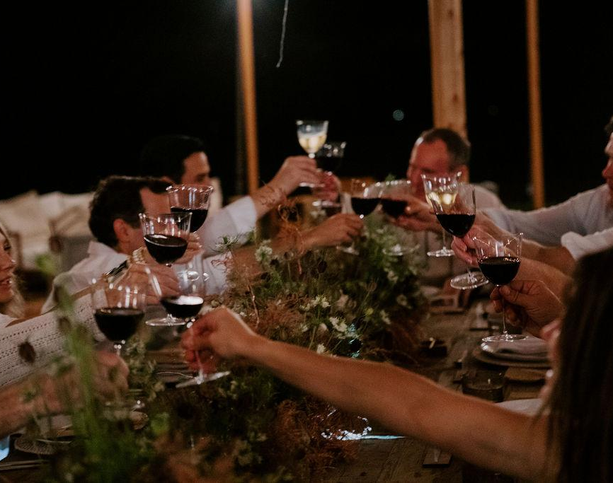
Over
40%
of adults are unpartnered -
meaning many meaningful milestones exist outside marriage.
Pew Research Center analysis of U.S. Census data (2023)

Slide 5
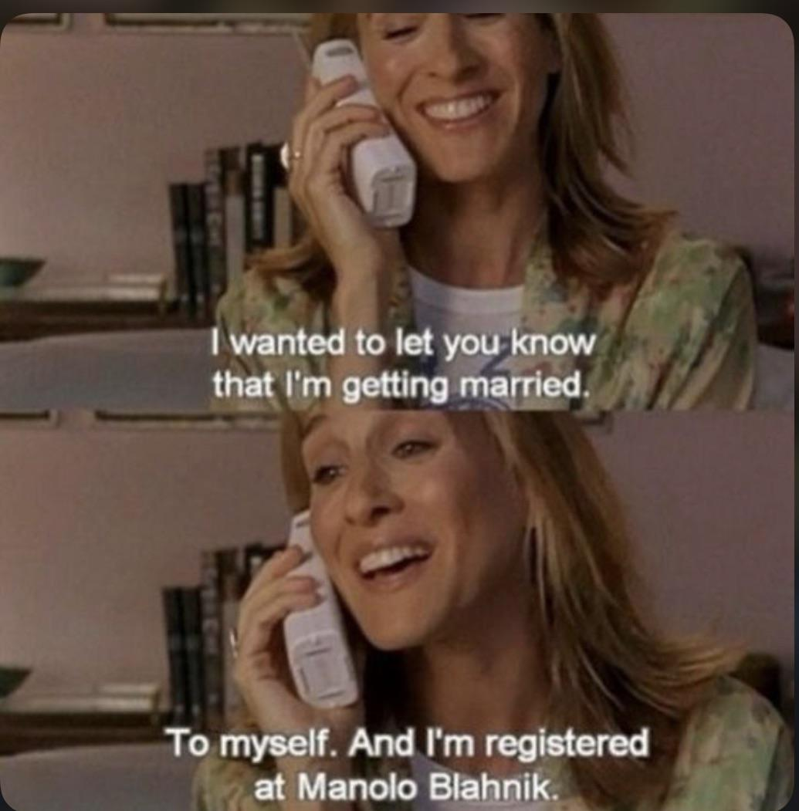
Let’s normalize
honoring our real lives,
not just the
storybook script.

Slide 6

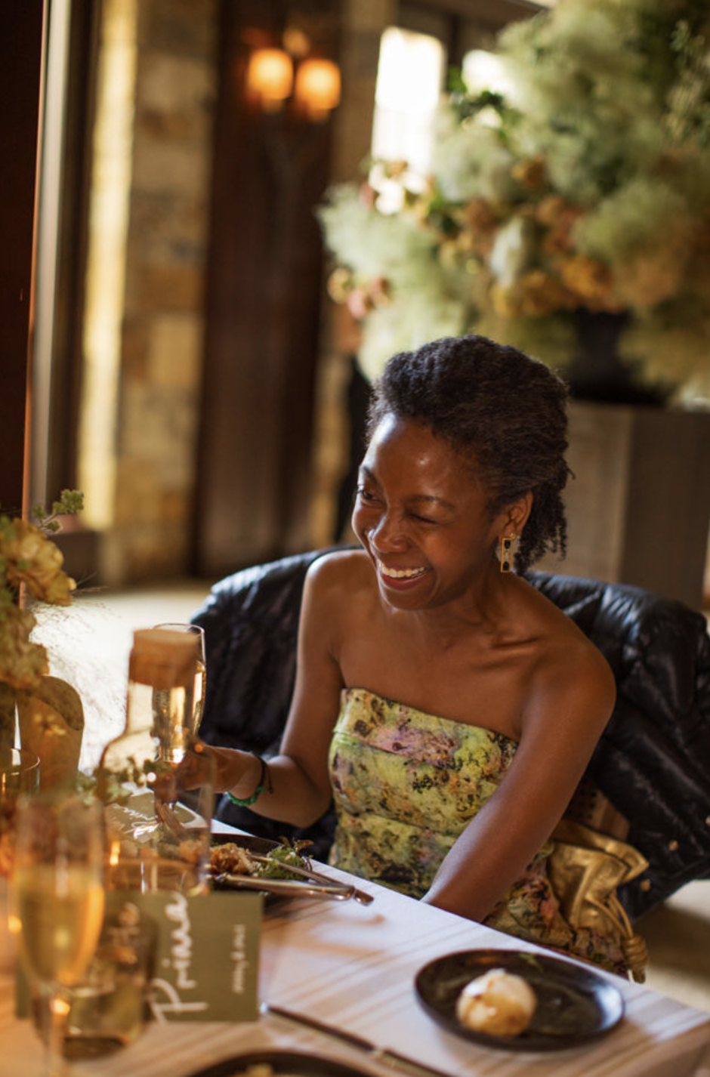

Non Traditional celebrations are not less meaningful, they’re often more personal.

Slide 7
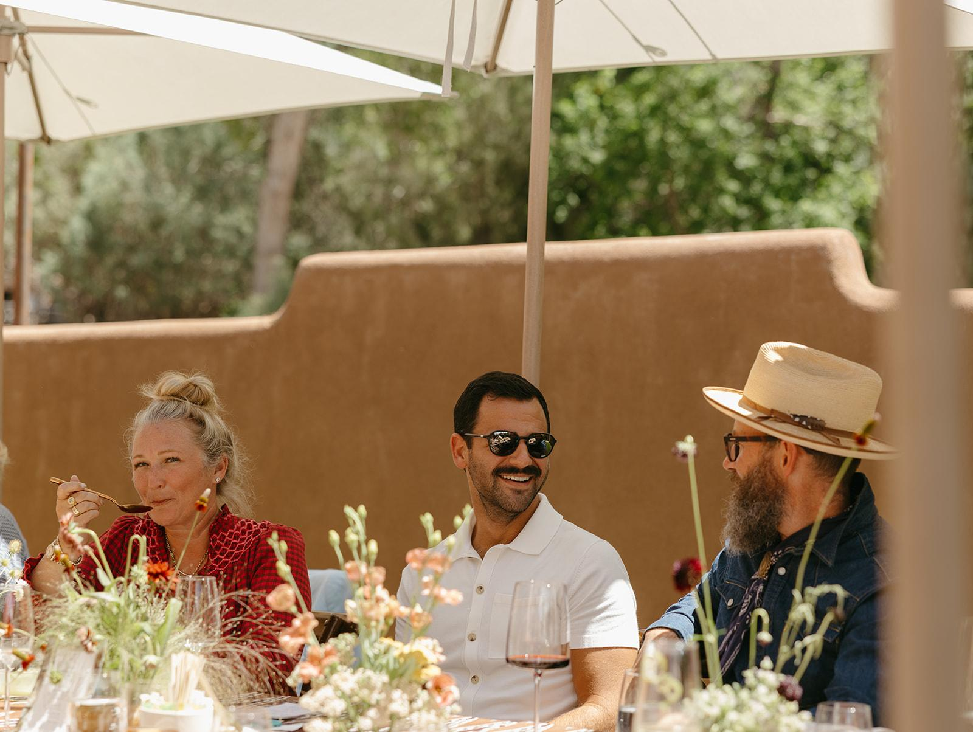
Less than
25%
of young adults achieve traditional milestones by their early 30s.
Pew Research Center, Census-based analysis

Slide 8
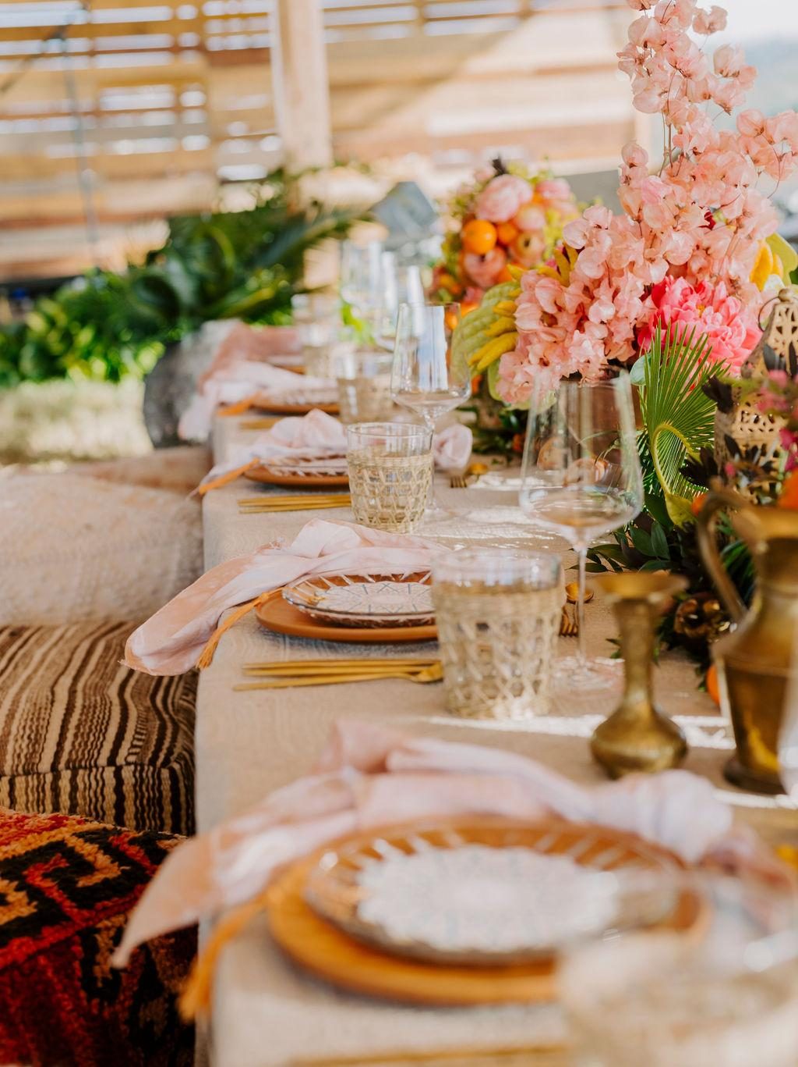
Why This Matters
This is where creativity meets opportunity.
Untapped markets
High emotional value
Less saturated market

Slide 9

How to Break In
To book different work, you have to show different work.
Curate the portfolio you want
Use inclusive language
Partner intentionally
Audit what’s customizable
Create 2–3 niche offerings
Market with intention

Slide 10
Follow the Life Journey
Wedding → Baby Shower → Vow Renewal
Divorce → Reinvention → Milestone Birthday
Career Shift → Rebrand Event → Anniversary Celebration
Executive Retreat → Book Launch → IPO Company Party
Your existing clients are your strongest growth strategy.

Slide 11
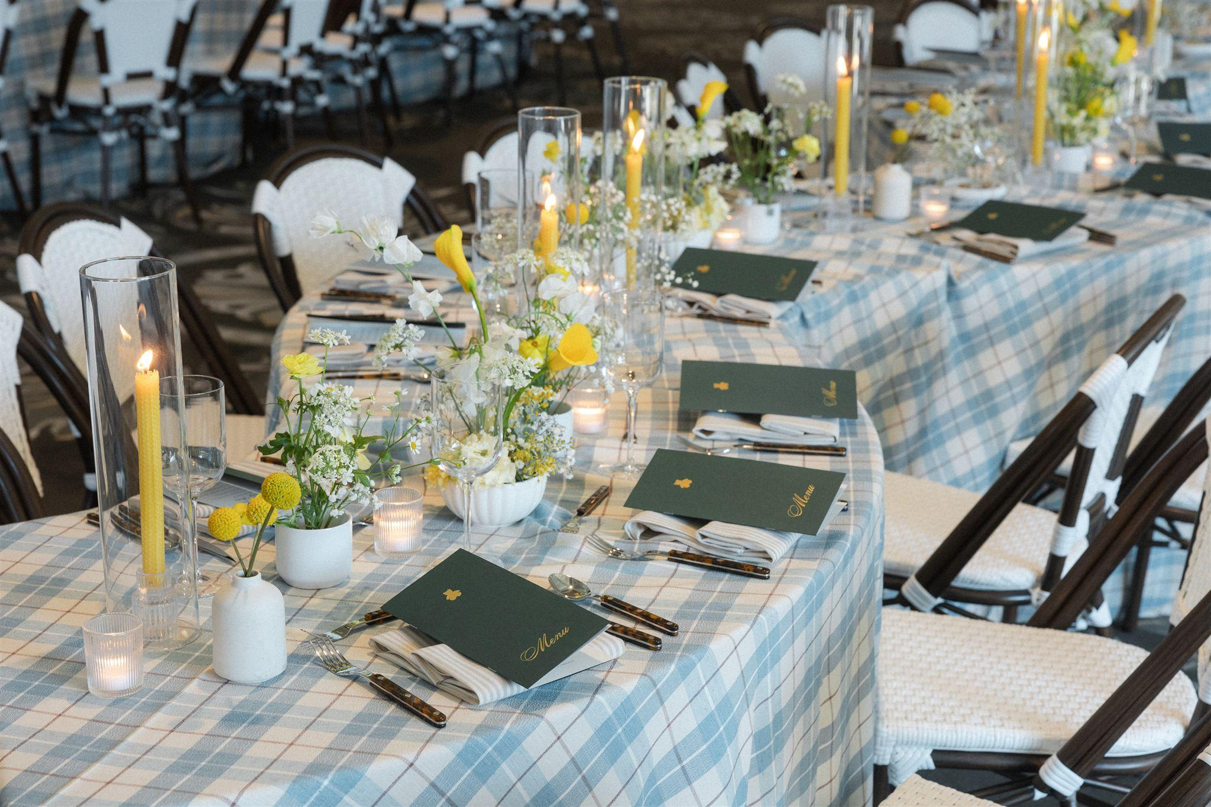
Start Small. Start Smart. Start Now.

Slide 12
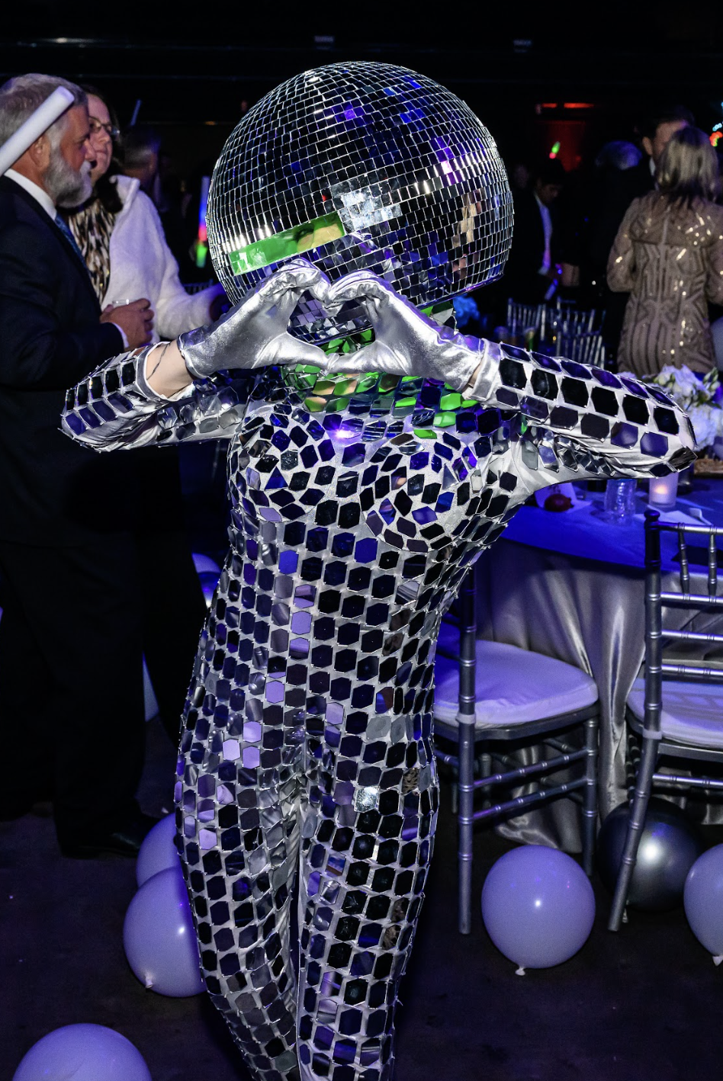
When we expand what we celebrate, we expand opportunity and connection.

Slide 13
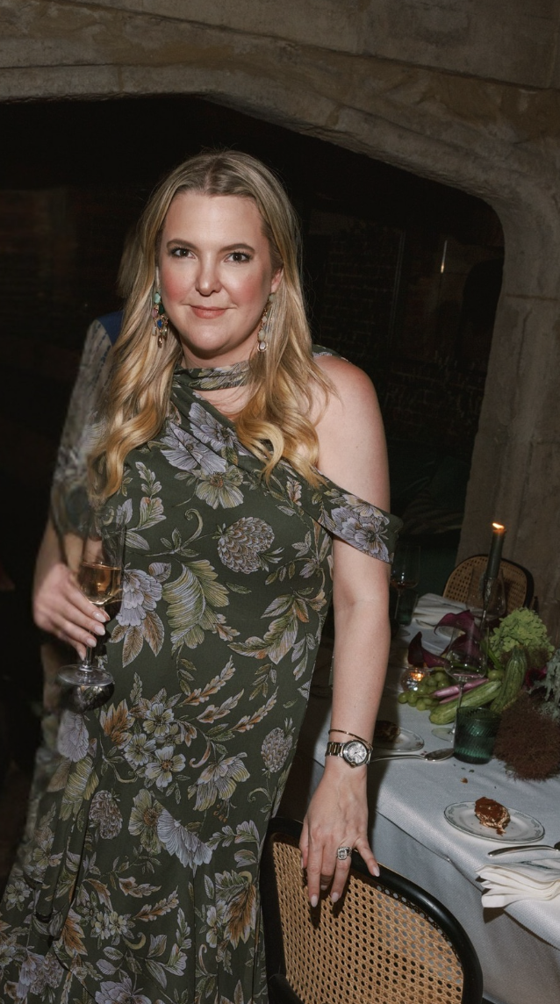

Let’s Continue the Conversation
I’d love to hear what you’re seeing, creating, and celebrating!
cassielamereevents.com
cassie@cassielamereevents.com
@cassielamereevents

