Slide 1
Stadium Seats to Luxury Suites
The Future of Catering at Live Sports & Entertainment Events

Slide 2


J.C. Campbell
EVP Operations
Proof of the Pudding

Slide 3
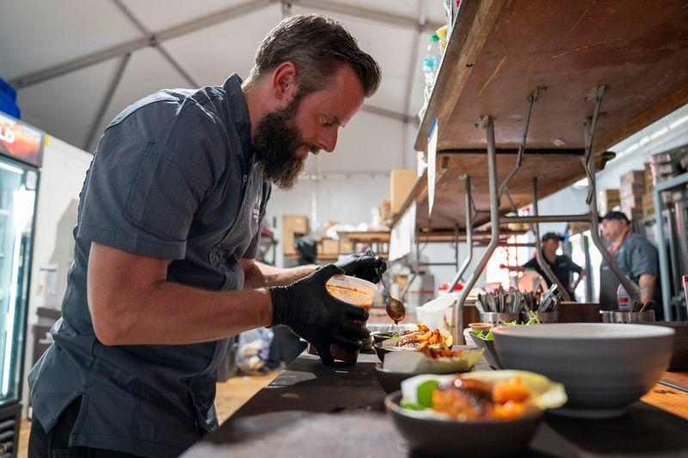
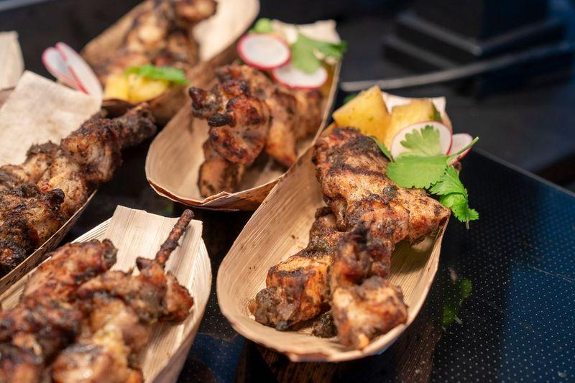
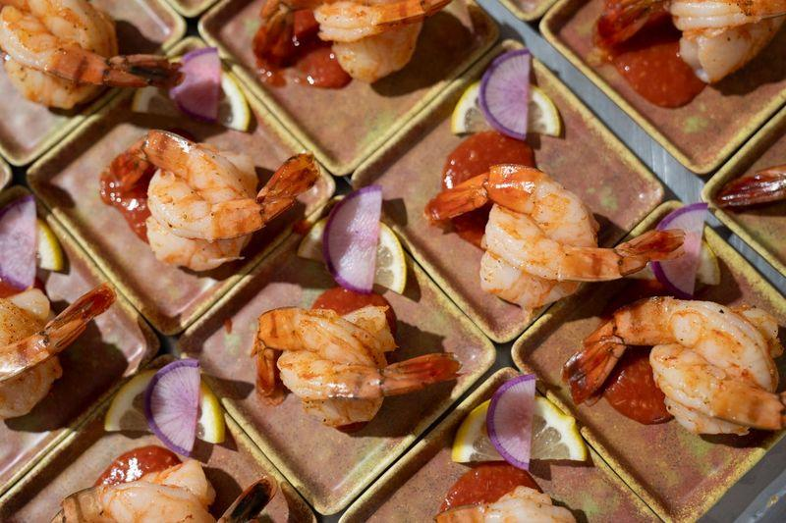

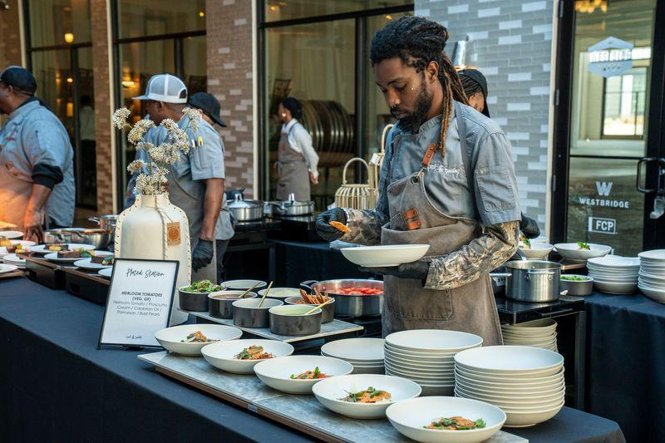
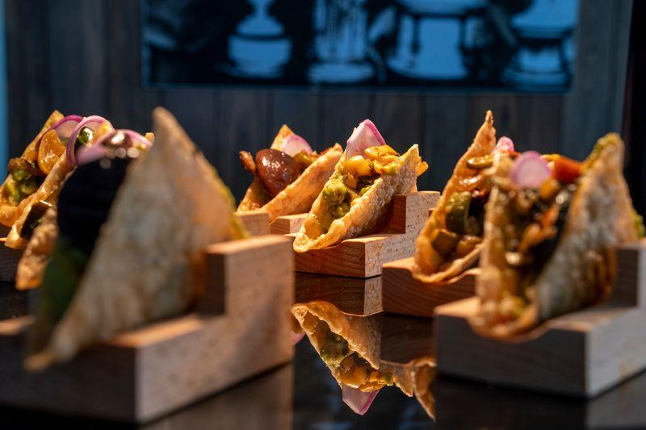
We create elevated, from-scratch culinary experiences that reflect the culture, community, and prestige of every event we serve. Through thoughtful sourcing, local partnerships, and flawless execution, we enhance the fan experience and deliver world-class hospitality at every level

Slide 4
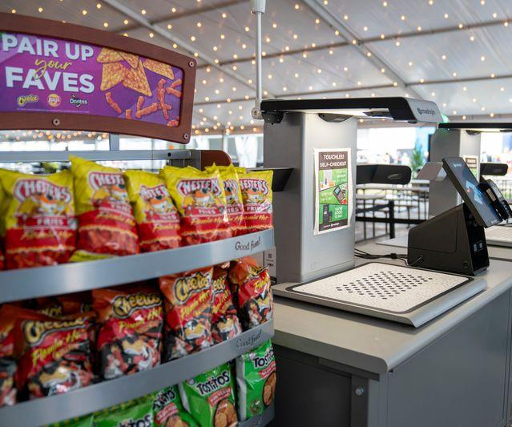
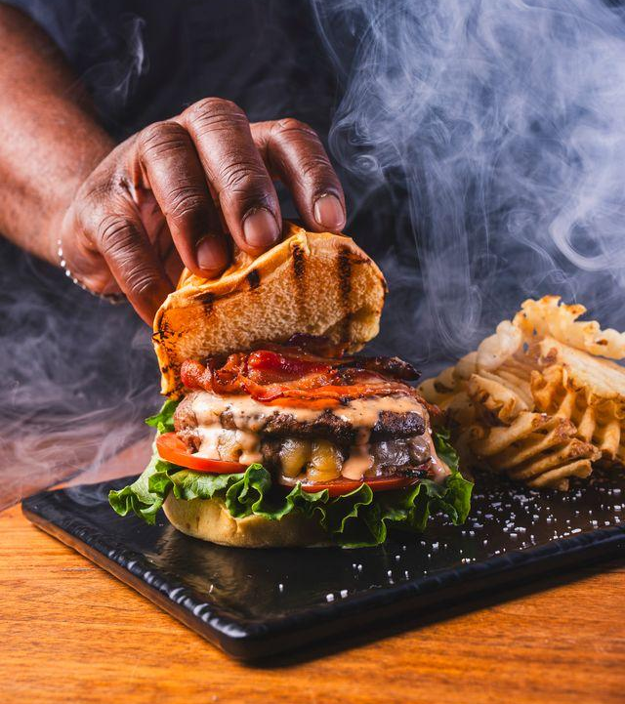
“Our business will change more in the next 5 years than it has in the last 50”
-Jimmy Petracci

Slide 5
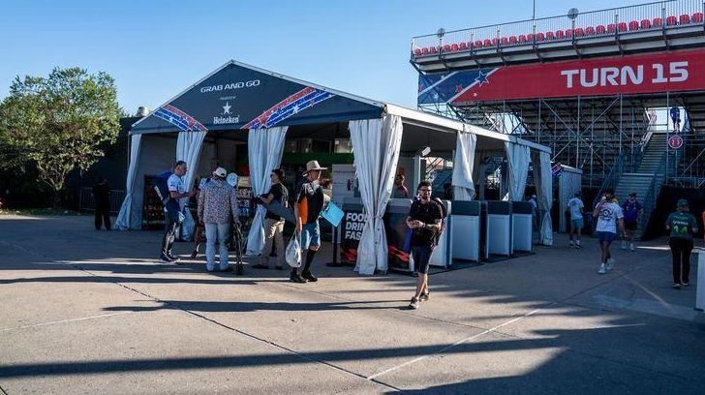
Concessions
Beer, Hot Dogs, Popcorn, Robots……

Slide 6
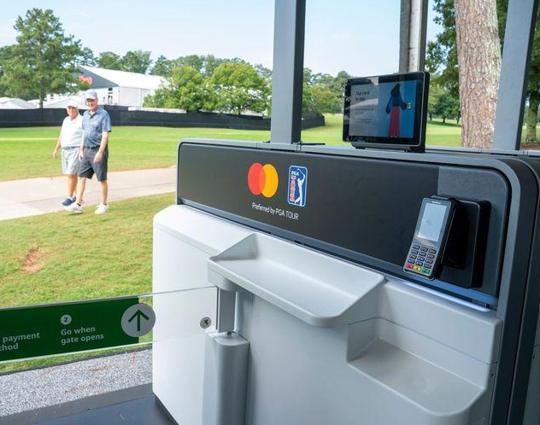
From What & Why to How & Who
In the early 2000’s BIG DATA drove strategy and innovation
  A lot of us paid a lot of people a lot of money to learn that chicken tenders, hot dogs and beer are very popular!
Today HOW FOOD SELLS drives the conversation
  All Inclusive catching fire
  Technology is no longer the future, it’s the NOW!
    Autonomous solutions lead the way
      AWS Just Walk Out Technology for food & retail, Mashgin and other leaders in the space drive throughput, revenue and efficiencies.

Slide 7
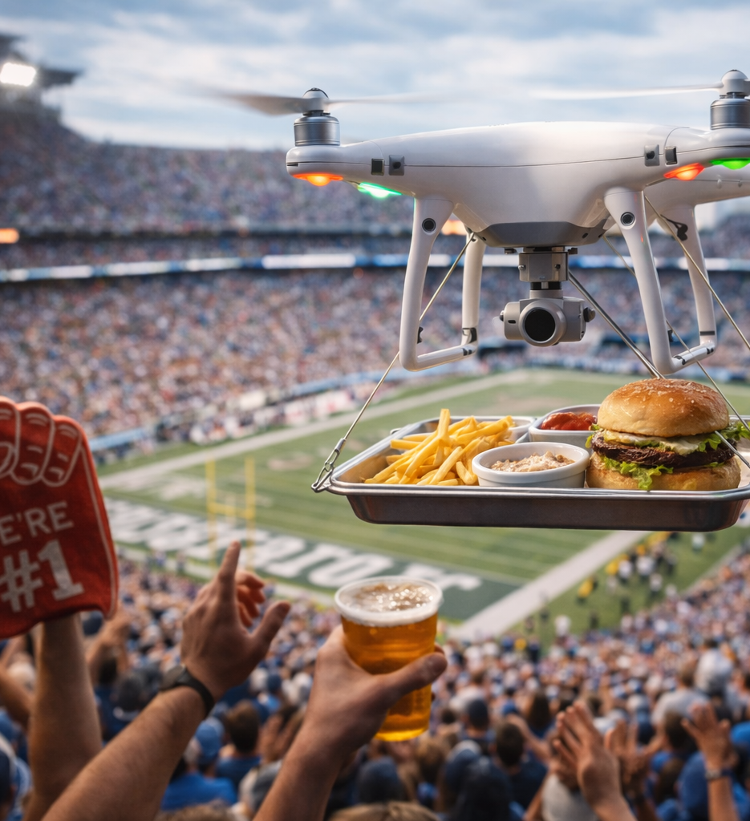
The Future of Concessions

Slide 8
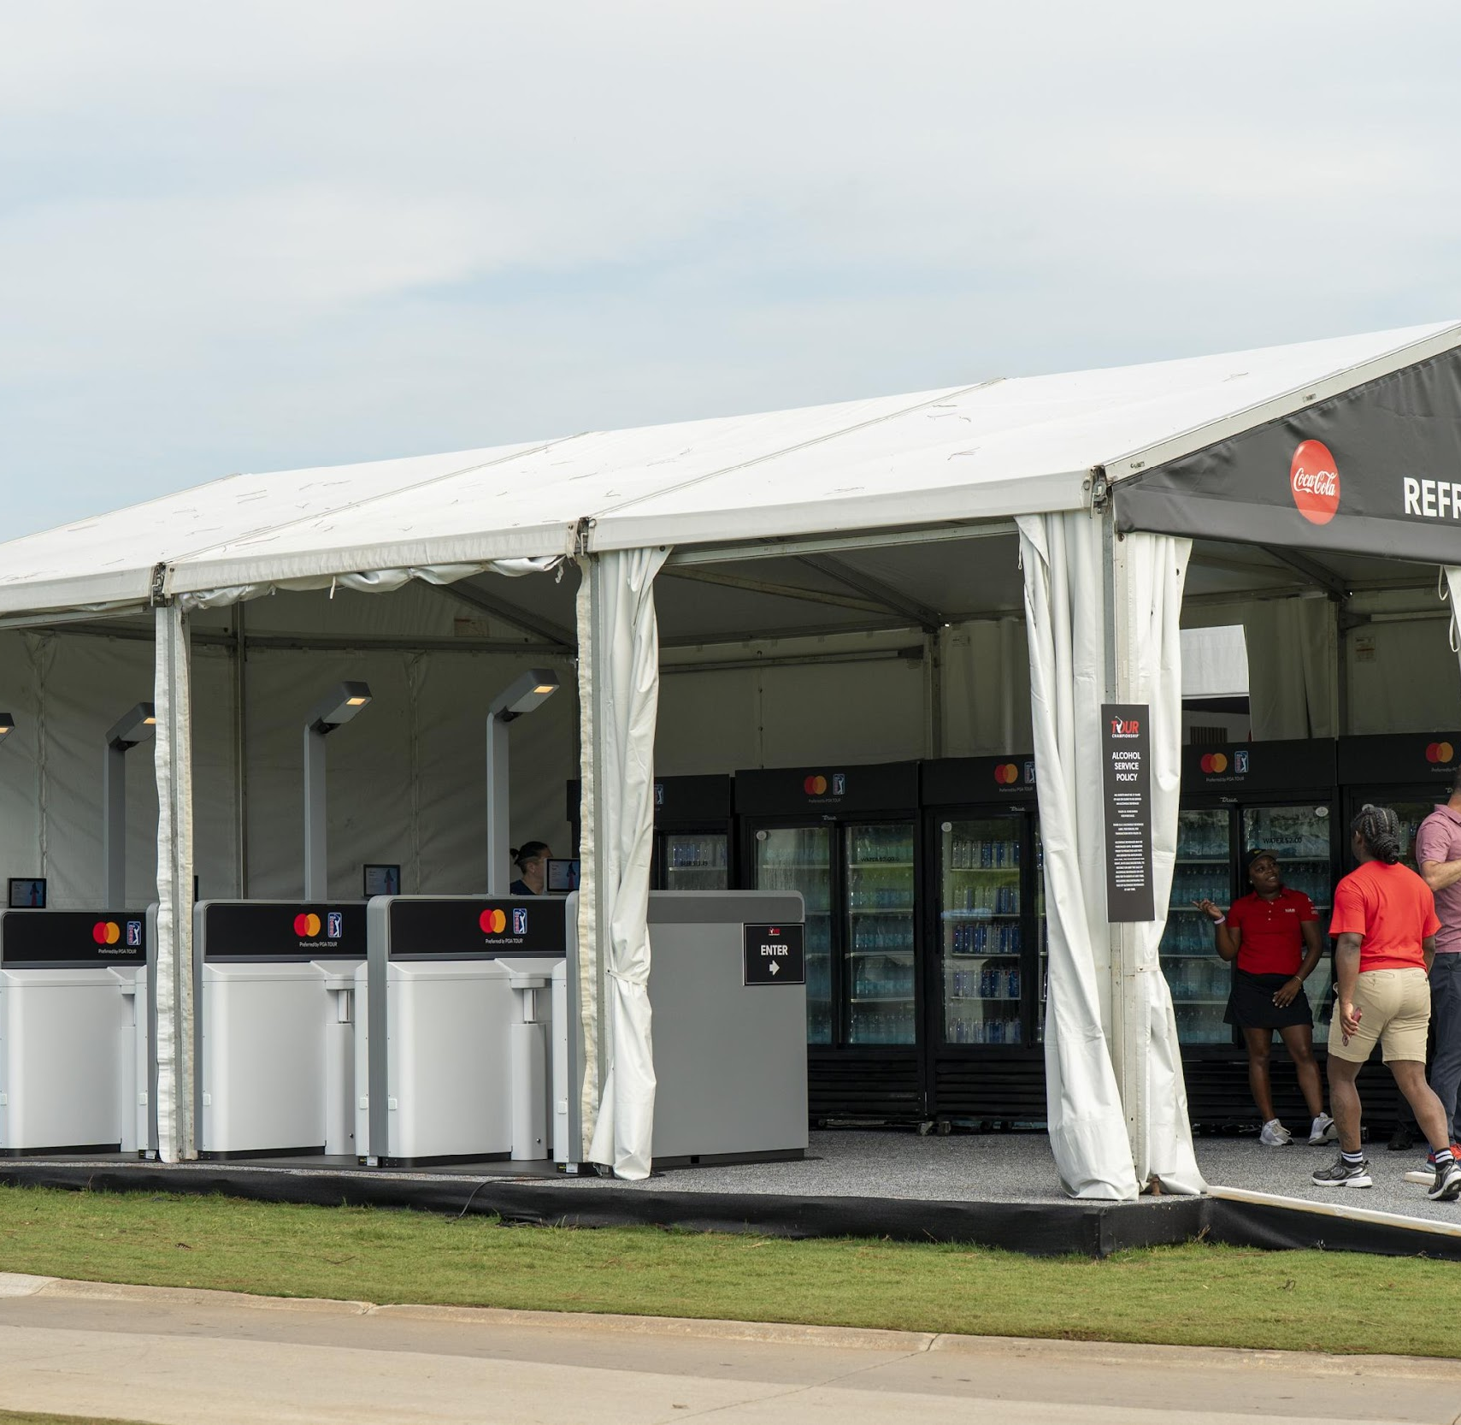
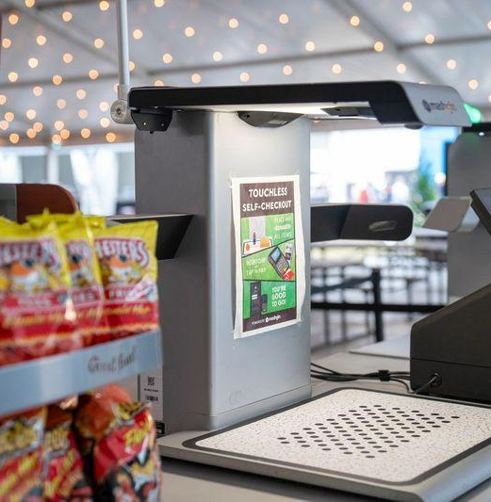
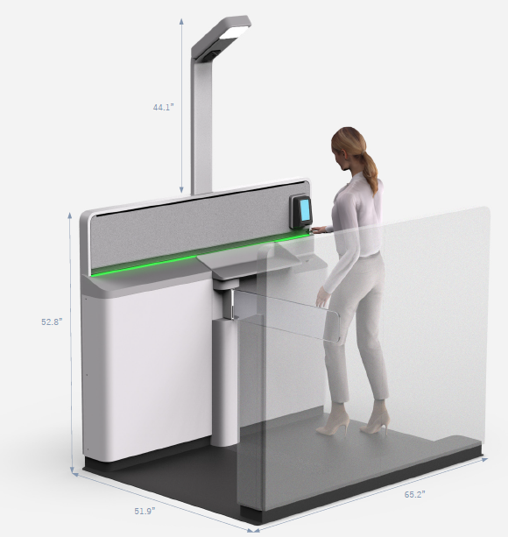
Autonomous Solutions
As fast as 15 seconds from entry to exit
Reduced hourly labor costs
Incorporates discounts and loaded ticket programs
Food, beverage & merchandise application

Slide 9
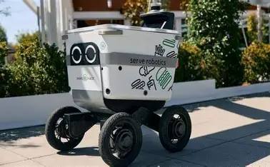
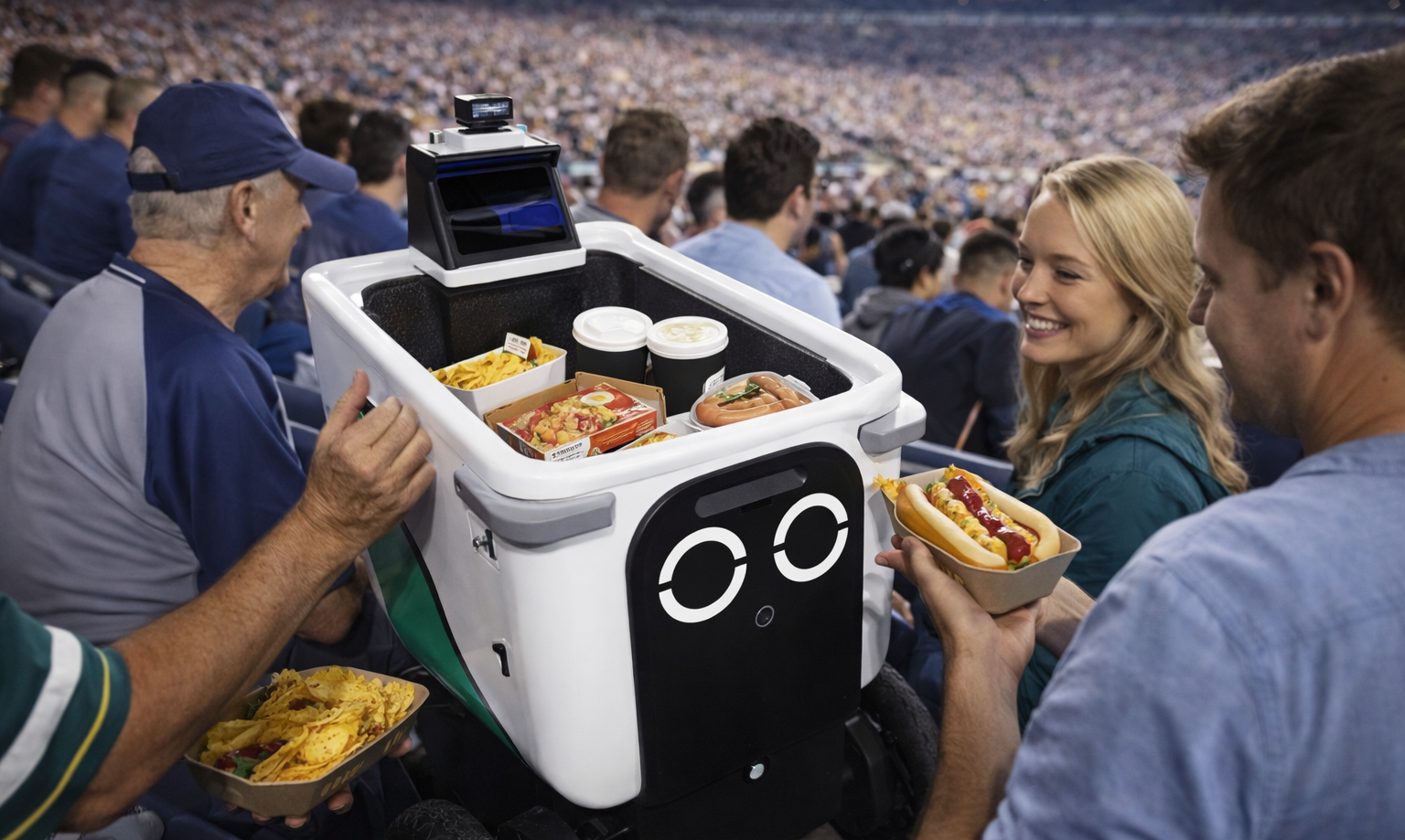

Disrupting without Disruption
Rivalry Tech Solutions
Re-inventing In-Seat service
  Reducing intermission/halftime concourse traffic
  Is there a magic pill
  Where can technology take us
Identifying & predicting purchasing patterns
Pushing autonomous capabilities
  Facial Recognition
  Guest mapping – Tracking in event trends with A.I.

Slide 10
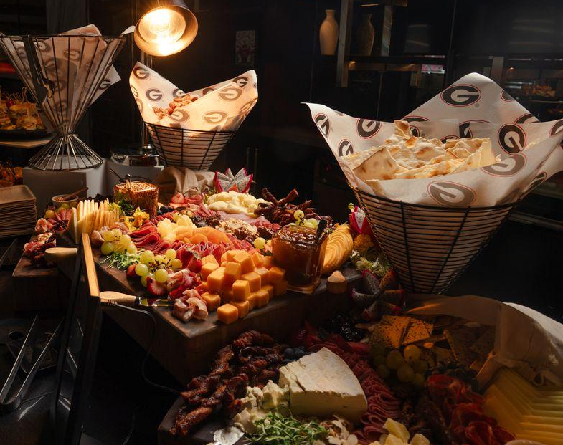
The Future of Premium Hospitality
Setting the Mood Before the Food

Slide 11
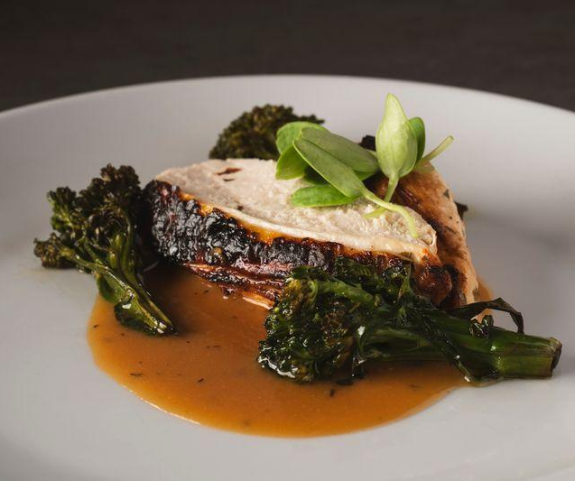
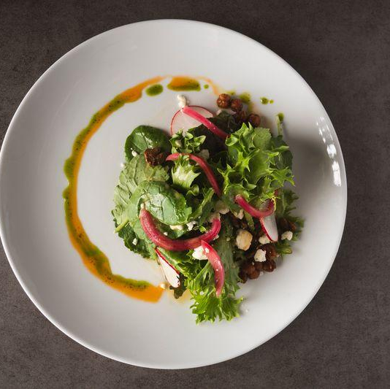
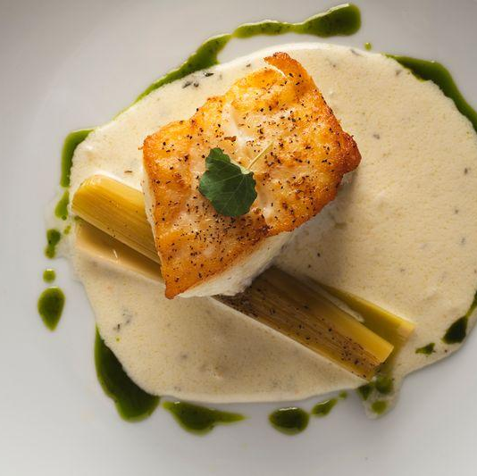
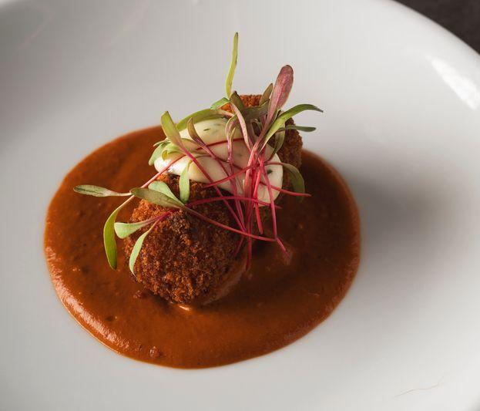

What’s at Stake
The loss of personal touch
The balance between customization and speed
The risk of being left behind
The cost of change vs. the cost of complacency

Slide 12
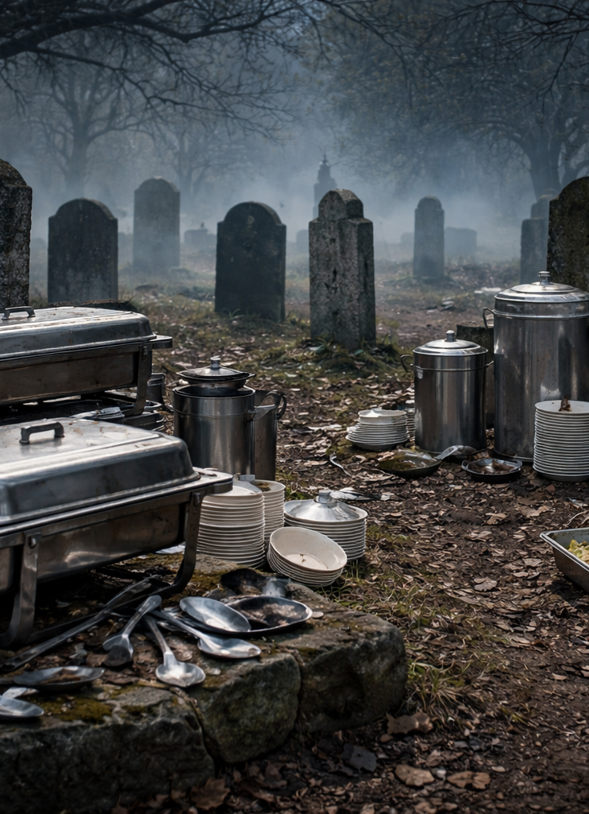
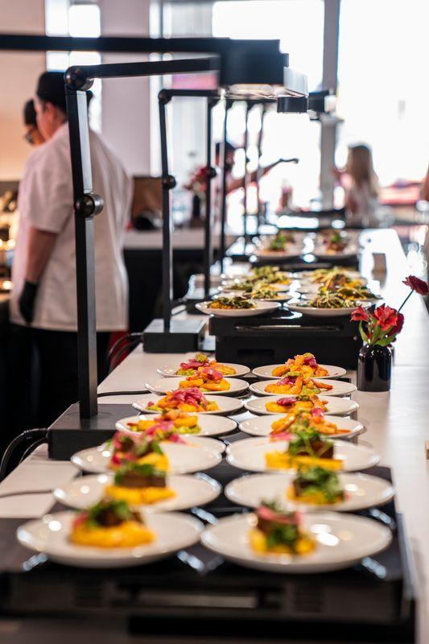
Creating Excitement
Suites designed around the client not the event
  Chef Stations
  Space for wow moments
  Unique and exclusive experiences
The Death of the Buffet Line
  Small plates & stations
  Interactive opportunities
  Modernizing equipment and presentation
  Wow Moments
    Shuckers
    Caviar Passers
    Drinks 2 Go
    Solato

Slide 13

More Questions Than Answers
A.I.

Slide 14

Artificial Intelligence vs. Human Instinct
How does A.I. help premium hospitality?
  Can we or should we unlearn hospitality as we know it?
White Glove vs. Cold Steel
  How does A.I. limit customization and how do we battle back?
  How is the customer right, if A.I. isn’t wrong?
  Will convenience in premium spaces ever trump true hospitality?

Slide 15
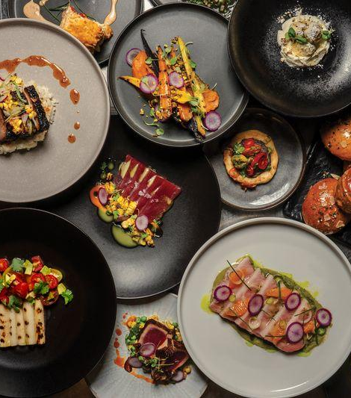
Questions & Conversation

