Slide 1
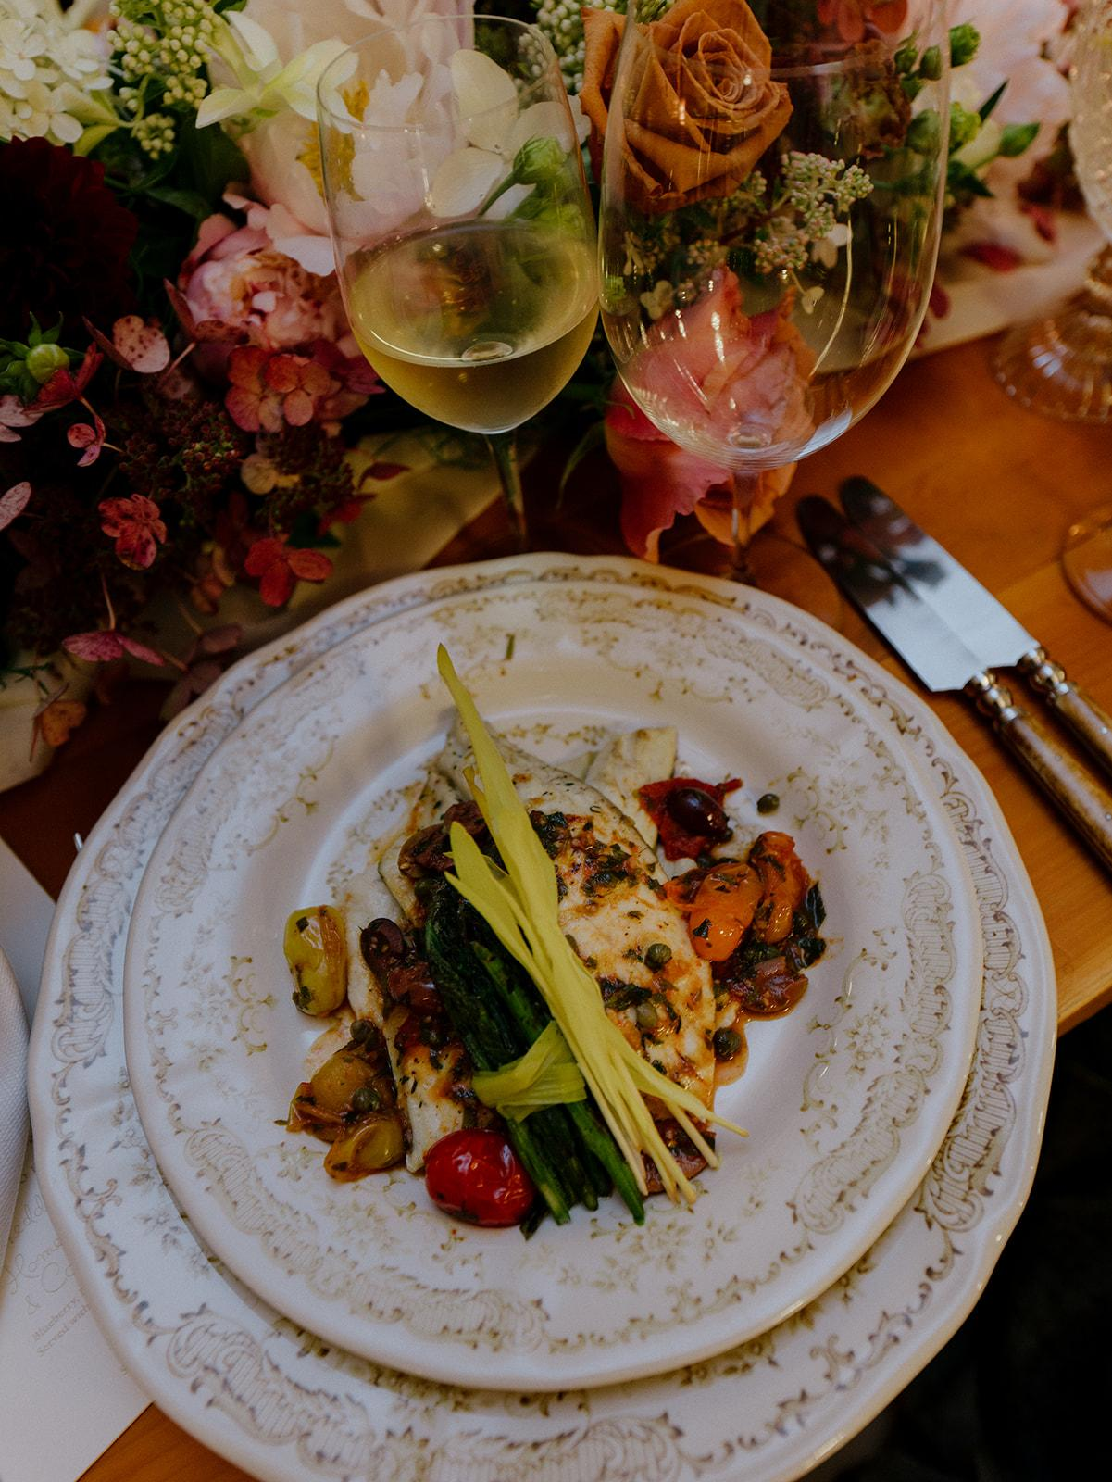
From Plate to Palette
How Culinary Presentation Shapes Event Design
Presented by Jaclyn Watson Events

Slide 2
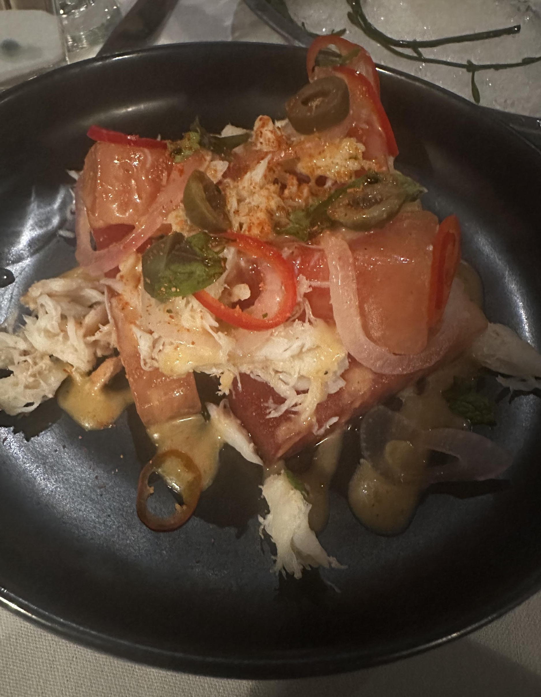
Why this topic matters
Guests experience food visually first, then taste.
The plate is literally placed in the middle of your tablescape.
If food clashes with the design, the room feels “off” even if everything else is gorgeous.
When it all aligns, the event looks more luxury, photos better, and guests remember it.

Slide 3
What you will walk away with
How the food on the plate shapes the full design story
Ways to tie menu, tabletop, florals, and room together
Simple tools to help planners, florists, and caterers collaborate

Slide 4
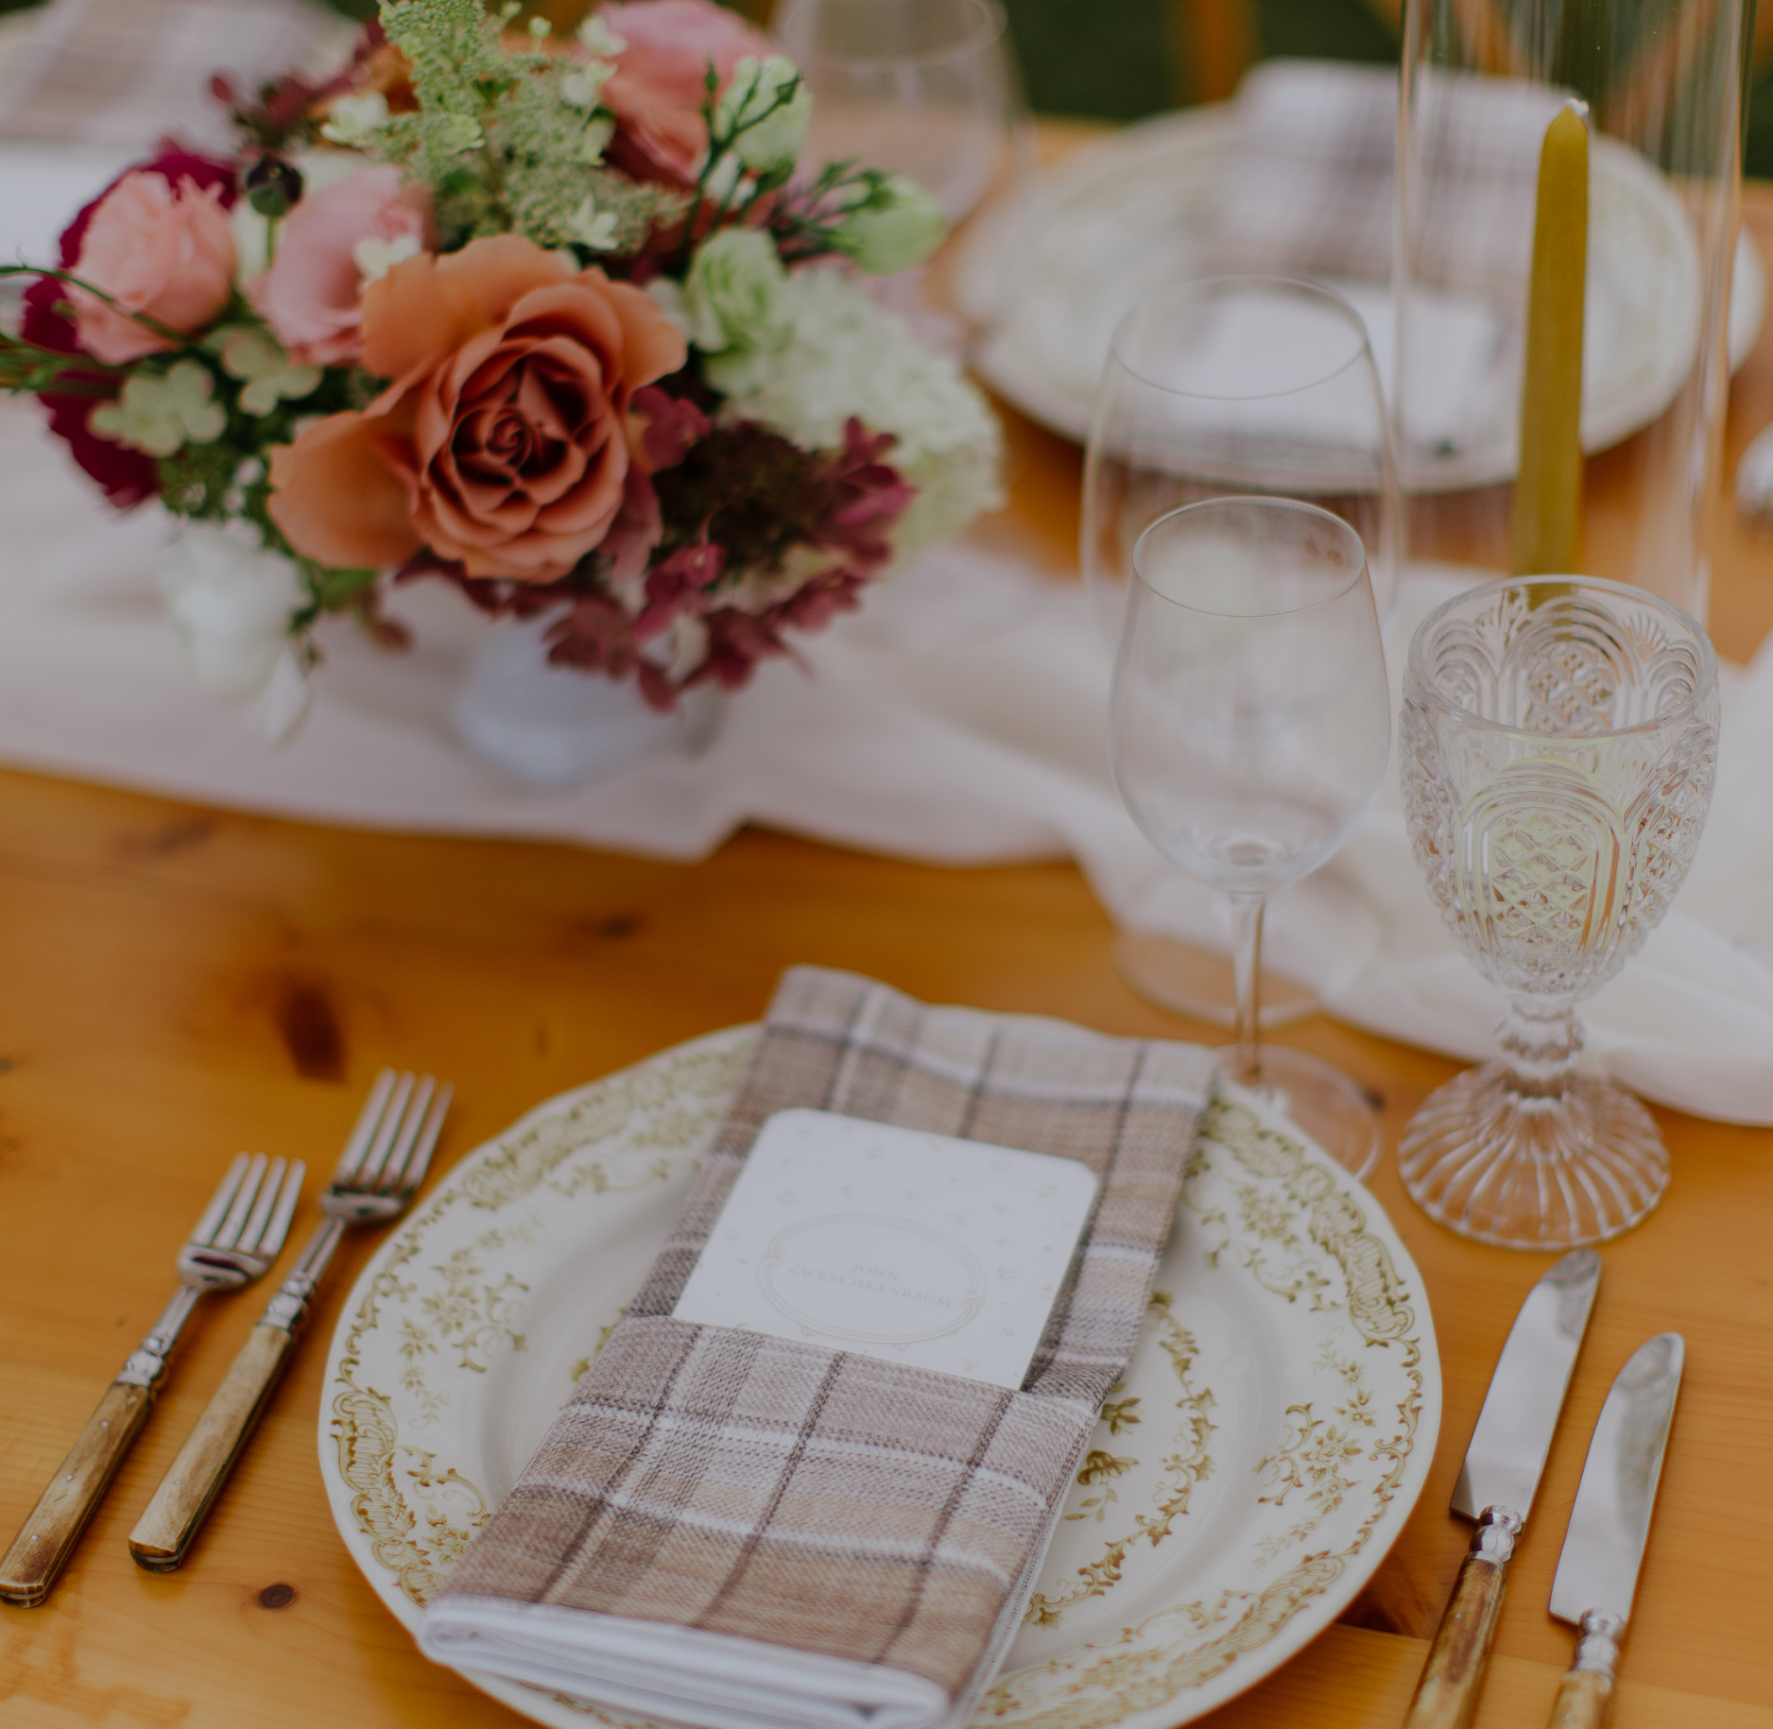
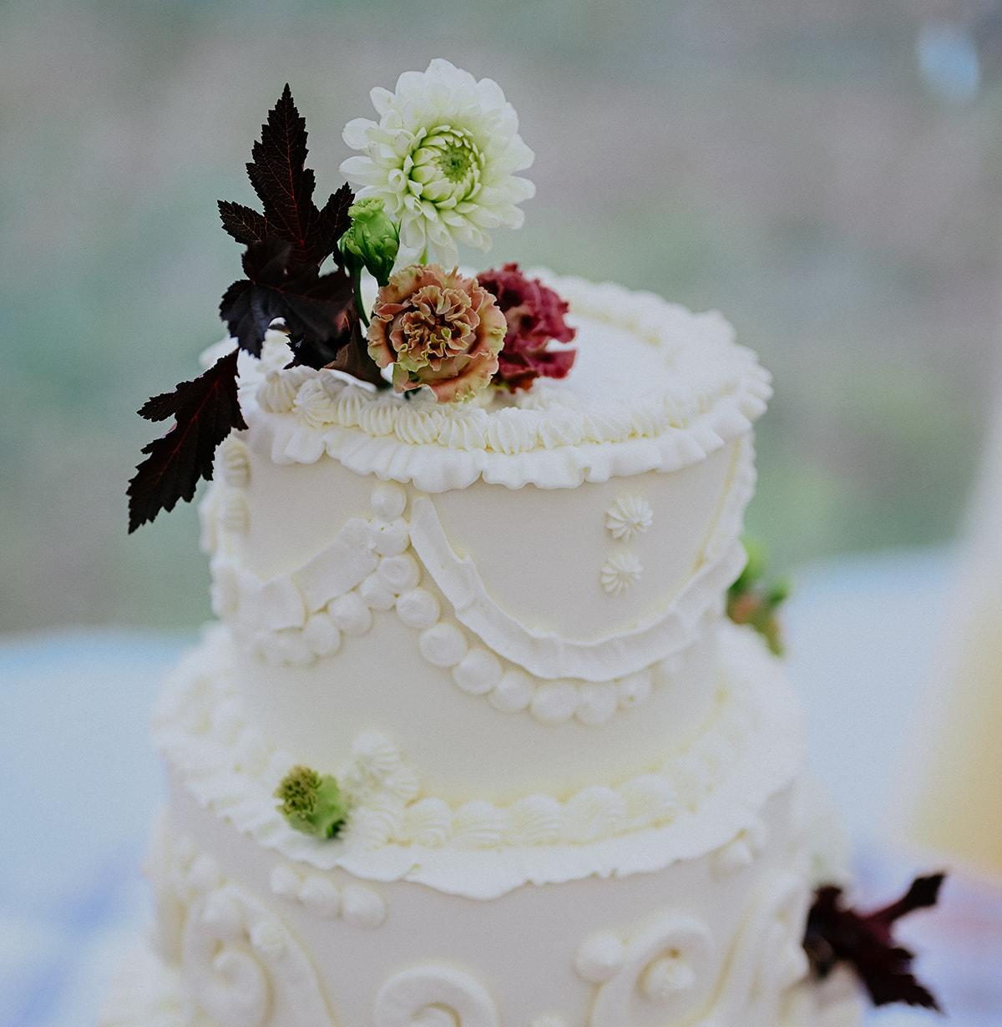

The Plate to Palette Chain
Menu vibe → plating style → color + texture → tabletop + florals → service style → guest experience
We need to remember that:
We are building one visual story, not five separate decisions.

Slide 5
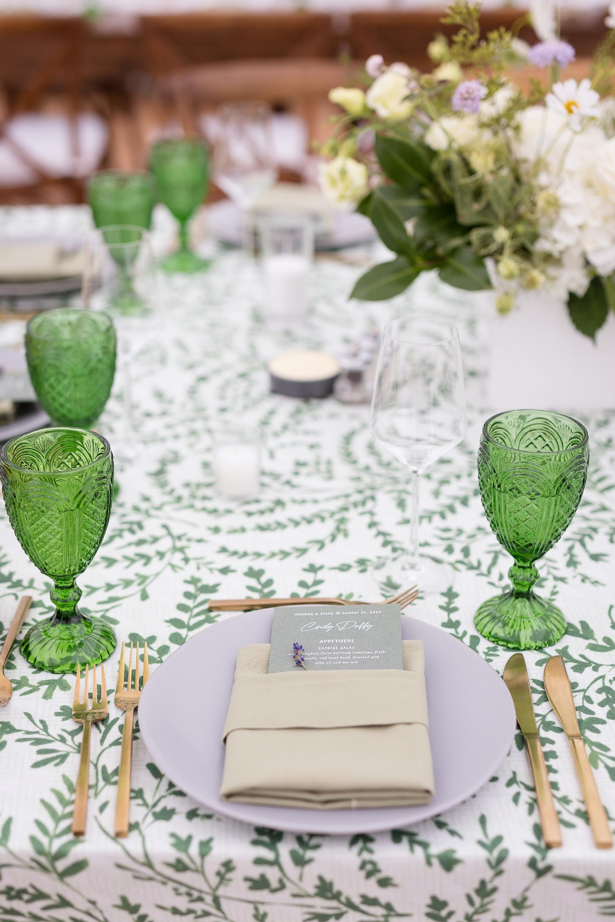
Color stories that start in the kitchen
Food, flowers, fashion, and tabletop should speak the same color language.
Greens and whites feel fresh and garden inspired
Warm rusts and blush feel cozy and romantic
Cool blues and whites feel airy and coastal

Slide 6
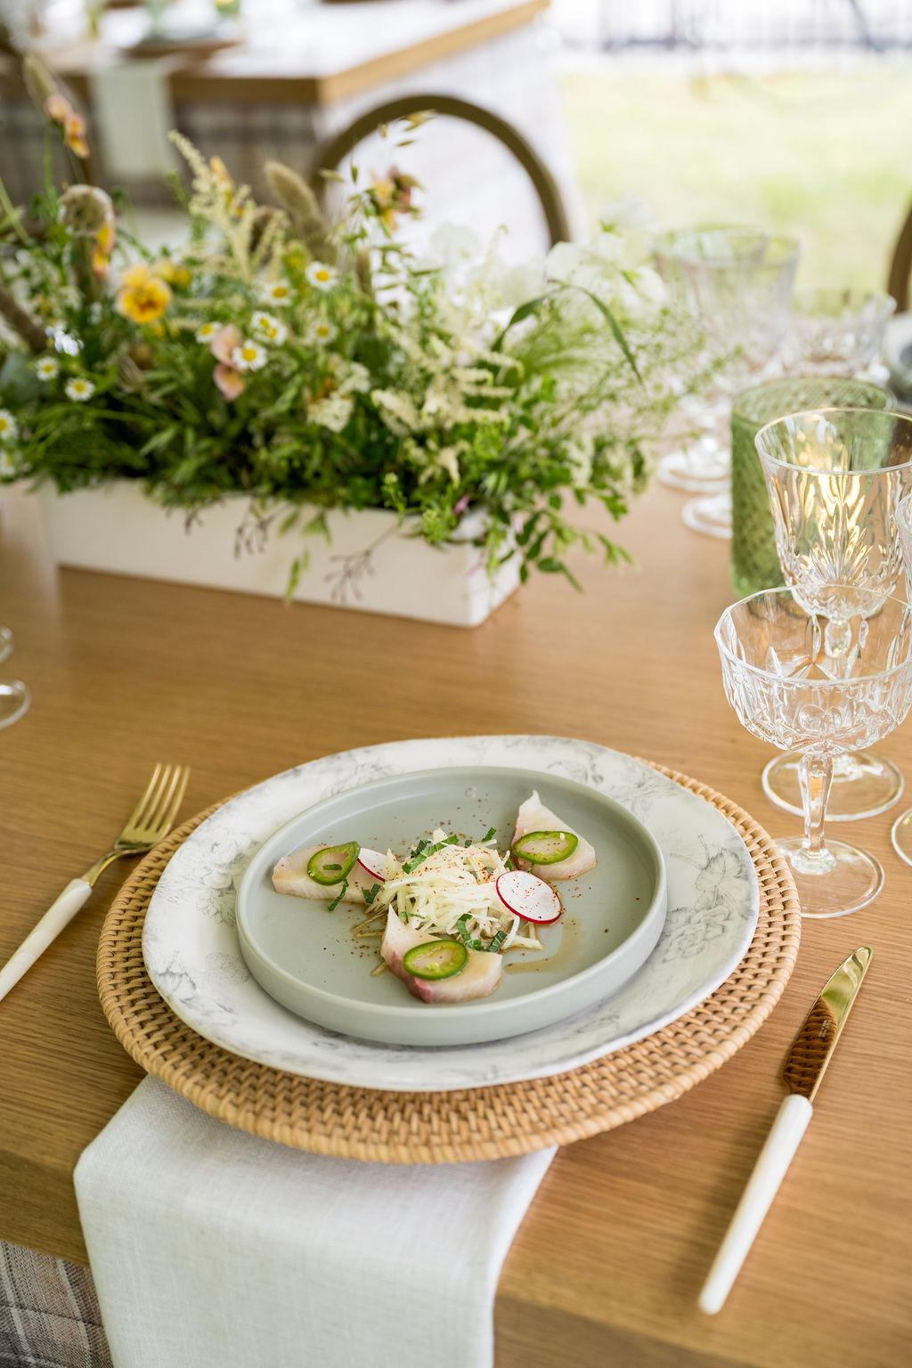
Service Style is Part of Design
Plated: editorial, polished, controlled
Family style: warm, abundant, communal
Stations: high energy, interactive
Passed: luxe, fluid, social

Slide 7
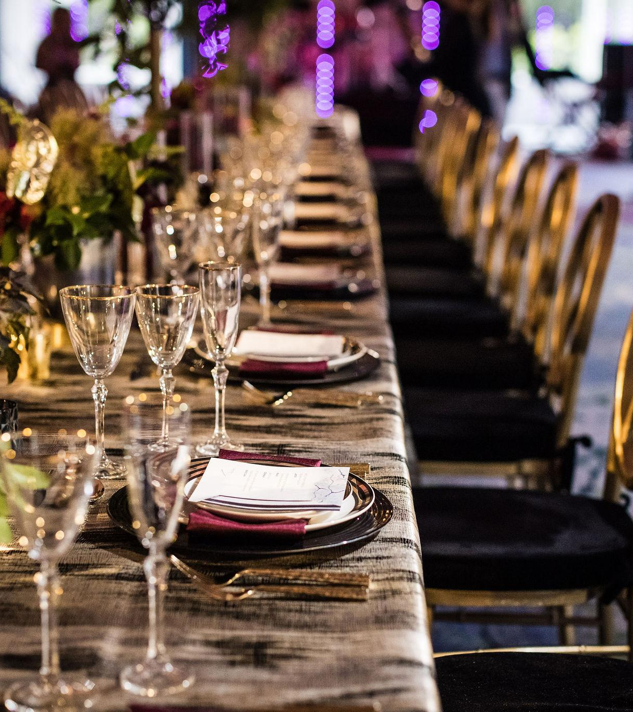
From first bite to final toast
Welcome bite
First visual impression, sets tone and expectation
Main course moment
The “wow” dish that guests will photograph and talk about
Dessert and late night
How you end the story, not just sugar on a plate

Slide 8
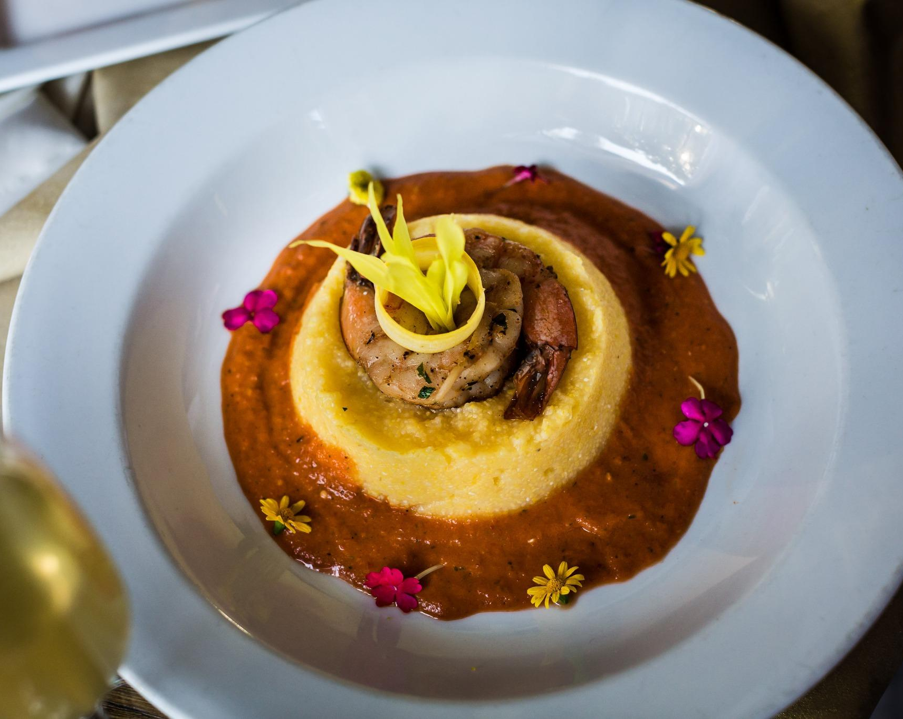
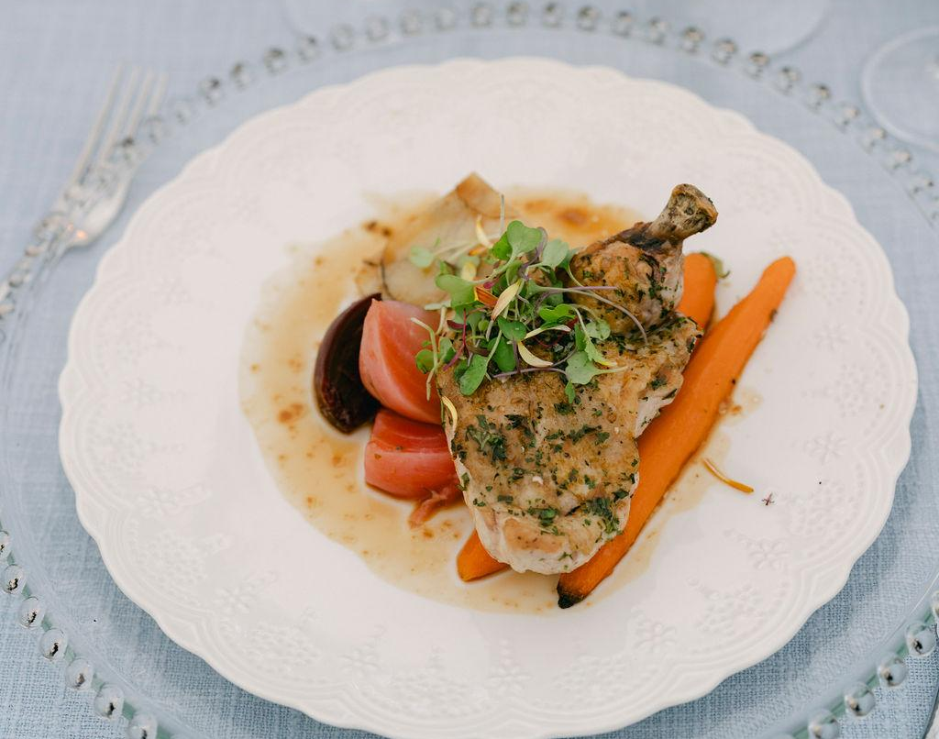
Food is not separate from design
Guests see and feel everything at once
The plate is part of the tablescape, not an afterthought
When food fights the palette, the whole room feels off
Think of one event where the food on the plate did not match the design. What do you remember about it?

Slide 9
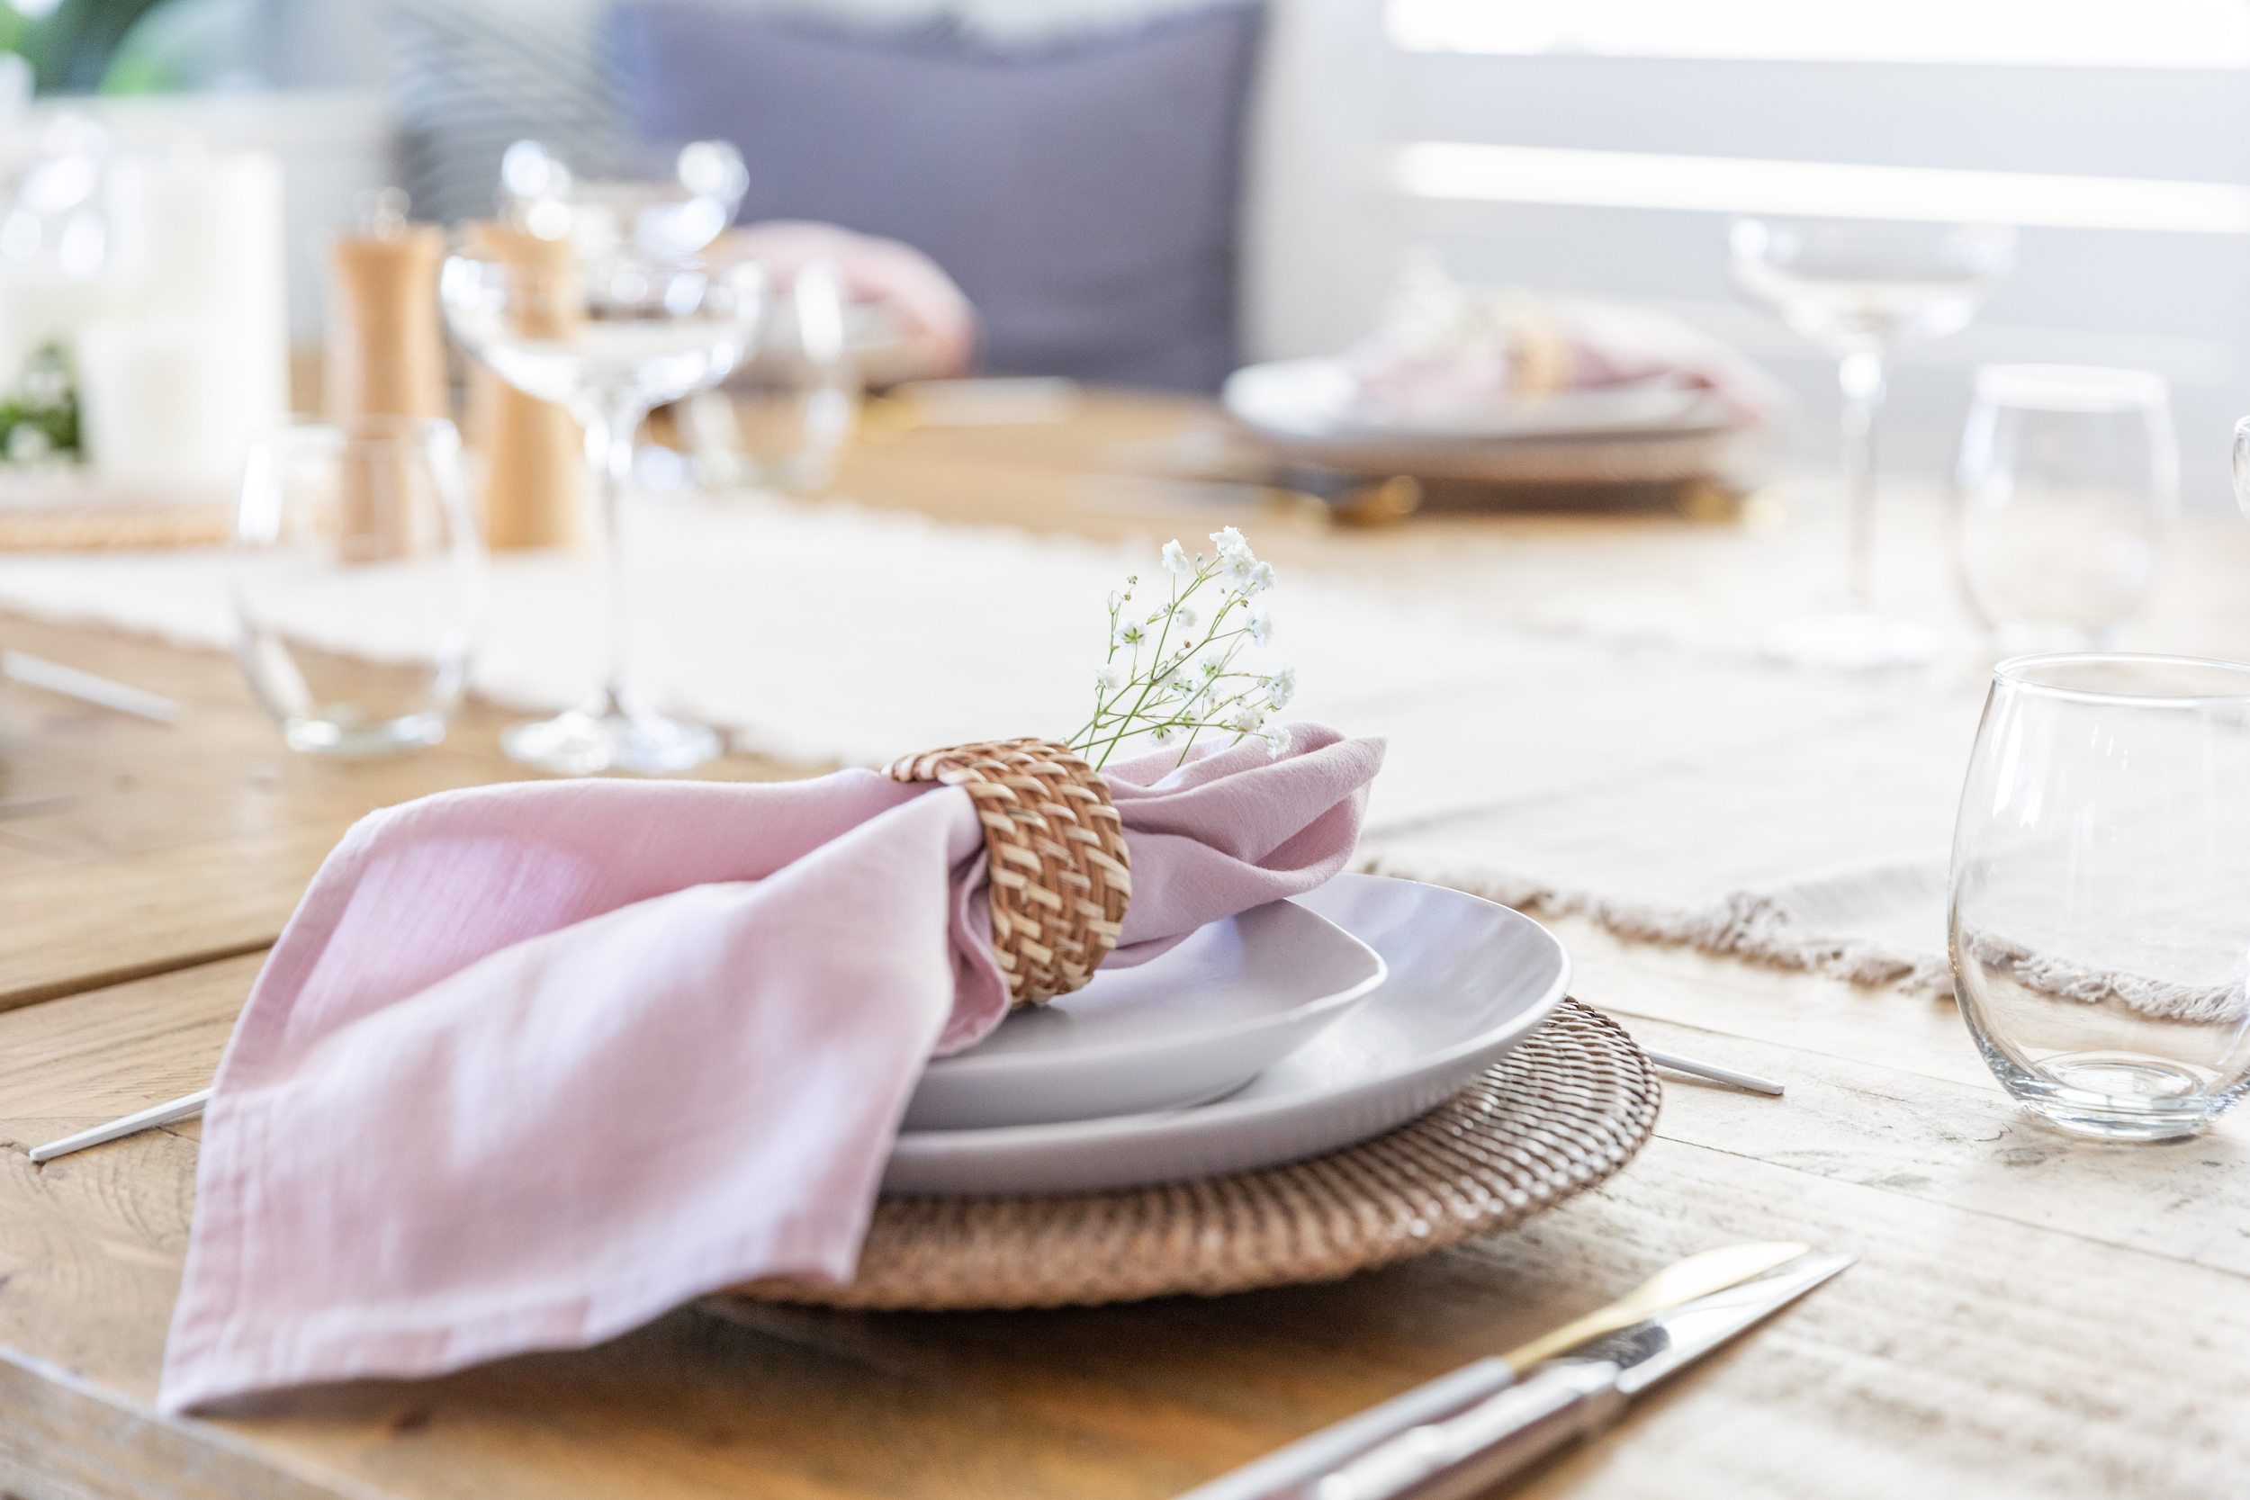
The Visuals everyone should have
3 vibe words (example: romantic, airy, modern)
Color palette (5 swatches)
Plate direction (white, stoneware, black, pattern)
Garnish rules (fresh herbs vs rustic, microgreens vs hearty)
Floral rules near food (low, low-scent, no falling petals)
Photo note (what is the hero dish moment)
What this solves: confusion, mismatched expectations, last-minute chaos.

Slide 10
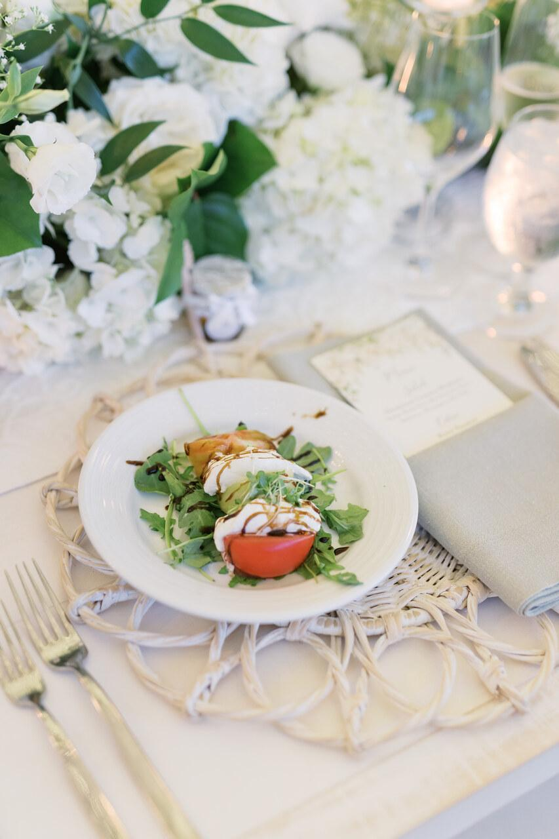
Plating Rules That Instantly Level It Up
Rule 1: The 3-layer plate : base, hero, finish
Rule 2: Negative space : stop crowding the plate
Rule 3: Contrast : Brown food is not pretty, light food needs darker contrast, dark food needs lighter contrast

Slide 11
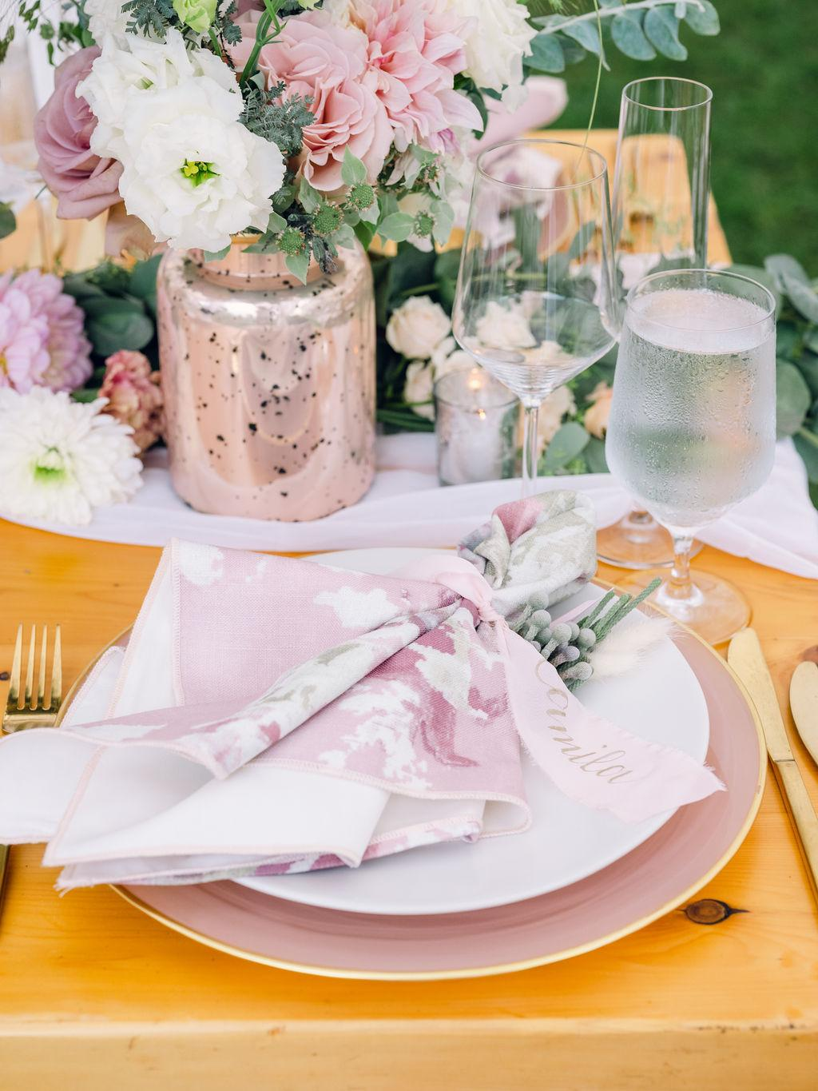
What makes it all look inexpensive
plate and linen are the same tone (no contrast)
garnish looks random instead of intentional
florals too tall or scented near food
messy drizzles that photograph like chaos
service style doesn’t match the vibe (formal room, casual execution)

Slide 12
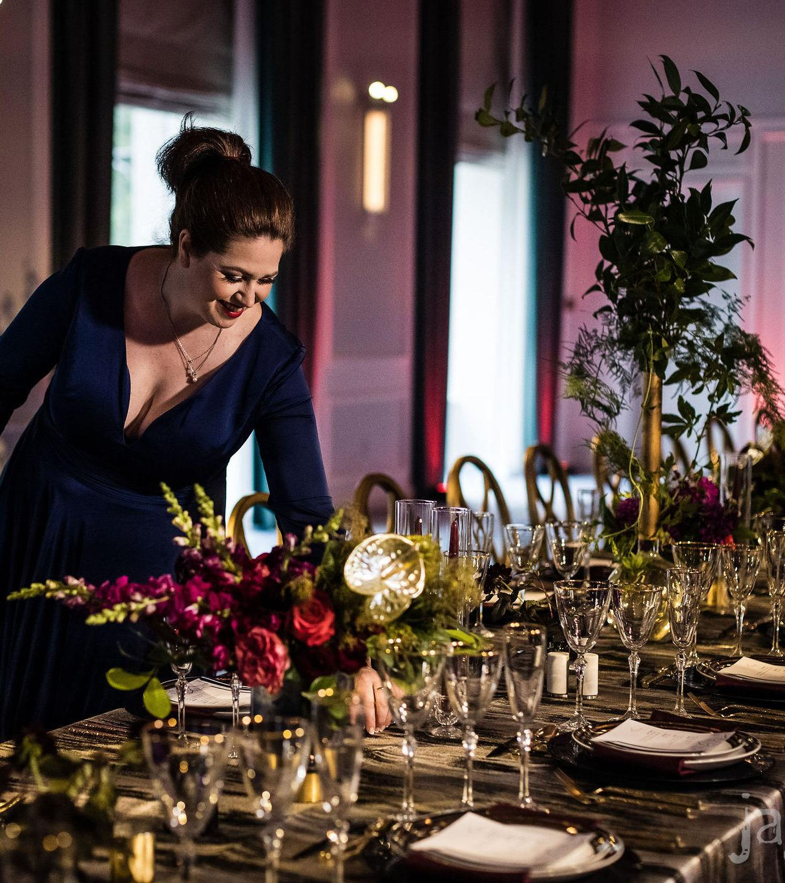
Teamwork makes the dreamwork
How planners + caterers + florists stay aligned
Use the Visual Menu Brief early
One shared timeline and design decisions
Define who owns what (plate choice, garnish direction, tabletop style, floral height rules)
Remember: You all own the design, otherwise the design will look likes it’s done by all different people.

Slide 13
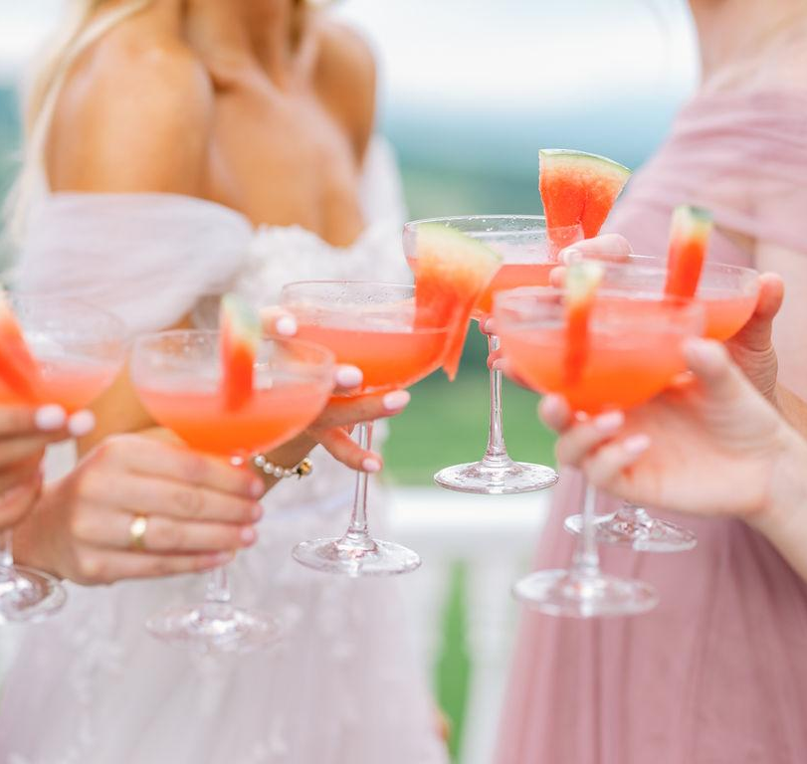
Remember
When food and design tell the same story, guests feel the intention, photographers capture it, and the event reads luxury without needing a bigger budget.

Slide 14

Want to reach out to me
Email: Jackie@Jaclynwatsonevents.com or echeloncreativeandco@gmail.com
Phone: 802-324-1433
Websites: www.jaclynwatsonevents.com & https://www.echeloncreativeco.com
Session Review

